Slide 1
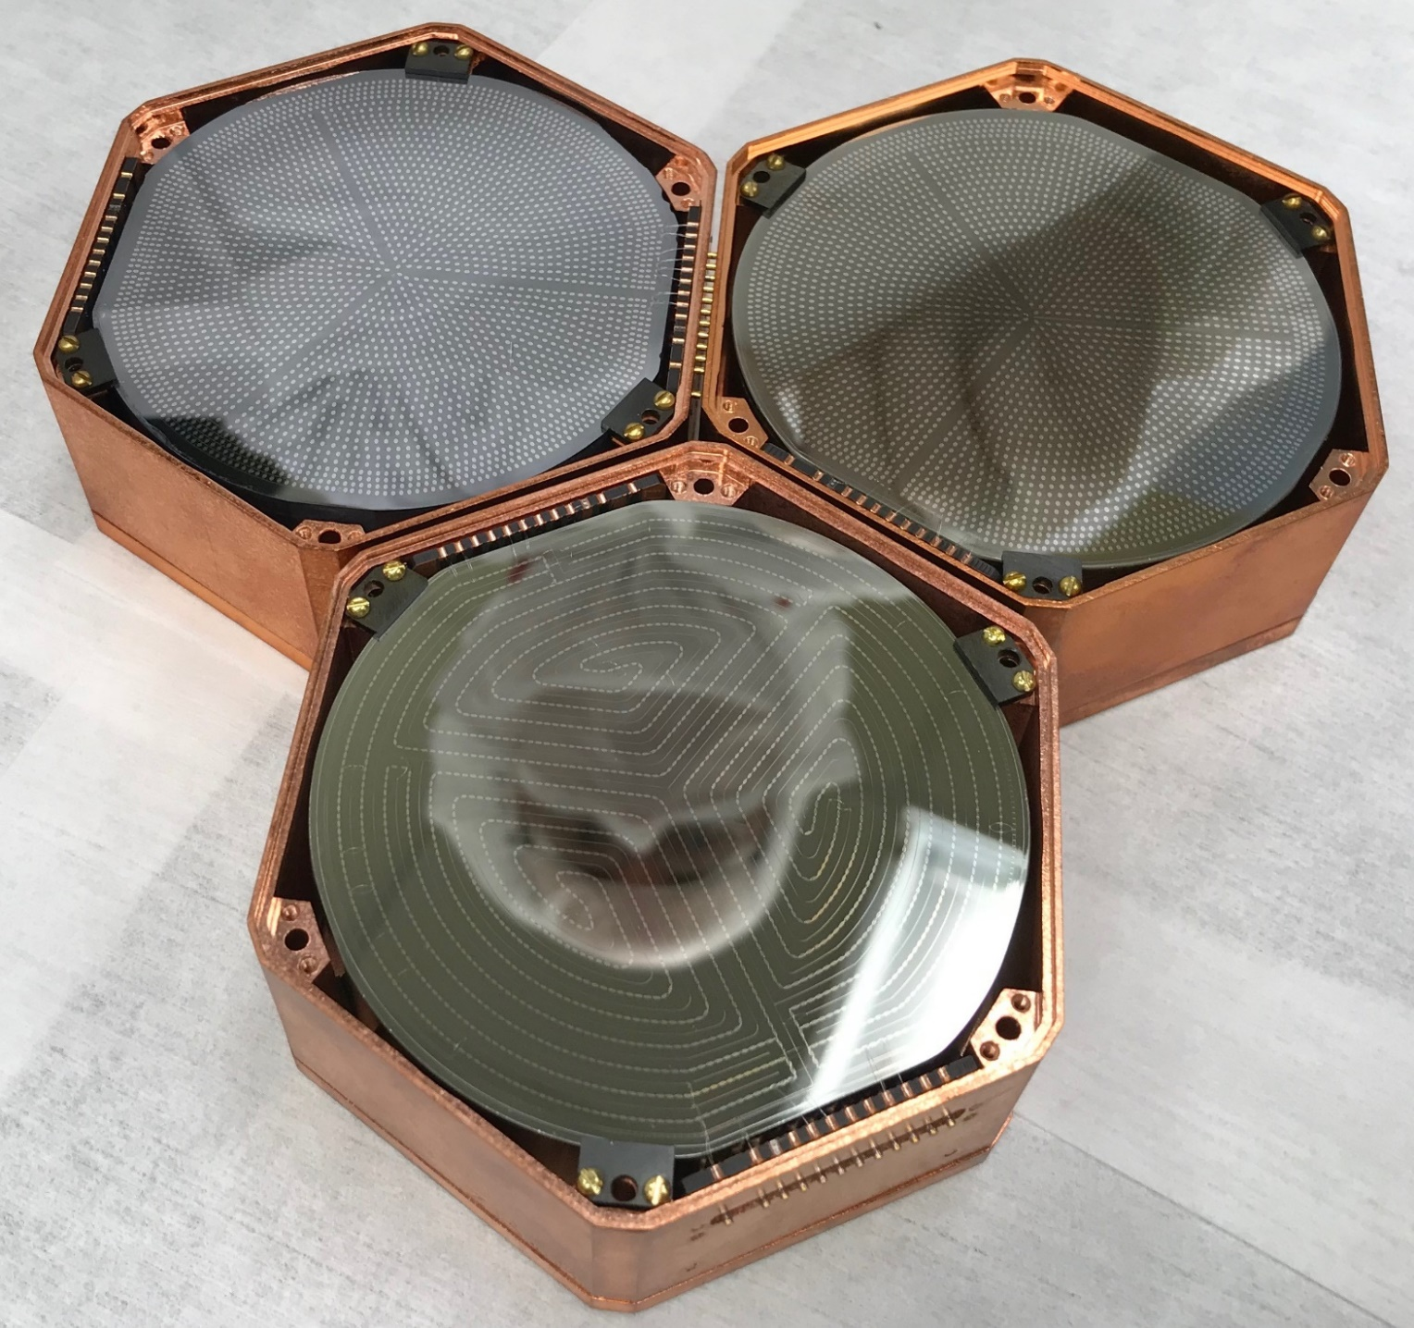
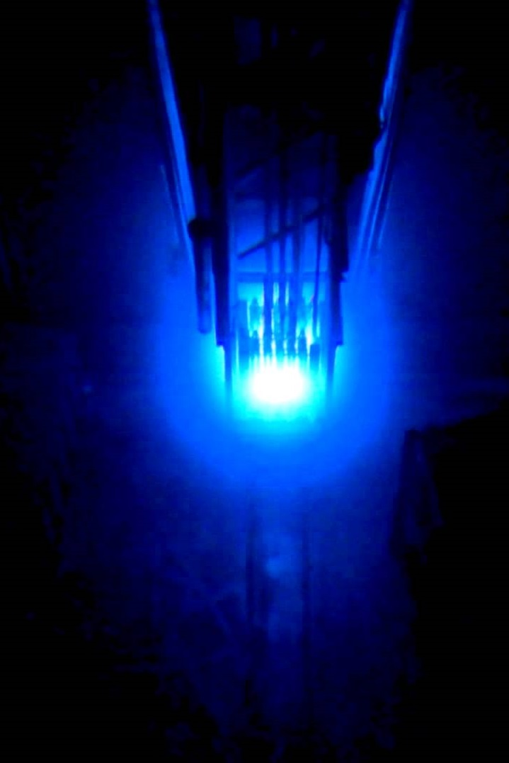

MIνER Experiment with Low-threshold Detectors
Rupak Mahapatra, Texas A&M

Slide 2
Coherent Neutrino Scattering: Connection to WIMPs
Coherent scattering of neutrinos and WIMP search have the same technological pursuit
Same low threshold detector challenges for SuperCDMS and CNS

Slide 3
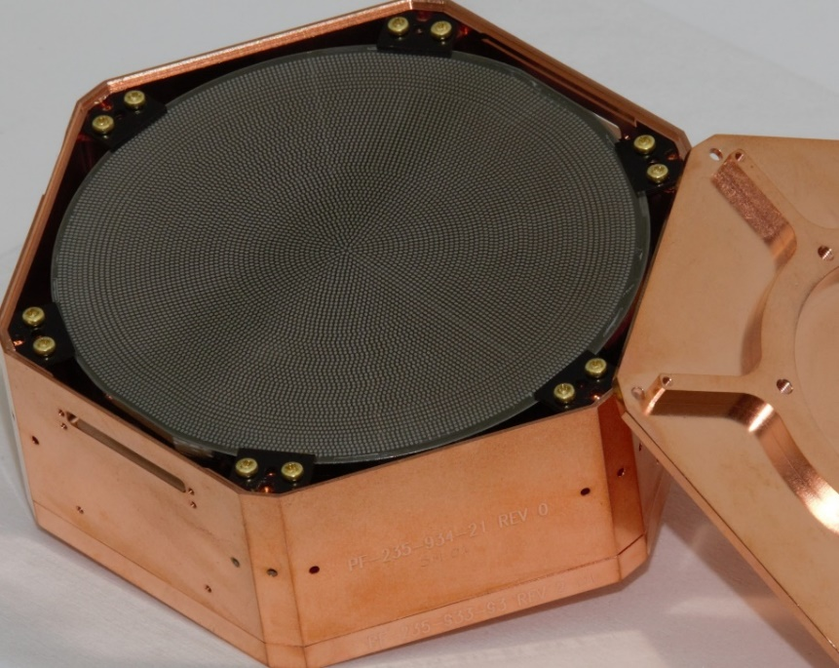
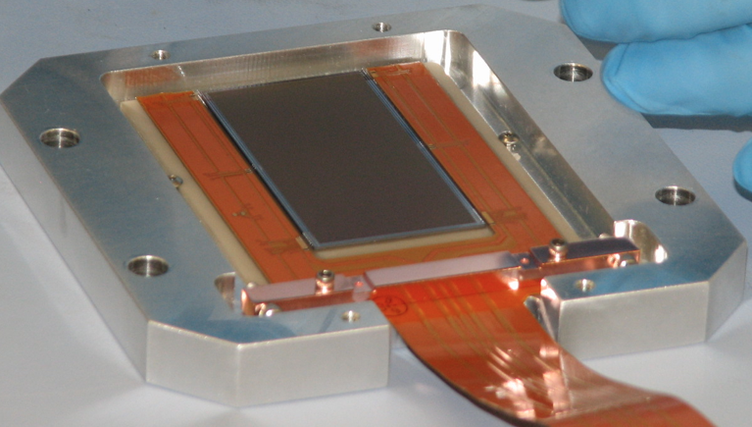
Challenges of CNS @ Reactor
End-point (2 E_{ν}²/M) with ~MeV scale reactor neutrinos is ~1 keV
Pro: 10⁵ more ν than stopped π
Con: Need low-threshold detector
New low-threshold (σ ~ few eVee) detectors enable this sensitivity
Integrated rate/kg-year
Background
Rate = N φ σ
Recoil energy in eV
CONNIE CCD: ~gm mass
SuperCDMS Detector:1500 gm
Notes:
Coherent scattering off nuclei is a neutral current process. Thus, any observation of an oscillation structure would indicate mixing solely to non-active neutrinos. Other methods, such as neutrino-electron scattering, must disentangle the mixing to sterile neutrinos from mixing to active neutrinos. The technique becomes even more powerful when combined with low energy mono-energetic sources. Oscillations to neutrinos at the eV mass scale would manifest themselves over the length of a few meters (for ∼ 1MeV neutrino energies)

Slide 4
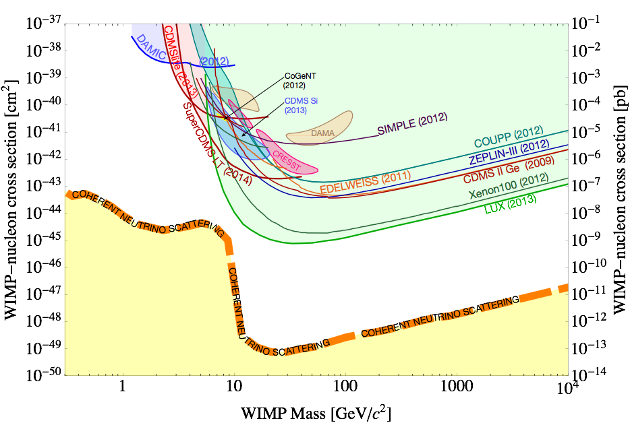
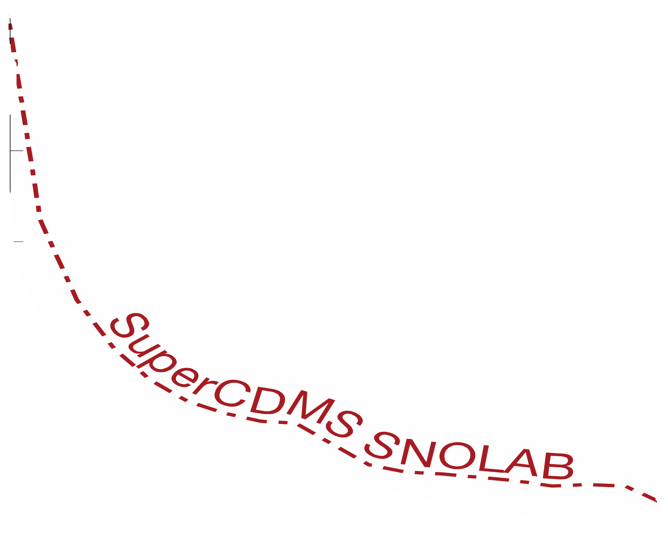
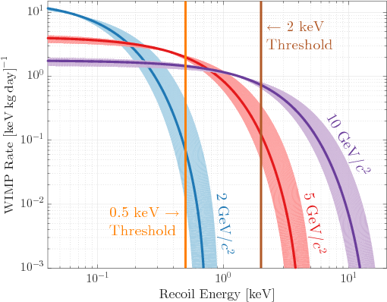
Reactor CNS ≈ Low Mass WIMP Search, with fewer worries about background

Slide 5
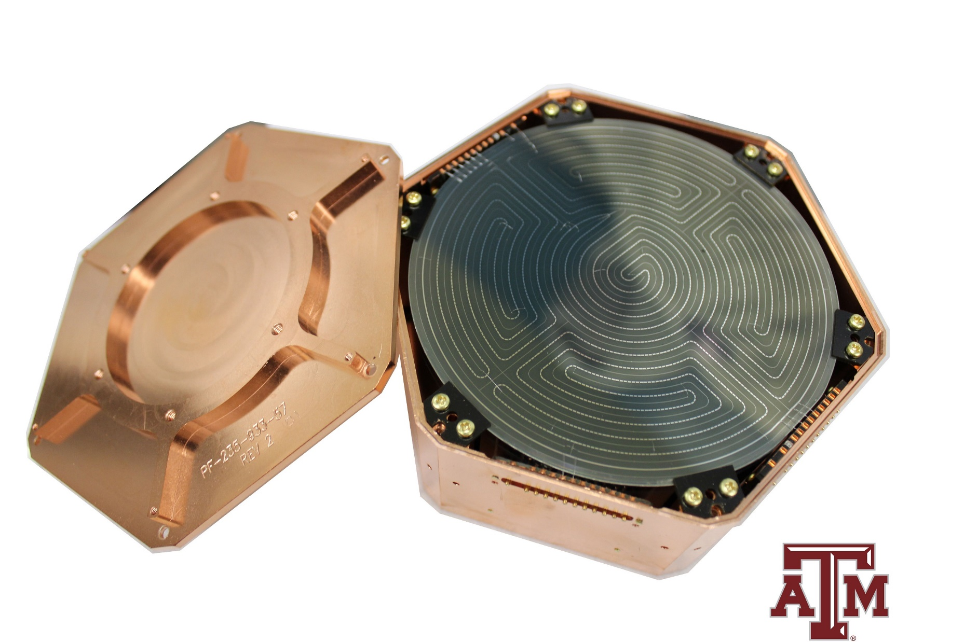

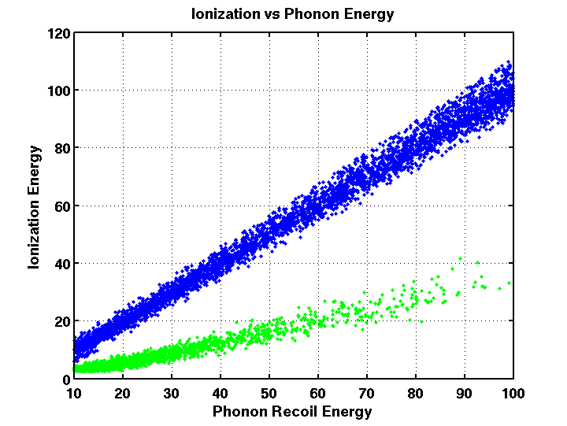
Detector Technology Developed for SuperCDMS
iZIP Detector with ionization and phonon sensors for ER/NR discrimination down to 272 eV (Ge)/166 eV(Si) (expected, not shown yet at a surface, soon to be tested at SNOLAB)
First SNOLAB Ge iZIP (fabricated at TAMU)
https://arxiv.org/pdf/1610.00006.pdf
Phonon
Ionization
High Voltage Detector with no discrimination, but low threshold of 40 eV (Ge)/78 eV(Si). Si has 2x better resolution, but worse Lindhard
First SNOLAB Si HV (fabricated at TAMU)

Slide 6
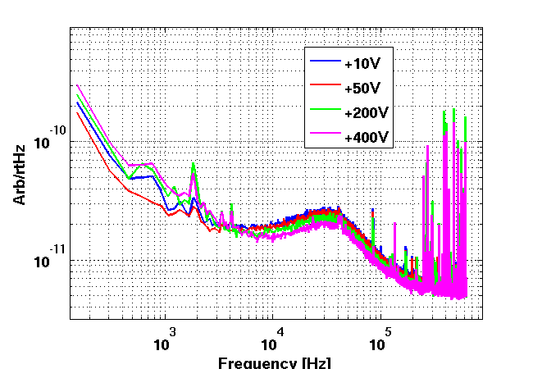
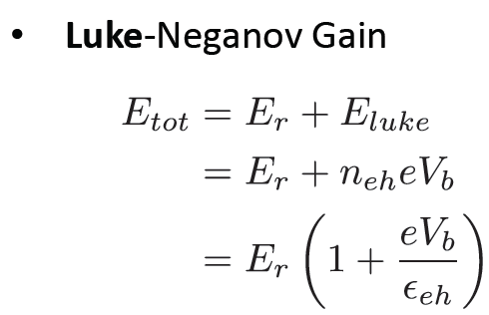
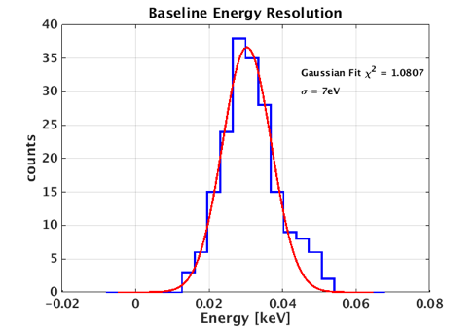
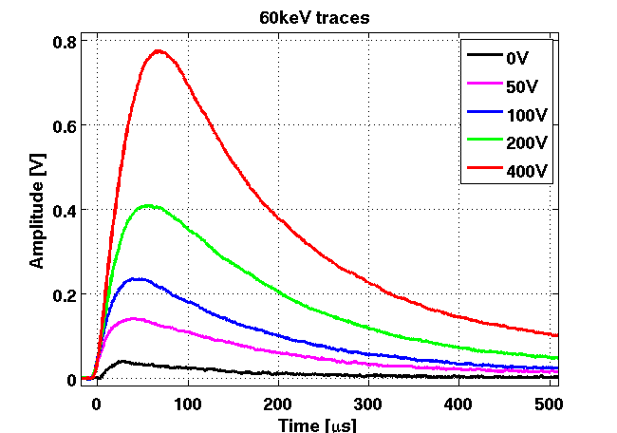
World-best Resolution from Large Mass Detector
CDMSII ZIP Phonon sensors
Observed no break down
~ 50 nm a-Si
Ge substrate:
Φ=7.5 cm, h=2.4 cm
500 micron gap
HV
Linear phonon gain versus applied bias
Already used by SuperCDMS Soudan up to 25V/cm, yielding a 9 eVee resolution
Linear phonon gain versus applied bias
σ=7 eV at surface
Mirabolfathi, Mahapatra et. al “`Toward Single Electron Resolution Phonon Mediated Large Mass Ionization Detectors”. NIM A855 (2017) 88-91
Single-charge sensitive (σ=.27eVee) device demonstrated by SuperCDMS for ~gm-scale
PRL 121 (2018), 051301

Slide 7
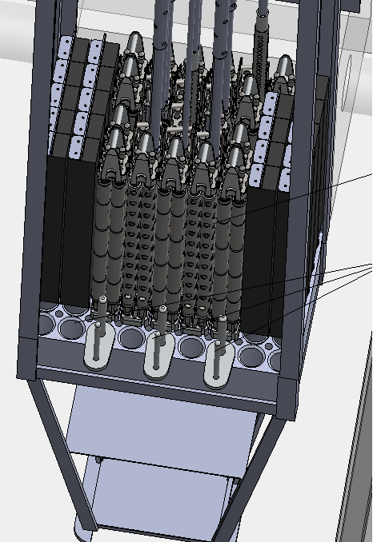
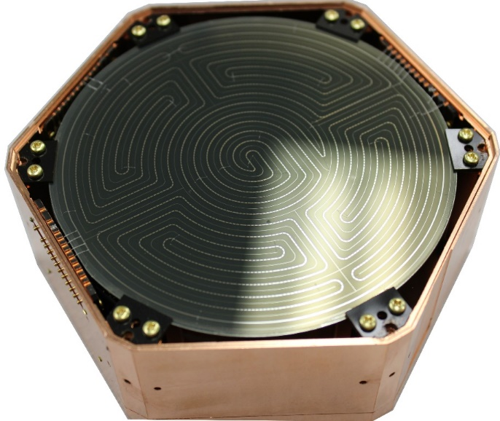
Mitchell Institute Neutrino Experiment at Reactor (MINER)

Slide 8
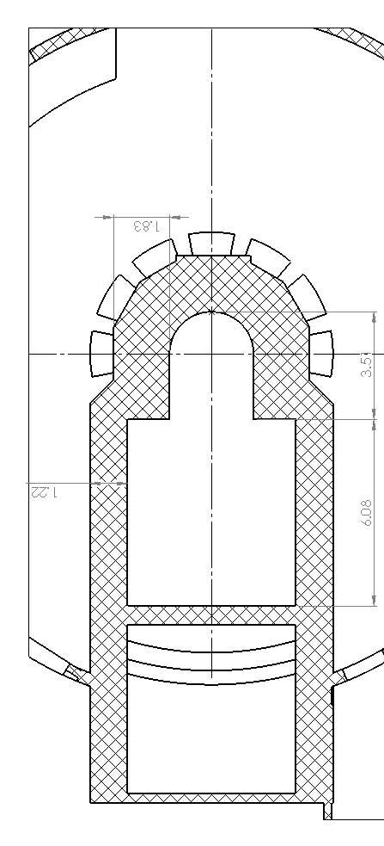
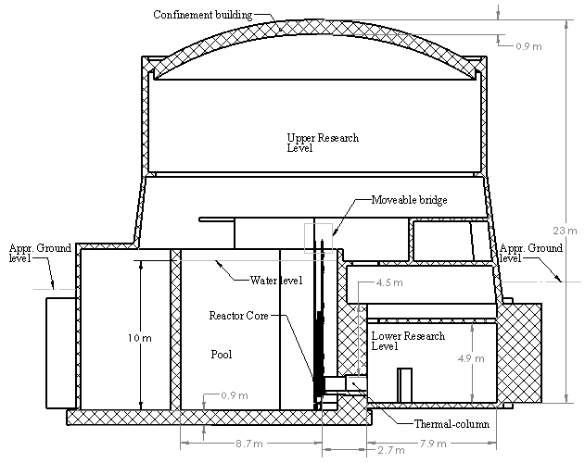


Experiment Plans
Key Features
Low-threshold (<100 eV) with sensitivity to CNS
2-10 m proximity to core (rate enhancement)
Moveable Core tests short baseline oscillation
4 kg (max=30) payload with CNS sens. in 4 months
Top View
Side View
Movable Bridge
Precisely Movable Core to Probe m-scale oscillation

Slide 9
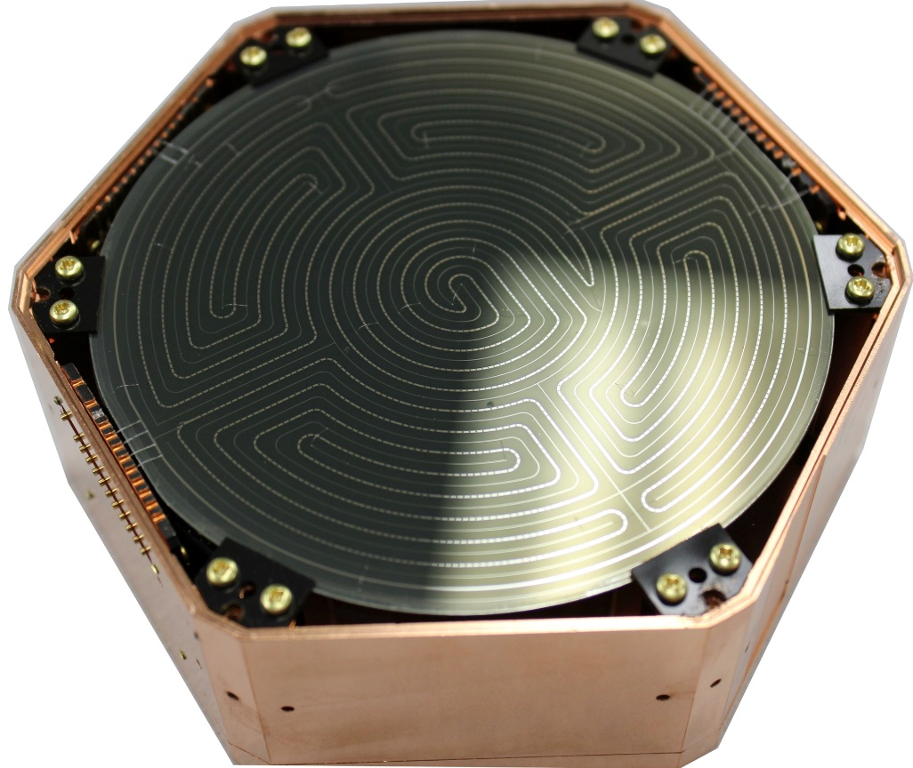

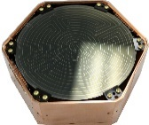
Distance from Core is the key!
Flux $ 1/r^2$
100 m Away
30 m Away
1 m Away
10 kg Detector
10 ton Detector
100 ton Detector

Slide 10
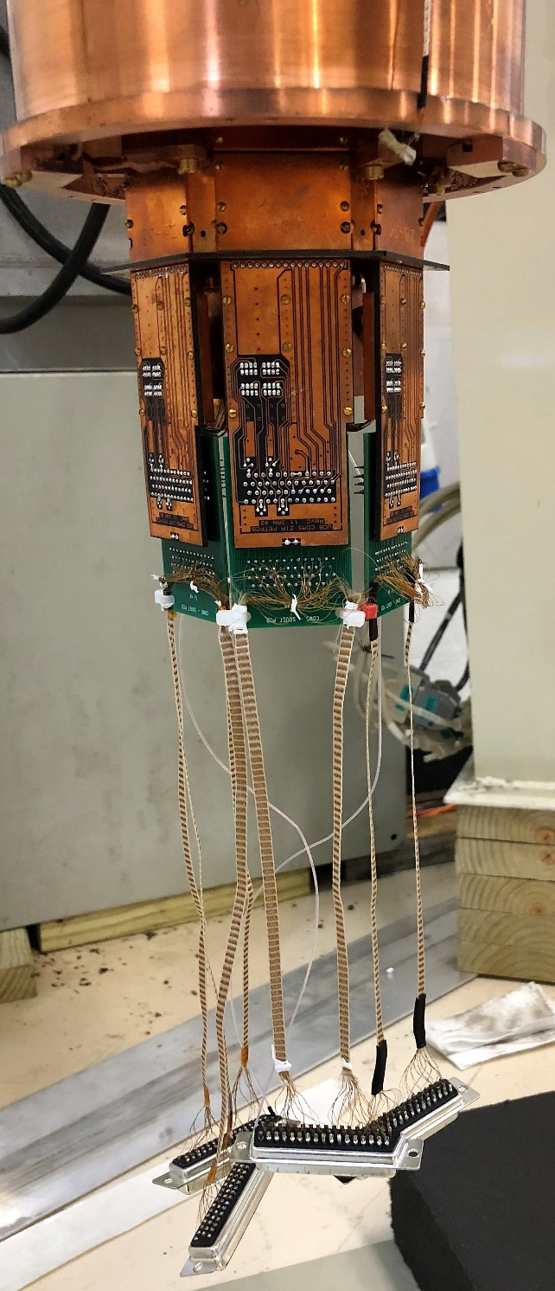
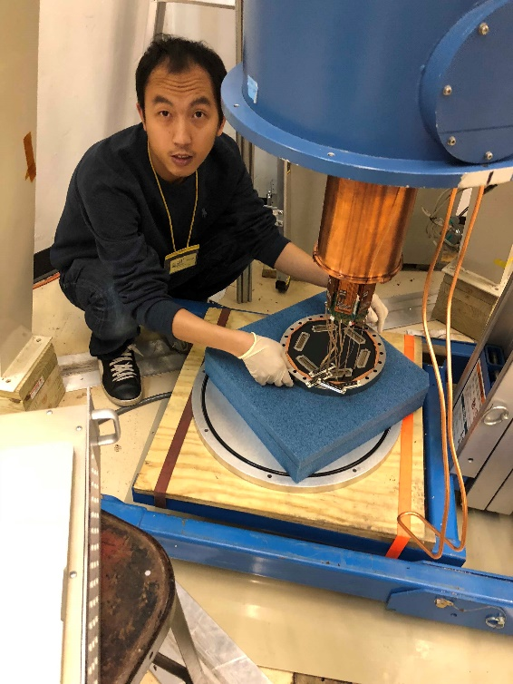
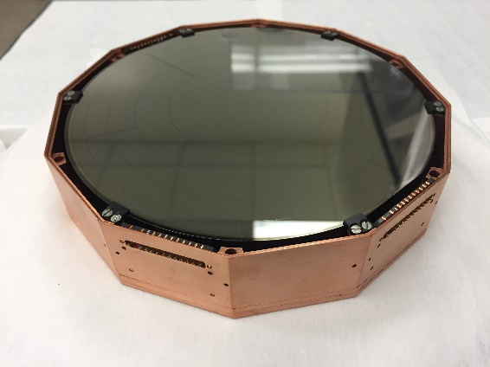
MINER Phase-1: ~2-kg run (up-to 4 kg possible)
Unlike SuperCDMS 4” detectors (1.5 kg Ge), we are using 3” detectors (.625 kg Ge) to reuse SuperCDMS Soudan cold hardware and get better resolution
CDMS SQUET with 4 SQUIDs and 2 FETs
UMN 6” Si: NIM A904 (2018)

Slide 11
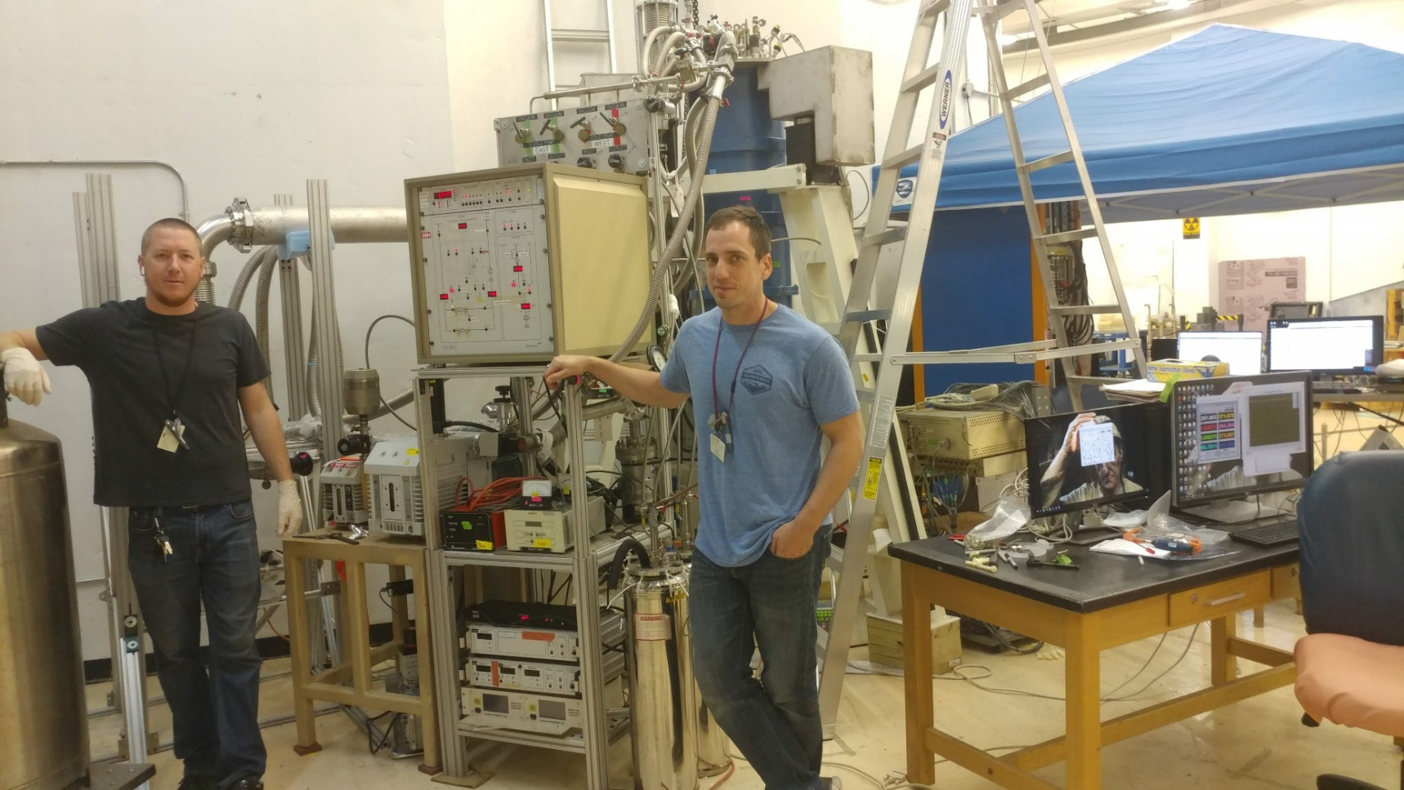
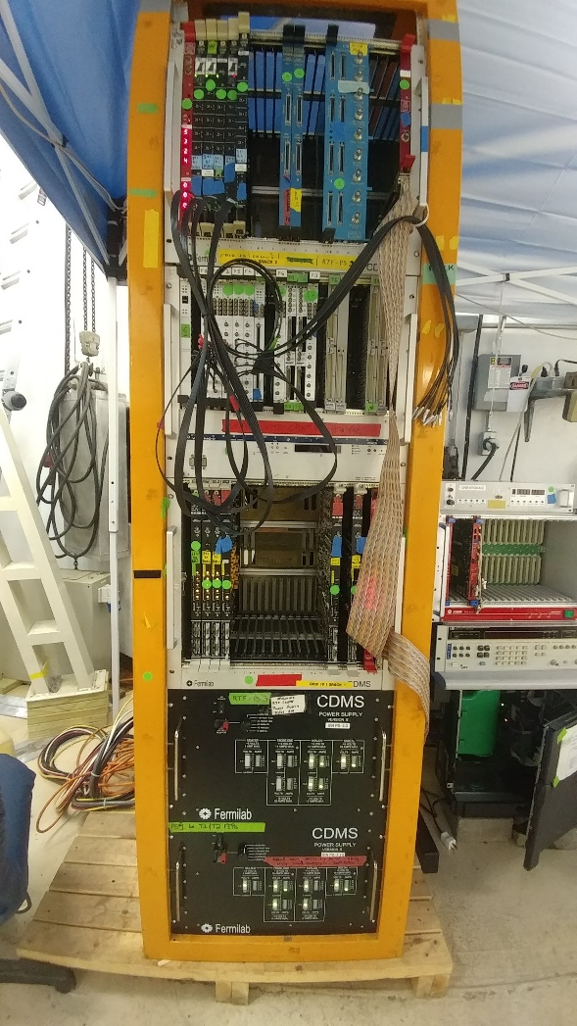
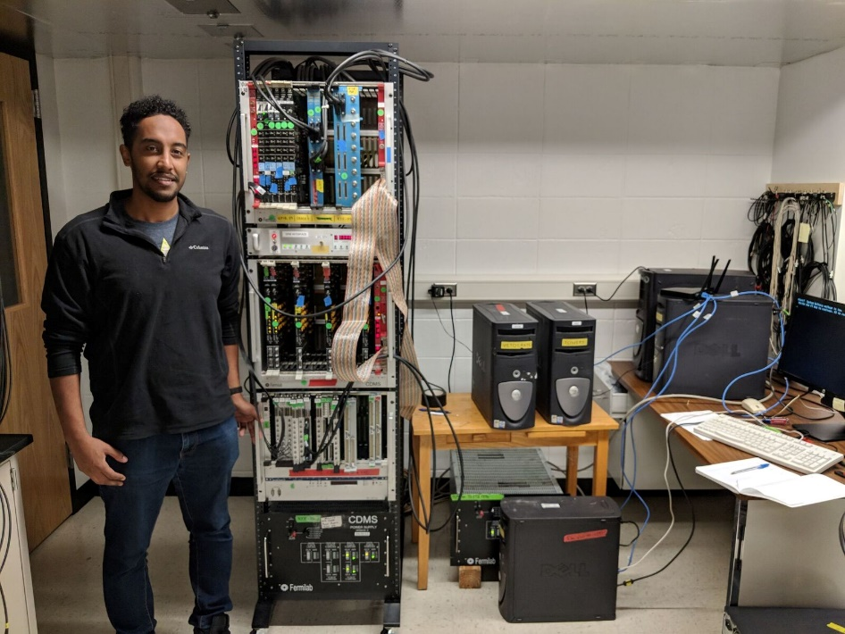
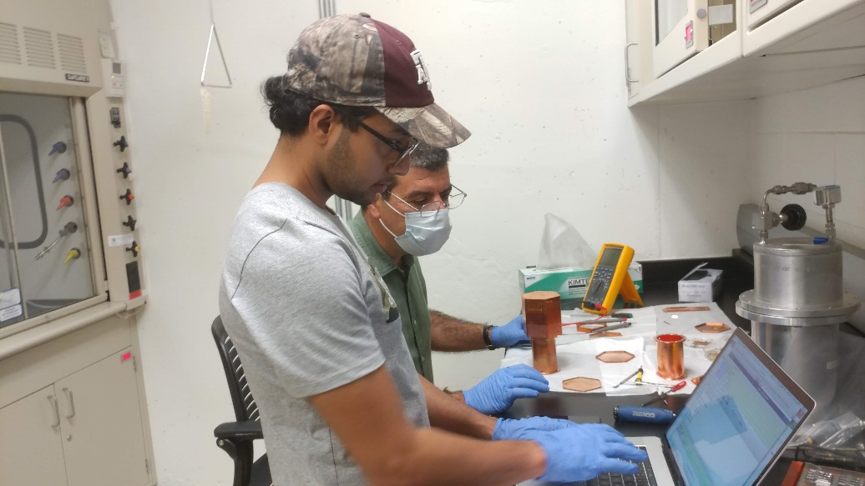
Hugely Leveraged from our SuperCDMS Work
Initial DAQ was fully set up at USD

Slide 12
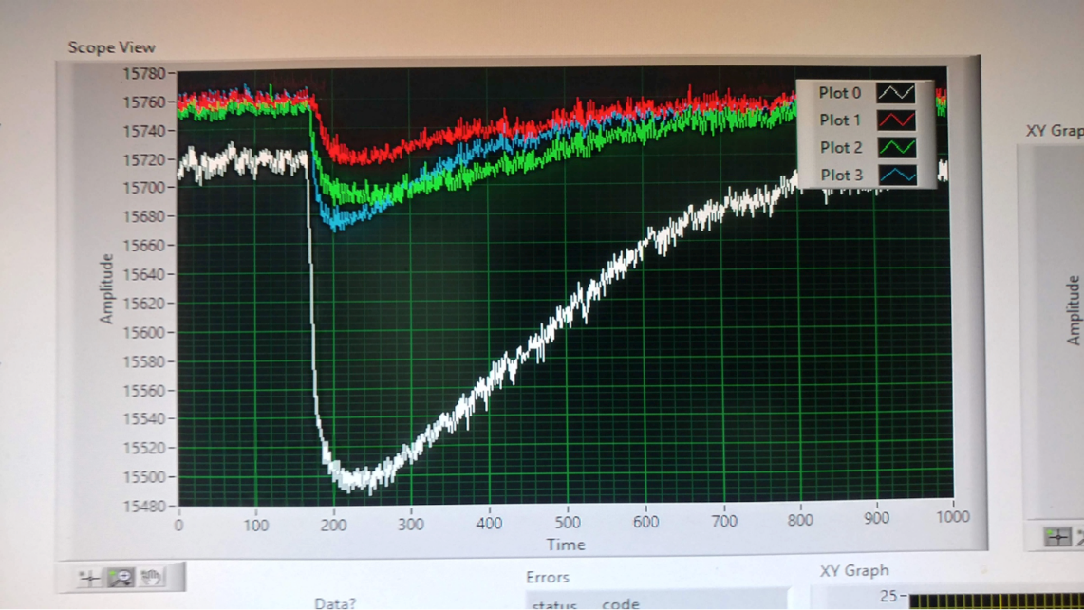
MINER Engineering Run-1 with 1 Ge HV
Identified major source of noise from turbo pump from engineering run in Aug.
Current full tower (1 Ge iZIP, 1 Ge HV, 1 Si HV) run addressed this problem.
MINER Run-2 will identify any remaining noise and performance issues before full science run begins end of this month.

Slide 13
MINER Experimental Parameters
Parameters | Phase-1 (current phase with SupeprCDMS Soudan fridge) | Phase-2 (Larger phase with Icebox in BlueFors and hermetic shielding)
Max payload | 4 kg | 30 kg
Baseline resolution | ~7 eVee | ~5 eVee
Lindhard | ~1/6-1/5 (Ge) and ~1/20? (Si) | ~1/6-1/5 for Ge ~1/20? (Si)
NR threshold | ~100 eVNR* in Ge/Si HV 300 eV in iZIP with discrimination | 100 eVnr* in HV in Ge/Si HV New detectors with possible discrim.
Background | ~1000 DRU | ~100 DRU
Neutrino Flux | 10¹²/cm².sec | 10¹²/cm².sec
Distance from core | ~4 m – 10 m | ~2m – 10 m
*Expected SuperCDMS threshold in Ge HV 40 eVnr. Using conservative value for surface set up
Phase-1 from local funding and in-kind contributions + fridge/electronics/DAQ from SuperCDMS
Phase-2 expected end of next year. Icebox design and rigorous shielding validation in progress.
400 uW BlueFors cryogen free fridge purchased by USD, TAMU and UT. Commissioning starts this month and base T validation early next month. Large cooling power with 7 mK base temp
Phase-2 will implement all detector improvements already being tested and planned.

Slide 14
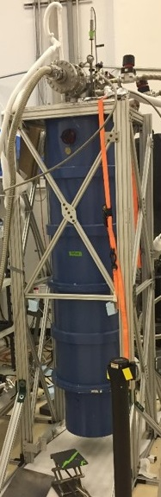
Core + Hermetic Shielding for Phase-2 (Upto 30 kg)
Core shielding already reduced rates to ~1000 DRU
Reactor Core
N
ν
γ
Hermetic Icebox shielding designed to reduce rates to ~DRU
Core shielding validation done with Canberra BeGe and UltraLeGe detectors as well as fast and thermal neutron detectors

Slide 15
MIνER: Unique Short-baseline Oscillation Test
Precisely moveable core to truly test short-baseline oscillation
Top View
Sensitivity to oscillation with a sterile fourth generation neutrino from ultra-low threshold neutrino-nucleus coherent scattering” –
Dutta et. al, PRD D94 (2016) no.9, 093002

Slide 16
Sterile Neutrino Sensitivity @ 5m – 3 tower Ge, 3 Year
Assumed 2:1 On/Off data. Sensitivity shown for optimistic and conservative thresholds (10/100)
Can check 1 eV sterile ν in a year of data! Movable core provides great systematic checks.
Mahapatra et. al, PRD D94 (2016) no.9, 093002

Slide 17
Z’ Competitive with LHC
Z
+
Z’
LHC looks for Z’ in di-lepton inv. Mass. Sensitivity ~4-6 TeV
MINER Phase-1 (4 kg) competitive with LHC
MINER Phase-2 (30 kg) superior (10TeV) than LHC
CNS a tool to search for BSM Physics
Dutta, Mahapatra, et. al PRD 93.013015

Slide 18
Sensitivity to Neutrino magnetic moment
MINER Phase-1 will have world-best sensitivity in 1 year of data
Dutta, Mahapatra, Strigari, Walker PRD 93.013015
World-best results from GEMMA collaboration - 3.2 x 10⁻¹¹ Bohr magneton
Astrophysical bounds from energy loss in stars of 3 x 10⁻¹² Bohr magneton
Some Majorana neutrino models predict magnetic moment ~10⁻¹⁴ Bohr magneton

Slide 19
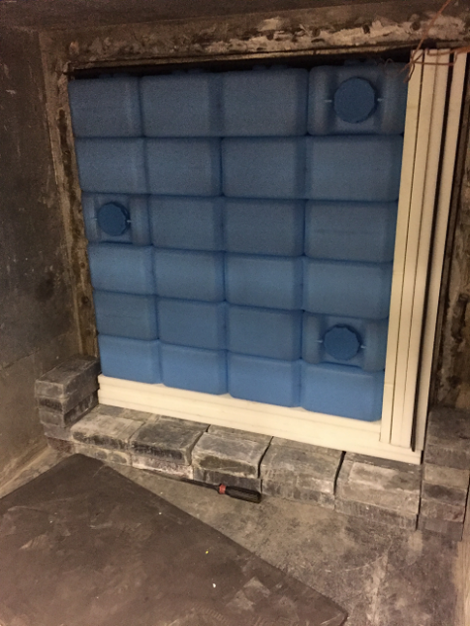
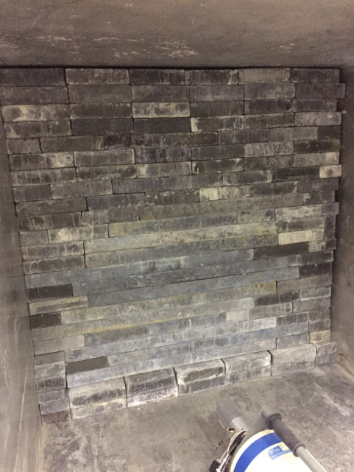
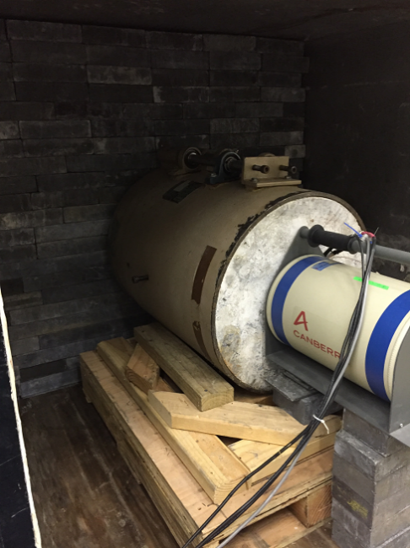
Shielding validation for Phase-2
Core shielding in place – in-situ γ, N measurements + MC simulation
Hermetic Shielding with Icebox inside goes in this cavern
Typical distance from core to detector is 2.2 m. Assuming 2.5m in all rate calculations
In-situ measurements of gamma using a Canberra BeGe High Purity Ge detector (~500 gm) inside a commercial 4” low activity lead shielding

Slide 20
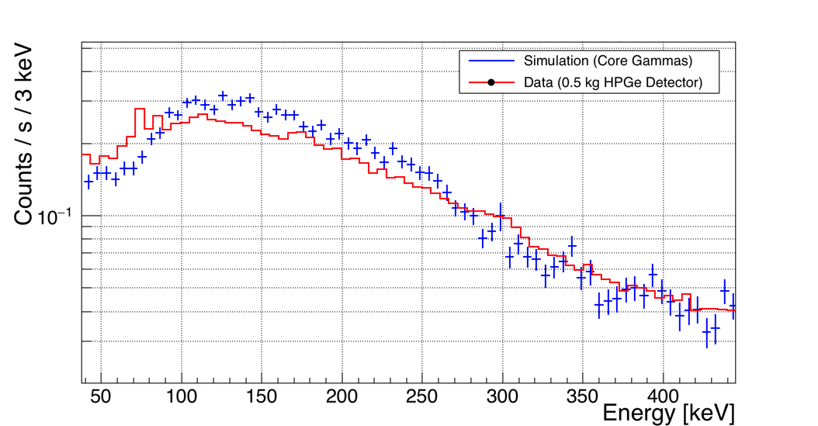
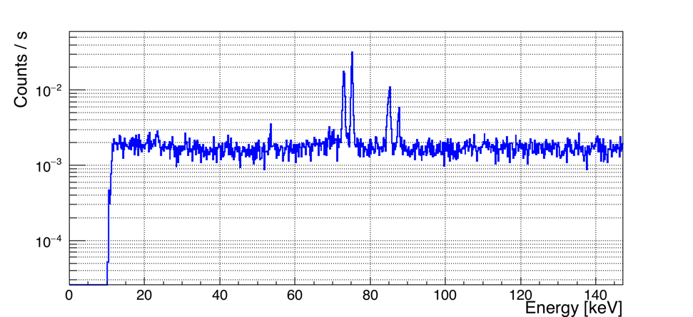
Shielding validation for Phase-2

Slide 21
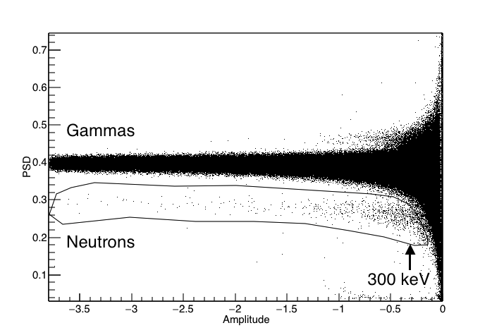
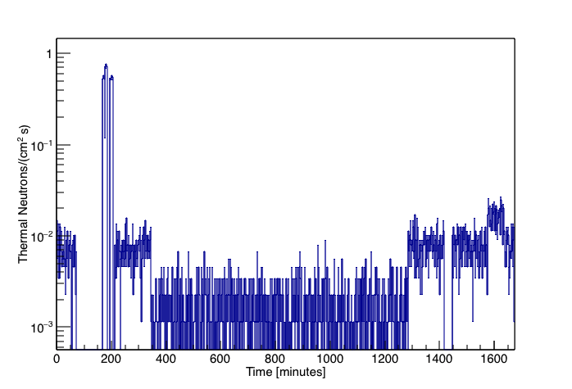
Fast and Thermal Neutron measurements
P-Terphenyl with PSD for fast N measurements
Core on, outside lead shielding
Core on, inside lead shielding
Core off, overnight
Li-6 Glass at Reactor

Slide 22
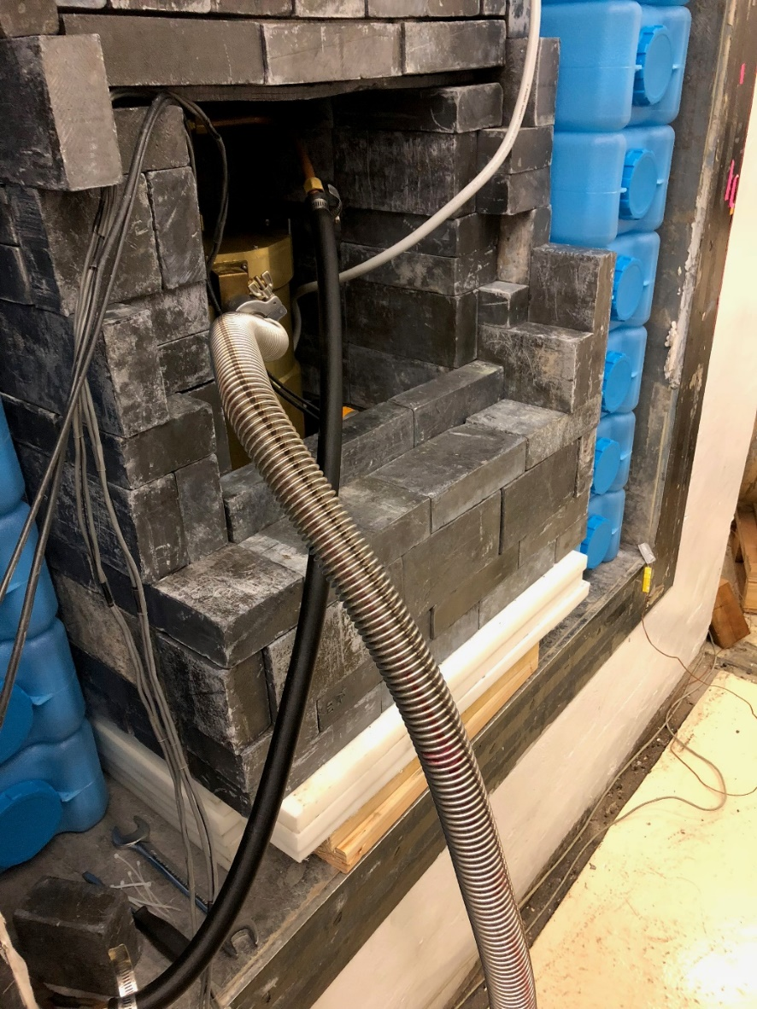
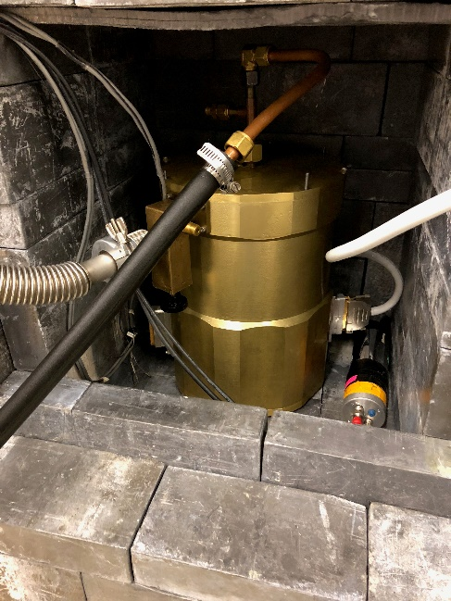
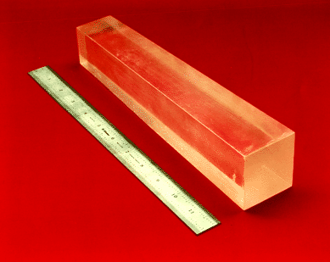
CONNIE Detector@MINER
A CONNIE detector in the Phase-2 cavern to study low energy background.
Another ~kg scale NaI crystal, as well as a ~kg scale Canberra BeGe detector used for MC validation.
Order of magnitude higher DRU seen in CONNIE CCD compared to ~kg scale NaI/Ge.
Trying to understand the discrepancy (cryostat?)
Radon and ⁴¹Ar decays will be reducing by a fresh air purge. Being implemented for MINER as well.
MINER Active veto with half ton (100 x 5 kg each) CsI may provide ~100x reduction (shielding) + rejection (active Compton tag)

Slide 23
Status and Outlook: 1-Tower run Started
Phase-1 in operation – 1-tower science run started with 3 detectors
  1 Ge iZIP to measure gamma and neutron background and have CNS sensitivity
  1 Ge + 1 Si HV detectors (few eVee resolution) for CNS signal measurement
  DAQ hardware and software from SuperCDMS Soudan. Strong synergy in detector development and calibration efforts between MINER and SuperCDMS efforts.
Few (up-to 4) months required for CNS 5-σ measurement
After CNS measurement, focus on sterile oscillation scan 4-10 meter, with optimized exposure-distance combination. Search continues during Phase-2 commissioning
Phase-2 will use new 400 uW cryofree fridge with 7 mK base temp and Icebox (holding upto 30 kg of detectors). Icebox allows the detectors to be inside a hermetic shielding, like SuperCDMS. Phase-2 operational next year and run for a few years.
Unique Sterile ν sensitivity due to movable core and very short baseline (~m scale)
NSI searches will require very low background level and ~year of running
Neutrino magnetic moment sensitivity competitive with GEMMA in a year of running

Slide 24

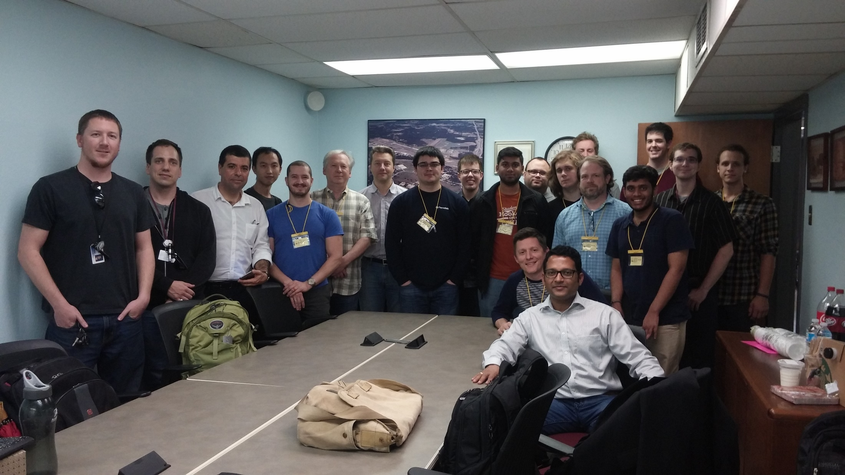










MIνER Collaboration
Texas A&M University, Physics & Astronomy
R. Mahapatra, G. Agnolet, B. Dutta, R. Harris, N. Mirabolfathi , L. Strigari, W. Teizer, B. Webb, Y. Gao, C. Hays, A. Jastram, A. Kubik, W. Baker, R. Beck, Z. Wetzel, F. Kadribasic
University Texas Austin
Karol Lang, Will Flanagan, Marek Proga, John Cesar, Dung Phan, Tom Carroll, Simon De Rijick, Ramon Salazar, Shiv Yadavalli, Kayla Leonard, Adam Rouhiainen
Cyclotron Institute - G. Rogchev, J. Hooker
Nuclear Engineering – C. Marianno, Daniel
National Institute of Science Education and Research (NISER), India
B. Mohanty, K. Senapati, V. Iyer
TEES Nuclear Science Center (NSC)
S. McDeavitt, J. Newhouse, J. Vermaak
University of Minnesota
V. Mandic, P. Cushman, M. Fritts, A. Kennedy, N. Mast, A. Villano, D. Barker
Queen’s University, Canada
R. Martin
Fukui University, Japan
Y. Tamagawa, I. Ogawa, K. Nakajima, M. Shimada
University of South Dakota
J. Sander, J. Liu, J. Mammo, T. Oli, A. Khan, B. Li
Sam Houston State Univ
J. Walker, J. Dent, J. Navarrete, C. Lanham, J. Manning, B. Sands, R. Ramos
Arizona State Univ
J. Newstead
University of Colorado at Denver
A. Vilano
University of Dallas
W. Flanagan

Slide 25
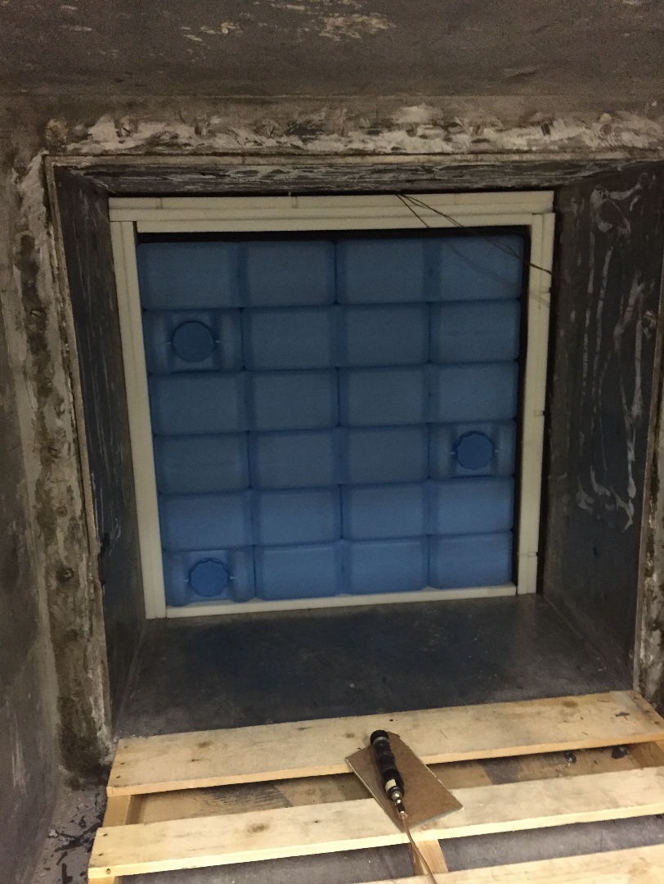
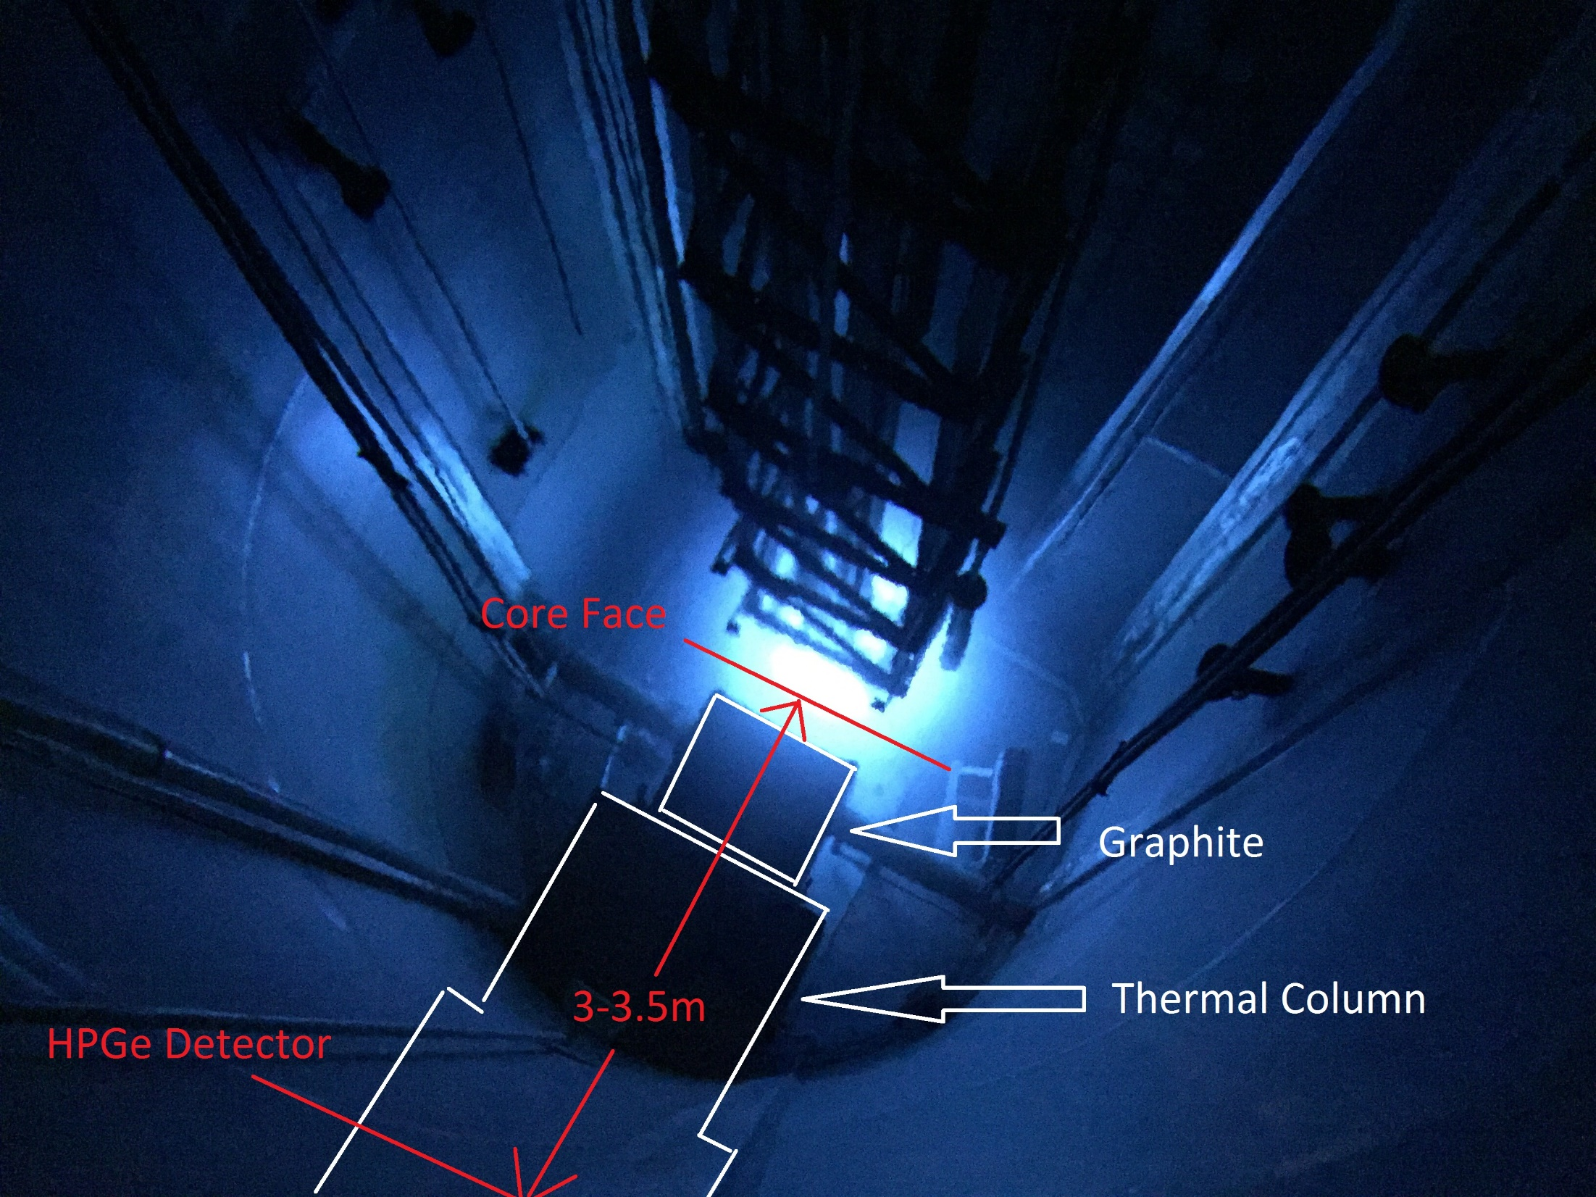
Now removed

Slide 26
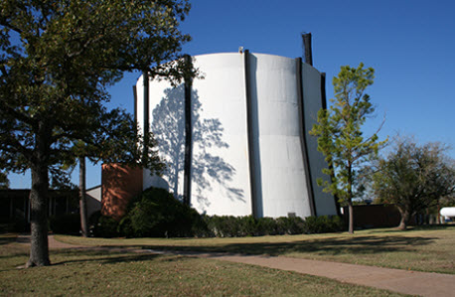
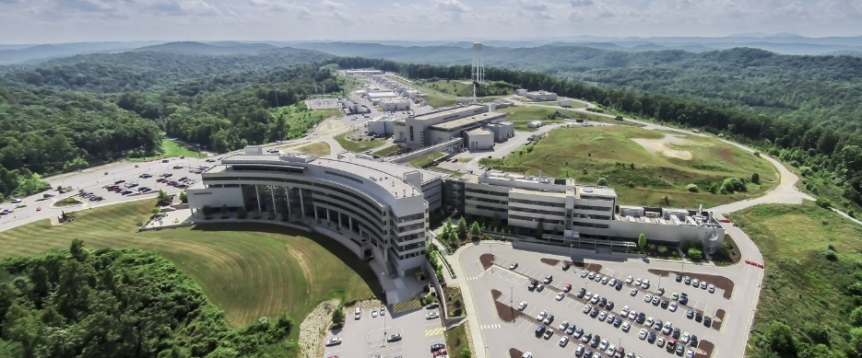
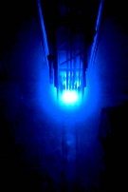
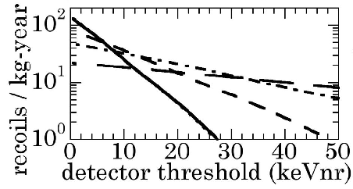
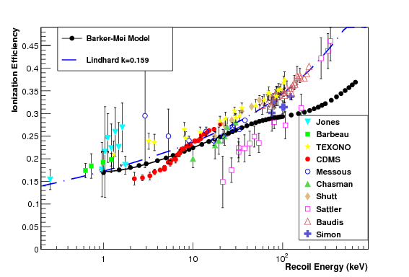
Goal: 200 eV NR
Light (quenched) | Ionization (quenched) | Phonon(no quenching)
Lindhard=.1-.2 | .15 (Ge), .05 (Si) | No Quenching!
Req E_{th} =20 eV | 30eV(Ge),10(Si) | 200 eV
Resol. σ=4 eV | 5 eV (Ge), 2 (Si) | 40 eV
CRESST (10 gm) | CDMS(kg), CONNIE(gm) | CRESST, CDMS
Excellent opportunity with high energy neutrinos that don’t need low threshold
Excellent way to test CNS A² dependence by quickly implanting different detectors
Lindhard still plays a role, since most of the sensitivity is still in low energies
Important to collectively do low-E calibration in same/similar facility
Si
Ge
Trick to overcome Lindhard: convert ionization to phonon

