Slide 1
Dark side of the exciton: self-organized criticality and low energy threshold detectors.
S. Pereverzev, A. Bernstein.
LLNL
This work was performed under the auspices of the U.S. Department of Energy
by Lawrence Livermore National Laboratory under Contract DE-AC52-07NA27344
LLNL-PRES-760947-DRAFT.

Slide 2
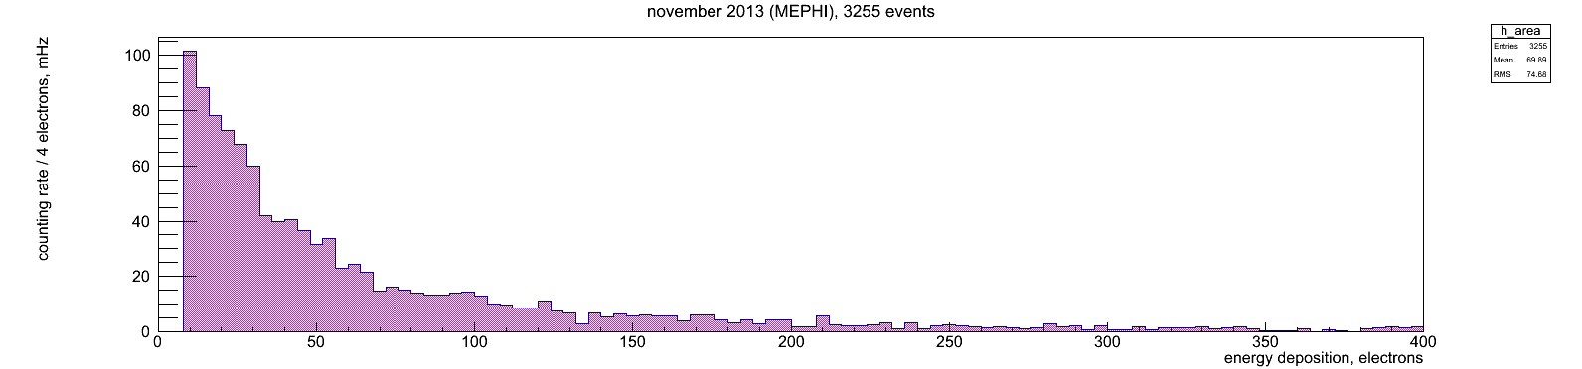
Xe detector low/ high background
Xe 10 – underground
“Flat” residual background- low angle Compton scattering
2010 Sorensen paper
Red curve- detector-produced components of background
-our hypothesis
A
B
Xe detector (prototype of Zeplin)
operating in reactor building in MEPHI
Private communication from Dmitry Akimov,
RED (Russian Emission Detetctor) group, Moscow
Low energy gammas or electrons can not penetrate deep inside Xe (Ar) because of self –shielding Some detector-generated background should be present

Slide 3
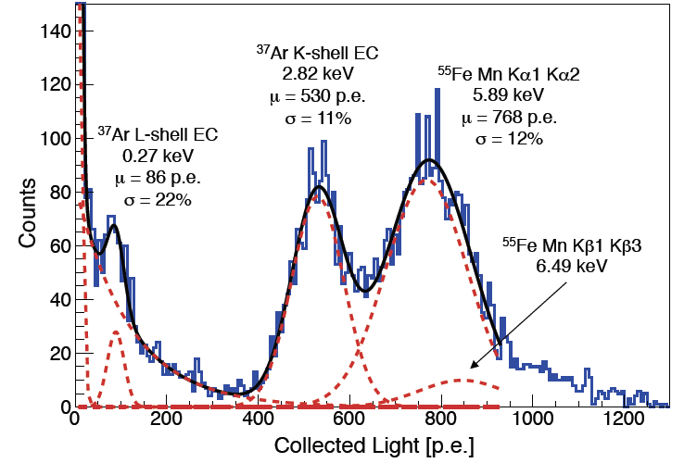
Ar detector low and high background
Dark Side 50 2018 arXiv paper; underground measurements
Same unexplained rise of background at small energies
Livermore Ar detector experiments
Sangiorgio NIM paper, First Ar37 L-shell 0,27keV detection/ calibration
Low energy background in few electrons signal range in underground experiments is sufficiently low to detect
neutrinos from GW power reactor at 25 m from the core. But what is the source of this background?
Can we suppress it 3-4 orders of magnitude for detectors at the surface?

Slide 4
Dual phase detector / time projection chamber
Photo-multipliers (PMTs)
Anode grid
Gas “secondary”
HV
Extraction grid
Few electron-ion pairs limit-
S2 analysis only (no Z coordinate of events)
up to single electron sensitivity
Radiation
Liquid “primary”
HV
e⁻
e⁻
e⁻
Cathode grid
Photo-multipliers (PMTs)
Usual assumption- positive ions recombine at cathode grid upon arrival -?

Slide 5
Three-phase detector: Solid multilayer physiosorbed films present on surfaces
Sorption diagram from review paper
L.W. Bruch, R. D. Diehl, J. A. Venables, “Progress in the measurement and modeling of physiosorbed layers”,
Reviews of Modern Physics, V. 79, pp. 1381-1454, (2007).
Noble gases always from solid dielectric film on cold metal surfaces
Ions can be trapped by solid layers

Slide 6

The model
Localized ions/ long-living excitons are produced in ionization events and are accumulating in solid films on electrodes.
Events of chain recombination of ions/ excitons result in bursts of electron emission (1, 2,3,…,n electrons per event).
So, we have Self-Organized Criticality dynamics
This model provides a unified “big picture” of a wide range of effects (see below)

Slide 7

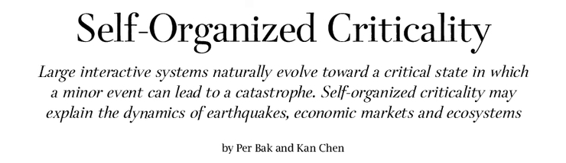
General theoretical framework
Scientific American, Vol 254, pp.46-53 (1991)
“excitations” are slowly produced, accumulate and annihilate in avalanche- like events.
Classical “soft condensed matter” problem : grows of sand pile, when material is added to the top and spreads horizontally by avalanches.
Applicable to “hardcore condensed matter”- crack formation, motion of quantized vortexes in superconductor, some interacting spin systems (not all interactions results in SOC), etc.
Many features of Self-Organized Criticality are universal
and do not depend on details of interactions

Slide 8
Self-Organized Criticality - properties
Probability of large avalanche is decreasing polynomially with energy: polynomial (not exponential) events spectrum, probability of a catastrophic event not negligible
Noise spectrum close to 1/f
“Energy up-conversion events”- even when low energy events produce excitations, “large events” are possible
Probability of large event can be suppressed by reinforcing relaxation at small scale-
For sand, put sand pile on vibrating platform
For solid nobles on metal, force recombination of trapped ions !
These features can help to identify the problem.
Microscopic model is required to suppress unwanted effects.

Slide 9
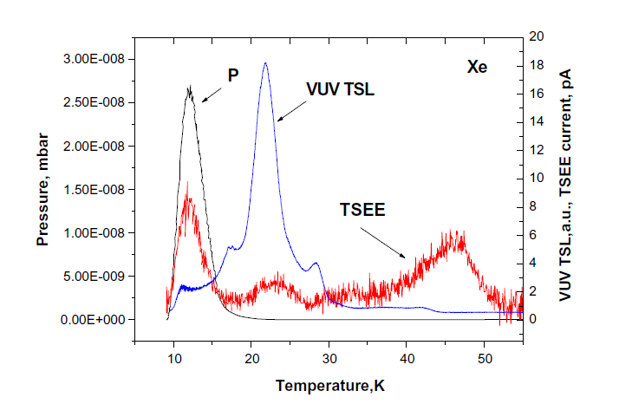
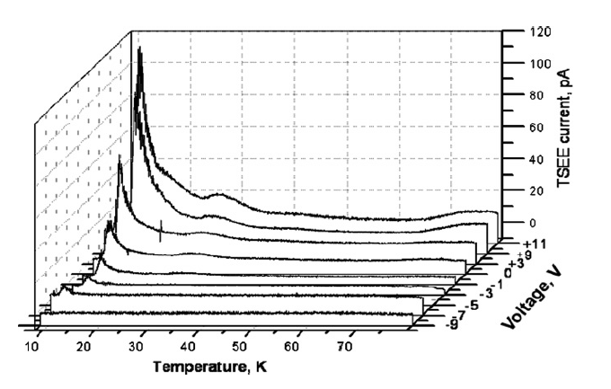
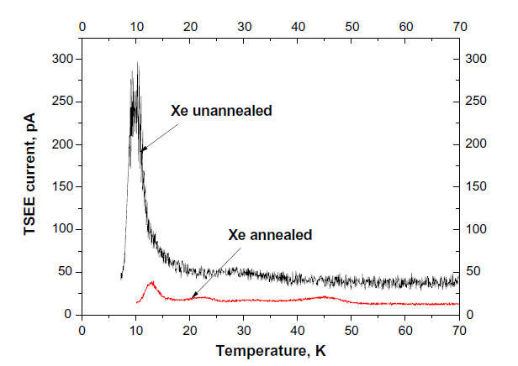
Thermo-stimulated luminescence and Exaelectron emission in Rare Gases Solid: phenomenology; long-living (metastable) excitons
Radiation effects in atomic cryogenics solids, E.V. Savchenko et al, NIM B268, 2010 see also M.E. Fajardo and V.A. Apkarian, J.Chem.Phys. 87, 1988
Long (days) energy storage: Xe₂⁺ and O₂⁻ (electronegative impurities) are involved (also halogen –doped Xe crystals)
Crystal field (e.i. local strain in crystal) prevent these ions to come close (Apkarian)
Thermally –stimulated luminescence and Exaelectron emission are very common for dielectrics crystals and films on metal substrate.

Slide 10
Thermo-stimulated luminescence and Exaelectron emission in Rare Gases Solid: metastable excitons interactions
Radiation effects in atomic cryogenics solids, E.V. Savchenko et al, NIM B268, 2010 see also M.E. Fajardo and V.A. Apkarian, J.Chem.Phys. 87, 1988
Likely, diffusion of molecular ions is vacancy –assisted, and vacancy can not enter in between ions
Still, molecular Ion pairs (long-live excitons) can diffuse across crystal and accumulates in “droplets” .
Exaelectron emission required two or thee ions: positive –negative ions recombine and energy transferred to another electron, or two ion pairs produce two excimer molecules Xe₂* which recombine by Penning process with production of energetic electron.
Not clear yet what trigger recombination events (tunneling?) and “chaining” of recombination (local self-heating?)
Non-linear interactions of metastable excitons are present.
Self-Organized Criticality dynamics should be expected

Slide 11
Predictions for RGS crystals
Bunching in exaelectron and / or photon emission from irradiated RGS with polynomial event spectrum.
Up-conversion: burst of photons and / or exaelectrons emission from RGS irradiated with UV photons.
While these effects was not looked for in RGS crystals,
They was observed in other materials.

Slide 12
SOC effects in Ar/Xe detectors
Polynomially decreasing component in of low-energy background
Increase in few-electrons event rate with increase of ionization load
Predictions:
Up-conversion: increase in few –electrons events after exposure to UV light, or when Ar 37 added, increase of background at energies above 3 keV e-e (polynomial component rise everywhere)
Increase of few electron background with electronegative impurities concentration ^{1,2} (likely observed by LUX and Darkside50)
¹ Electronegative impurities in solid film likely are catching electrons produced by photo effect due to S2 light (proportional electroluminescence in gas), so few electron background may rise with increase of gas amplification in the detector (number of photon produced by electron moving in gas)
² Even in absence of impurities, non-linear effects in photo effect caused by trapped positive ions can lead to SOC
While other effects can produce electron emission (field emission, photo-effect from electrodes, impurities ionization by UV, delayed “evaporation” of electrons trapped into electrostatic potential well near liquid surface), not checking for SOC effects will lead to confusions.

Slide 13

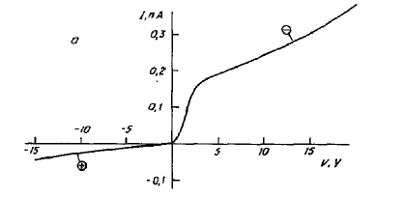
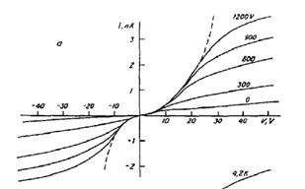
Electrode polarization/ charging
Observed in liqid Helium:
Ti³H
⁴He at 4K
V
I
Stainless
Wait…
S. Pereverzev, A. Parshin
Physica B 197, 347 (1994)
• hysteresis (red) due to electrode surfaces charging (shifts up to 20-30 V)
• Strong (~kV) AC Voltage (at 1 mm gap) remove hysteresis by de-trapping ions
• AC field across 10-20 nm solid layer much less than dielectric strength (layer hold 20-30 V )
Back in 1991-1993 we attributed this effect to solidied residual gases on electrodes.
The effect should universally be present for physiosorbed solid films of Noble gases.

Slide 14
Possibility to suppress few electron background
If the criticality hypothesis is correct, a mitigation is possible
For sand pile- application of vibrations enforced small avalanches
Apply AC voltage between grid wires to prevent ion accumulation, thereby preventing “large avalanches” events
Imposition of a local AC field may mitigate this source
of noise
Because of self-shielding of gammas and electrons, in surface operation majority of low –energy background should be generated by the detector, so several orders of magnitude reduction in background could be possible

Slide 15
Conclusions
Self-Organized criticality model for detector-generated background in Xe/ Ar dual-phase detectors is suggested.
Suppression of few-electron background by reinforcing ion recombination on the surfaces of electrodes is possible.
In underground experiments background reduction should result in additional parameter space exclusion for
light dark matter particles.
For surface detector operation several order of magnitude reduction in few-electrons events cold be possible
because of self-shielding.
Continuation of work in this direction can lead to detection of reactor antineutrinos
with reasonably small (below 100 kg) Xe or Ar dual-phase detector.

Slide 16
Additional slides

Slide 17
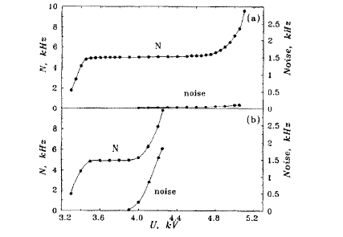
Trapped positive ions and photo-effect
Monochromator
V
Initial (in vacuum at 4K)
Light off
Picoammeter
hν
After gas discharge
Photocurrent [a.u.]
Light on
Wire ring anode
hν
Final (warm-up)
Ag film on glass
cathode
Ar gas filled Geiger counter with Al cathode
(Aluminized MYLAR) sensitive to visible light
in presence of ions (radioactive source)
Chirikov-Zorin et al., NIM A 371, 375 (1996)
hν
Photon energy
Observations in Paul Leiderer lab, Konstantz, Germany,
December 1992 (unpublished)
Ions trapped in solid He film (and on aluminum oxide film) change local work function and photo effect red boundary. Similar effects can lead to SOC dynamics for Xe₂⁺ or Ar₂⁺ ions accumulating near metal surface.

Slide 18
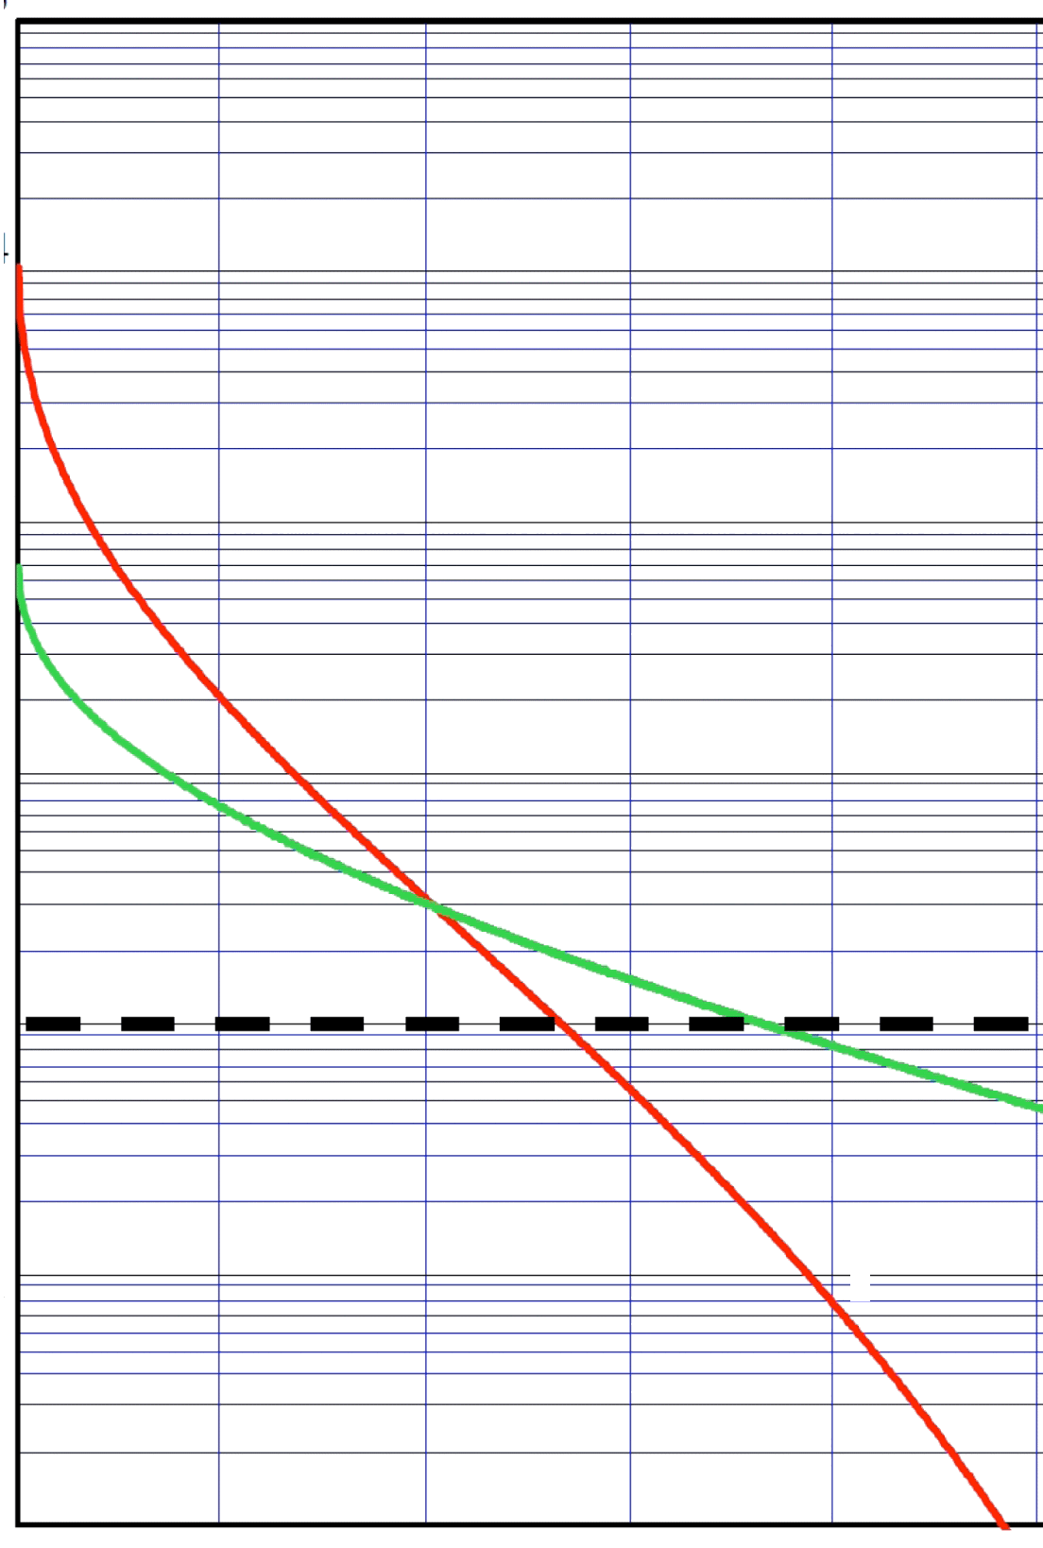
Neutrino coherent scatter can be measured at a reactor
- if the energy threshold & background is low enough…
Ionization sensitivity limit: 1 electron
created by neutrino interaction
Only 100 kg of
Ar or Xe is required
Could be used to monitor
reactor operations for
nonproliferation
Need reduction in
energy threshold to 100-300 eV
About same threshold required to see low energy solar neutrinos
D.Akimov et al., JINST 4 (2009)*
10⁴
10³
Events/ keV/ kg/ day
10²
Limit for phonon detection: ~few eV
Limit for ionization: ~few 100 eV
Background
Ar,Ge
10
Xe, CaWO₄
1
0.2
0.4
0.6
0.8
1
Nuclear Recoil Energy [keV]
The more we can suppress ion-induced background, the less muon flux suppression required….
Notes:
No matter how the ionization detector operates you’ll never see less than 1 electron

Slide 19


A Dielectric Cryostat
Design goal:
Avoid combination of high electric fields, UV radiation and positive ions at metal surfaces;
avoid high field where possible
Features:
• Teflon shield to block UV and avoid ions on
electrodes in liquid
• PMT and PMT readout at HV to reduce
electric field behind cathode grid
• HV field cage to lower field in vacuum
(High field only in thick external dielectric)
• No HV feed-through and no HV cable
• HV source in vacuum space
Only grid wires are (unavoidably) exposed
to high electric field, ions and UV radiation.
Dielectric
HV field cage
Teflon
Teflon
HV field cage
Dielectric
PMT at -HV
PMT readout at HV
Vacuum
Mega
Volt

Slide 20
Thin Film Emission from Luis Malter (Phys.Rev. 50, 1936) to present photocathode developement
Malter effect- self-organization of efficient field-emitter structure on anodized Al surface
Cathode surface: aluminum oxidized electrolytically and subsequently treated with Cs and oxygen
Exited by low energy electron beam in vacuum and secondary electron emission measured.
Ehe primary e- beam can be snitched off, but strong emission (much large then primary current) continued for some time (“anomalous emission”)
“Off” time (and “on” time in certain conditions) became shorter if cathode illuminated with visible light
For larger primary current (and charge density) light emission from cathode starts due to “violent electrical breakdowns” of oxide films; eventually effects would be destroyed.
“anomalous field emission” was absent for most of other oxides tested (Al₂O₃ ,BeO – yes, Cao, CbO, Ag₂O, CuO, NiO, Ta₂O₃, Wo₂, ZrO- no )
Present -day development- photocathodes with engineered ultra-thin dielectric layers
Still, no theoretical models except 1D case (homogeneous in plain distributions);
Efficient field-control emitters or photocathodes are important for many applications
Cold emitters and thin film photocathodes is an active area of research

Slide 21
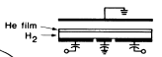
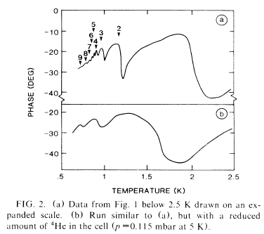
Physisorbed solid films of rare gases
Solid He films on H₂ surfaces
• Ar, Kr and Xe form several solid monolayers on metal surface at low temperatures
L.W. Brush et al., Rev. Mod. Phys. 79 (2007)
Structure of growing films by X rays diffraction and cold atoms diffraction.
Thickness of physisorbed film is rising monotonically with gas pressure.
After ~5 solid layers- re-entance behavior: top monolayer grow as disordered (liquid), but ordered as more then half of the next layer is added. Eventually, layers start to add as liquid.
Surface electron motion
Number of He
monolayers
• Measured electron surface mobility
peaks at filled He monolayer(s)
Cieslikowski, Leiderer, PRL 58 (1987)
• Solid He monolayers form on solid H₂ surfaces
• They will also form on metal surfaces at low T
Noble gases always from solid dielectric film on metal surfaces

Slide 22
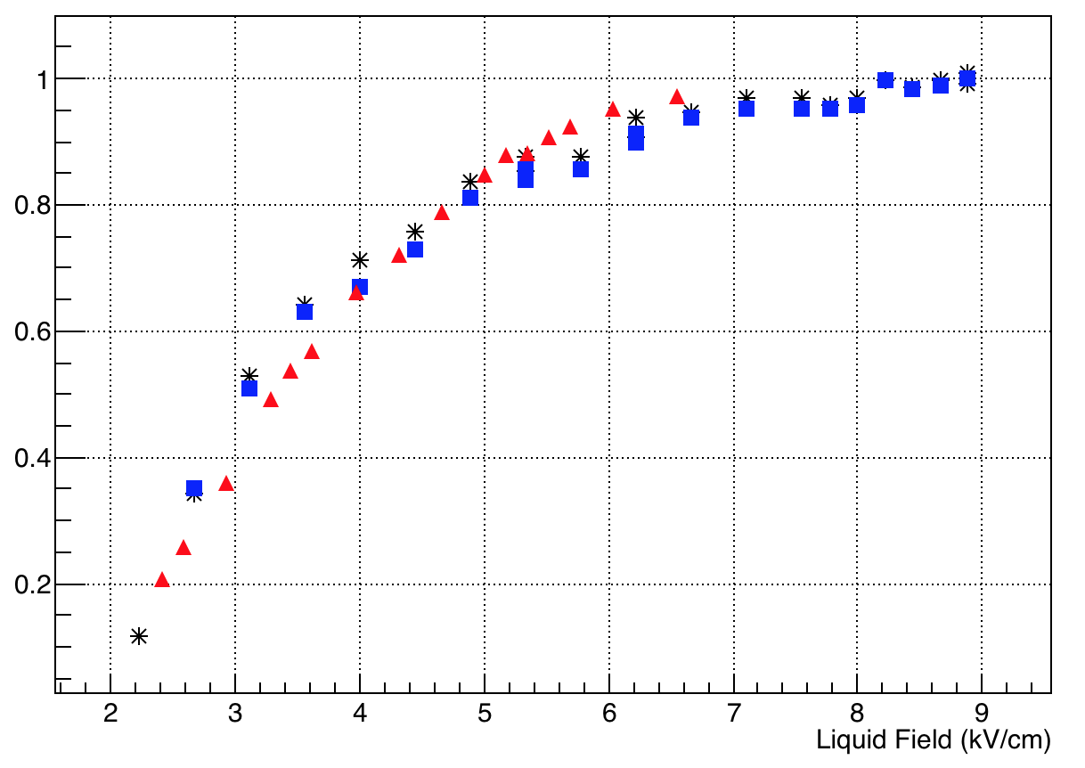
First physical result- relative electron extraction efficiency in extended field rage
PIXeY result
270 eV line
✴ 2.8 keV line
Do we see saturation?
Can “quantum reflection” features be present?
Even large field range is desirable.

Slide 23
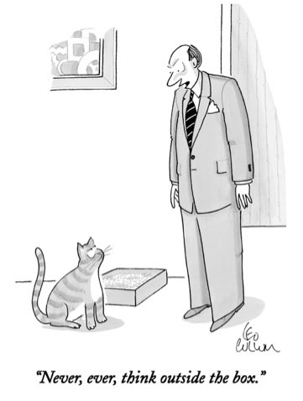
Important connections with Quantum Information
Material sources /microscopic mechanisms of noise and decoherence are important and still non-resolved problem in quantum information.
Decoherence is believed to be due to tunneling two-level systems (low-lying energy levels) in materials. Experimental evidence points concentration of those objects around surfaces and interfaces. Boundary charges and magnetic moments (spins of localized and de-localized boundary charges, impurities and nuclei) contribute to fluctuations.
Analogy with charges on metal-Xe boundary implies that the interaction in between low-lying energy levels needs to be taken into account to describe self-developed criticality or any other non-equilibrium effects related to the energy flow through the system of low-lying energy levels.
Current models for noise and decoherence are not considering possibility of self-organized criticality (in quantum limit) in the system of low-lying energy level in the materials; other words, model different from non-interacting two-level systems is required.
Charges in solid noble gases layers on metal surface provide unique possibilities to study self-organized criticality in quantum limit- both spectroscopic and transport measurements are possible in a wide range of important parameters- fields, ion concentration, chemical potentials, etc.

Slide 24
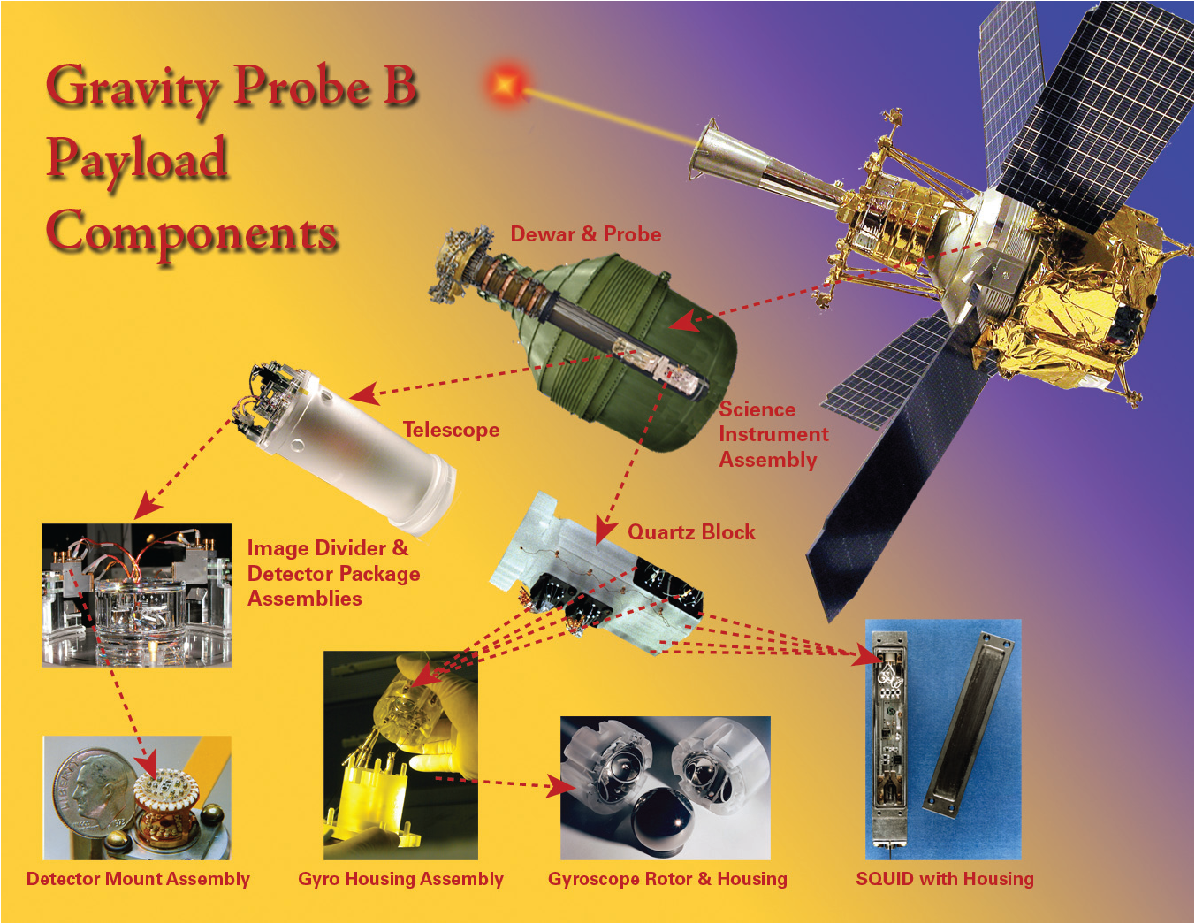
Ions trapped on cold surface
and Gravity Probe B experiment
Einstein was right…
After years of data analysis
to model gyroscope precession
due to parasitic charging effects
Solid Helium
+
+
+
+
+
–
–
–
–
–
metal
Experimental Condensed Matter Physics and Surface Science does matter...

