Slide 1
η Carinae: 170 years after its Great Eruption
Noel Richardson
University of Toledo

Slide 2
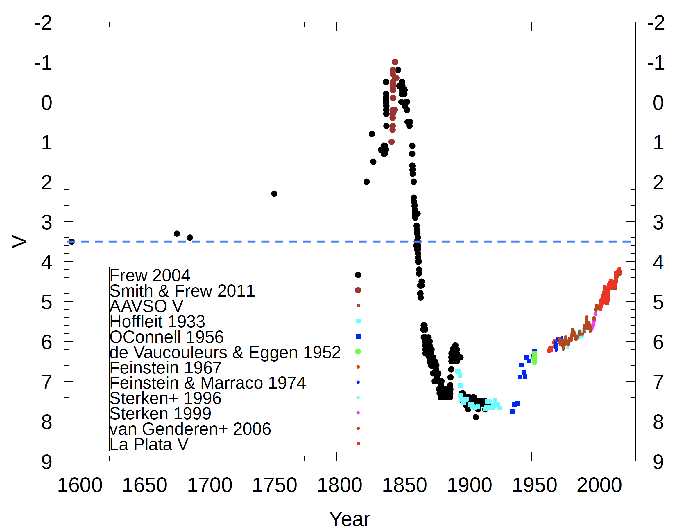
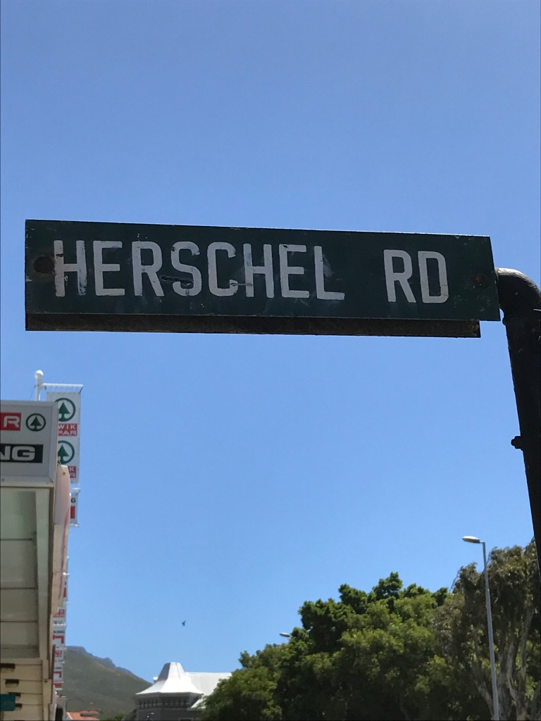
Damineli+19
Damineli+2019; Davidson & Humphreys 1997

Slide 3
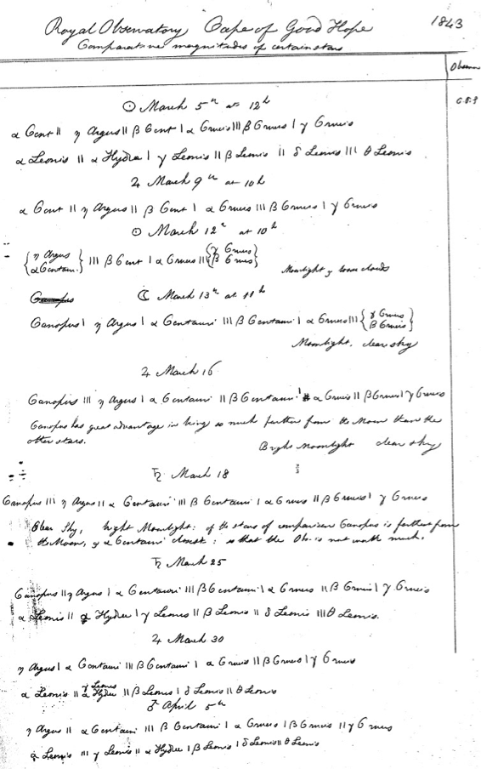
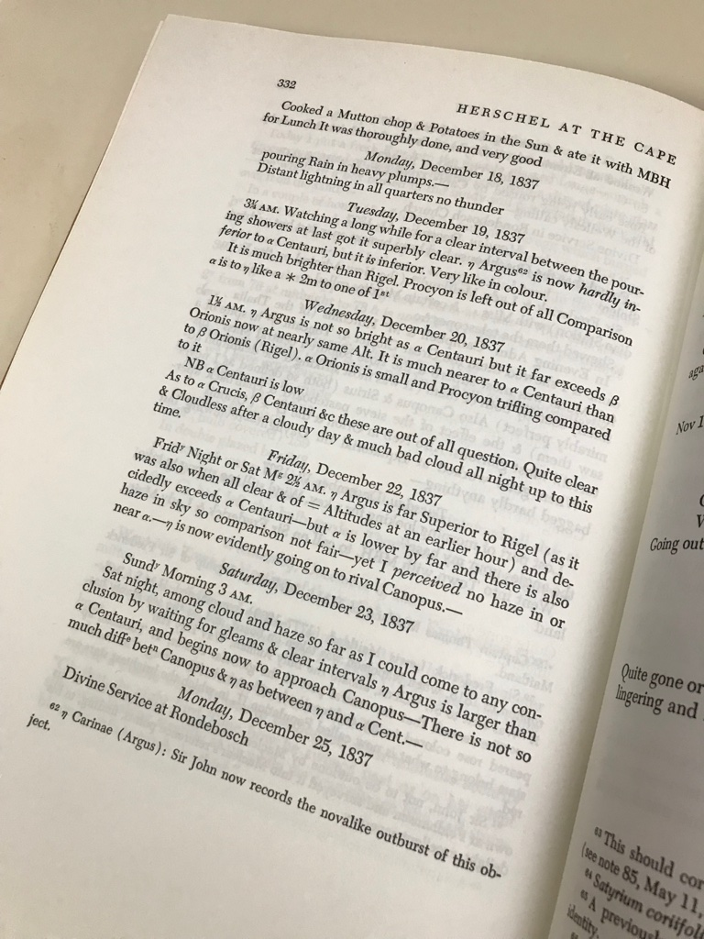
Smith & Frew (2011) Herschel at the Cape

Slide 4
Smith & Frew (2011)

Slide 5
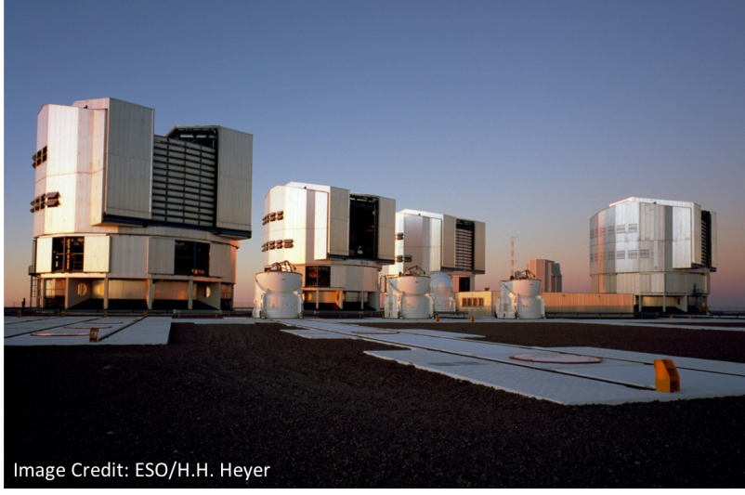
The 3D Structure of the Homunculus
Full spectral mapping (2990 Å – 24,790 Å) of the entire Homunculus Nebula in March 2012 with the Very Large Telescope in Chile.
Assemble a data cube. Focus on molecular hydrogen infrared emission, which traces fronts and backs of lobes.
Steffen+ 2014

Slide 7
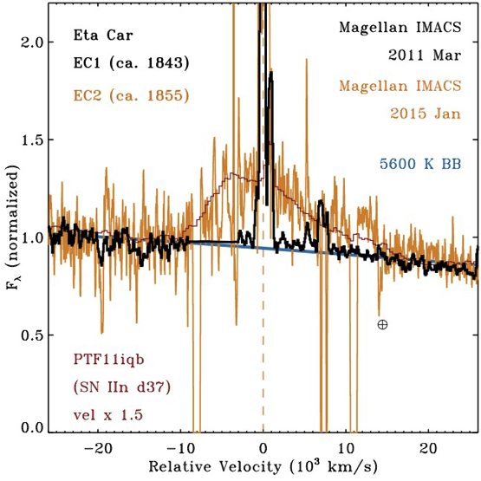
Light echoes
Smith+2018

Slide 8
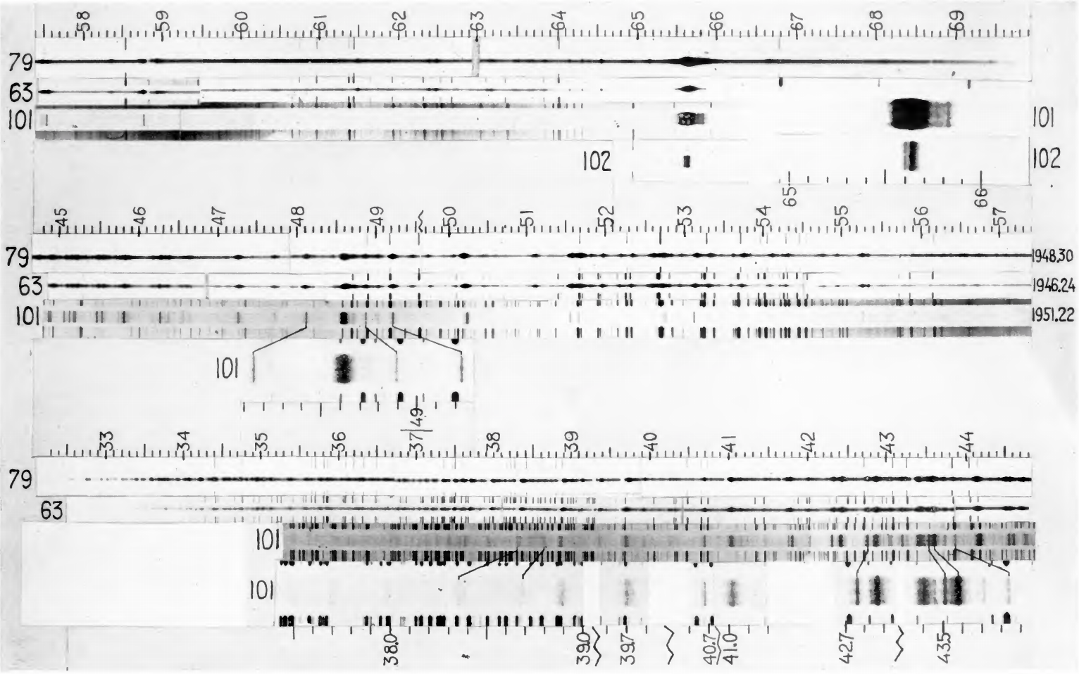
After the Eruption… significant spectral variations
Gaviola (1953)

Slide 9
Unusual, close ejecta
Weigelt & Ebersberger (1986)

Slide 10
New clues… periodicity (P=2022.7 d)
Damineli+ 1997, 1998, 2008

Slide 11
http://etacar.umn.edu/

Slide 12
RXTE Monitoring
Corcoran+ 2001

Slide 13
Long-term monitoring with X-ray satellites

Slide 14
Orbit:
5.54 years
e~0.9
(No kinematics yet)
𝜂 Car B:
30 M⊙
Ṁ ~ 10⁻⁵ M ⊙ yr ⁻¹
𝜂 Car A:
90 M⊙
LBV-like, large
radius
Ṁ ~ 10⁻³ M ⊙ yr ⁻¹
Periastron passages:
He II excess
Lower energy optical spectrum
X-ray maximum (and minimum)
Next event in February 2020

Slide 15
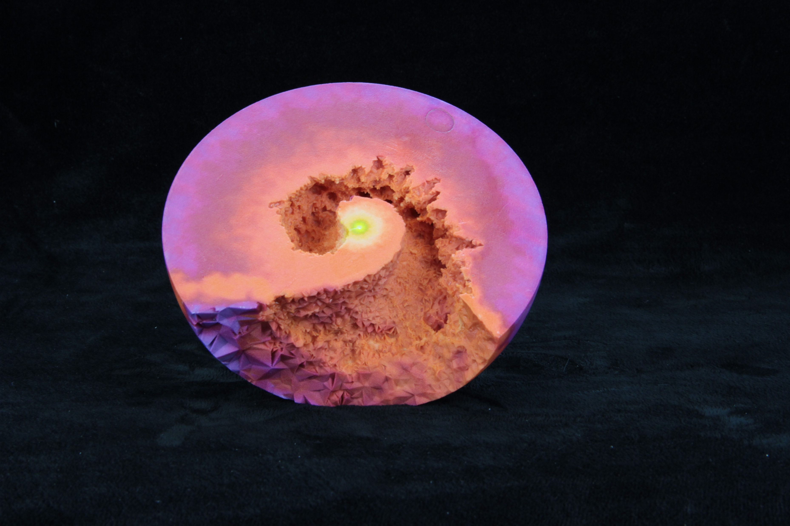
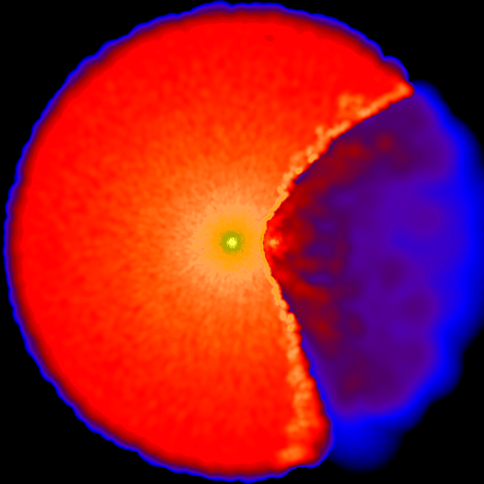
DOWNLOAD AND PRINT YOUR OWN!
Madura+ 2015

Slide 16
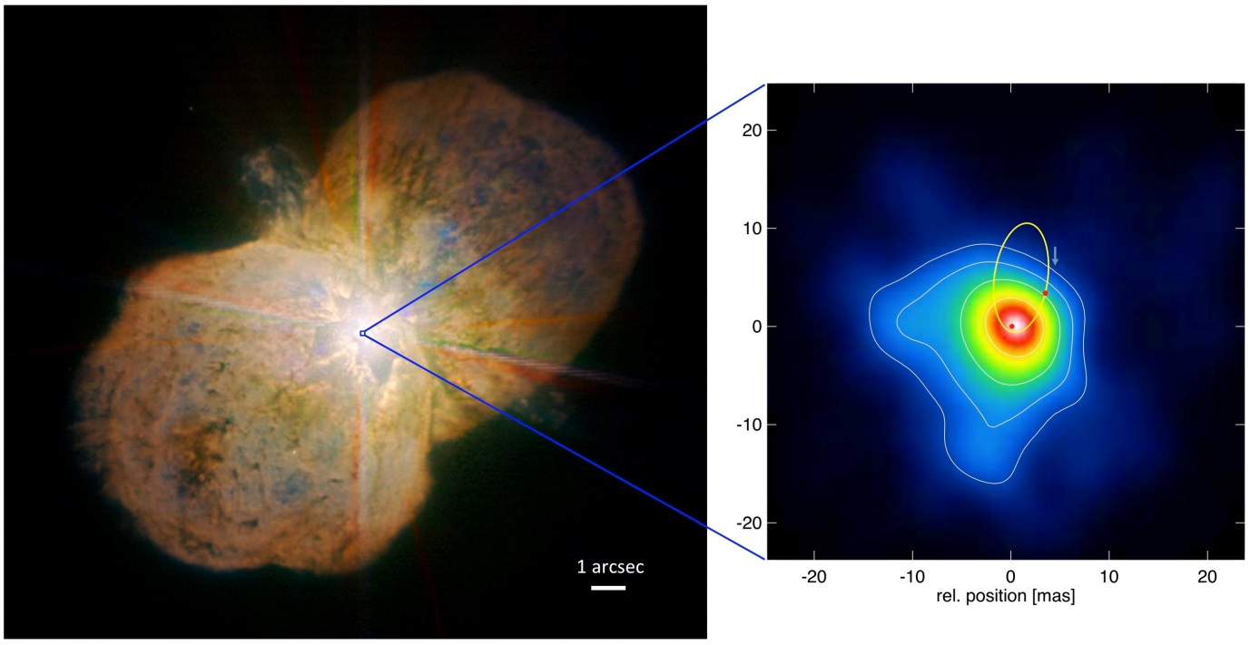
Weigelt+ 2016

Slide 17
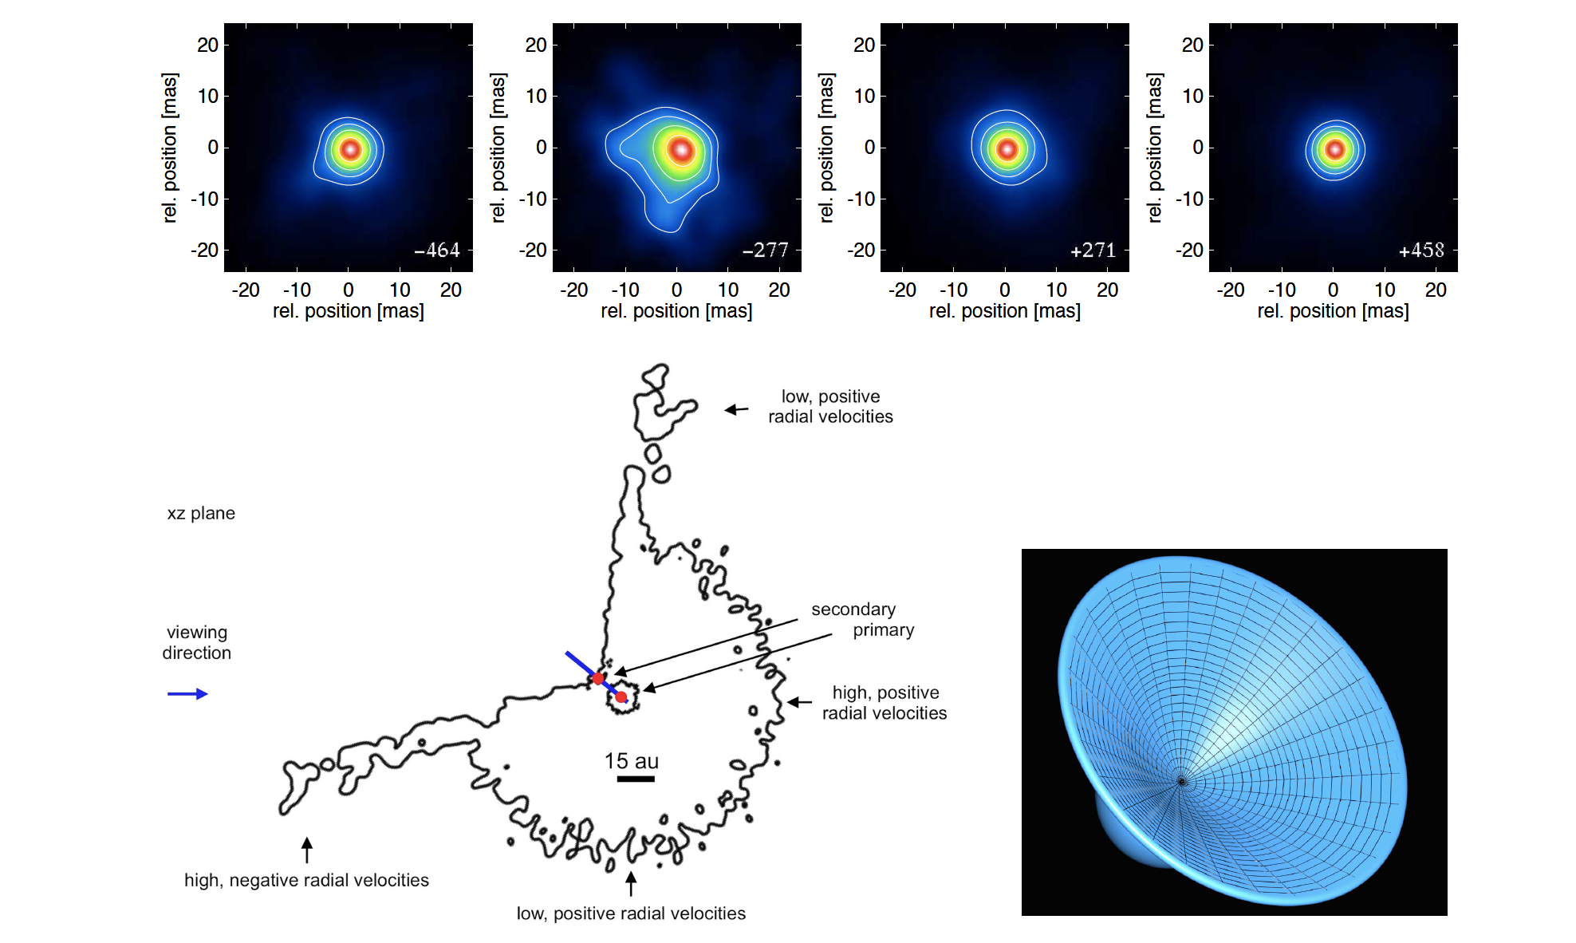
Weigelt+ 2016

Slide 18
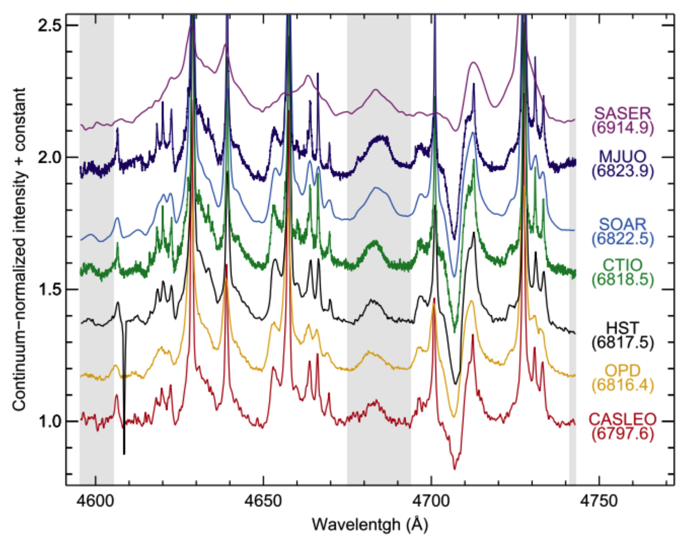
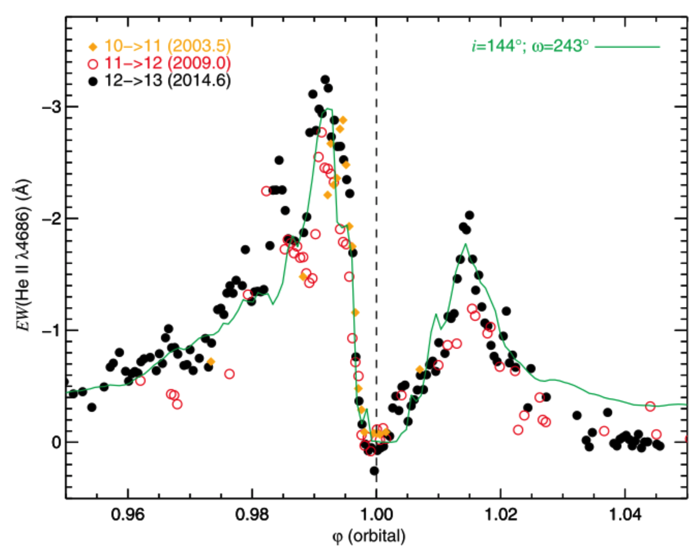
Eta Car
Teodoro+2016
Wavelength (Angstroms)

Slide 19
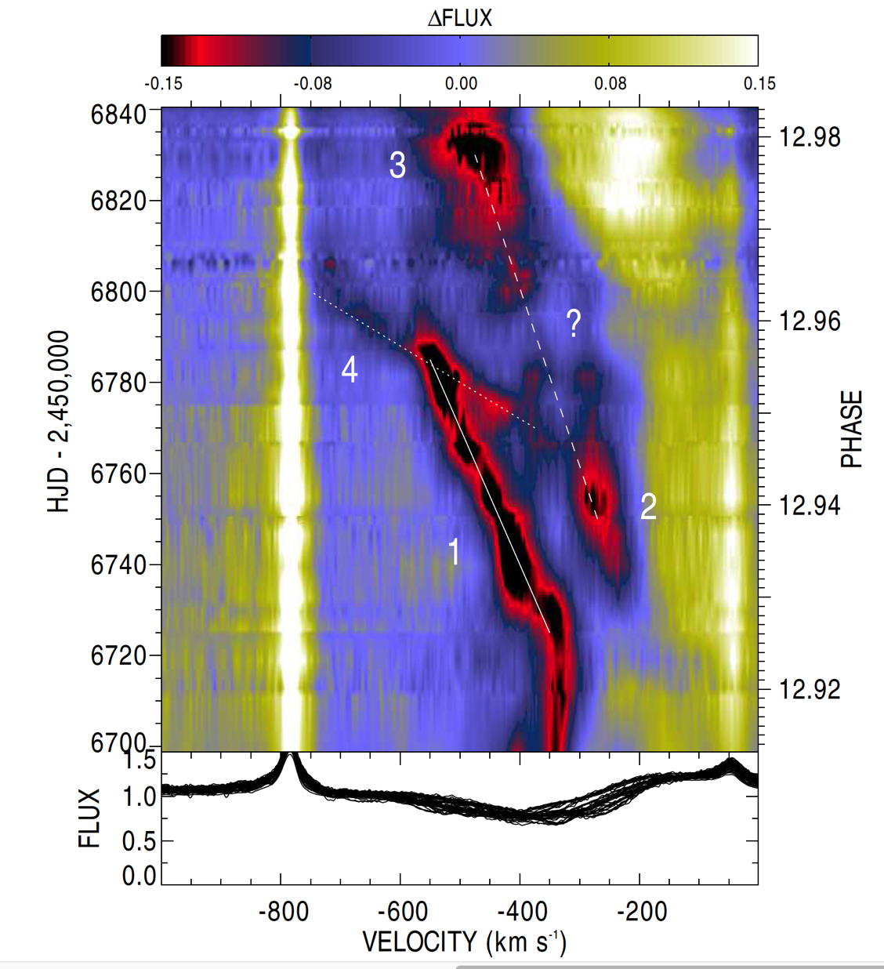
Richardson+ 2016
Notes:
Bottom, 0.938, 0.98

Slide 20
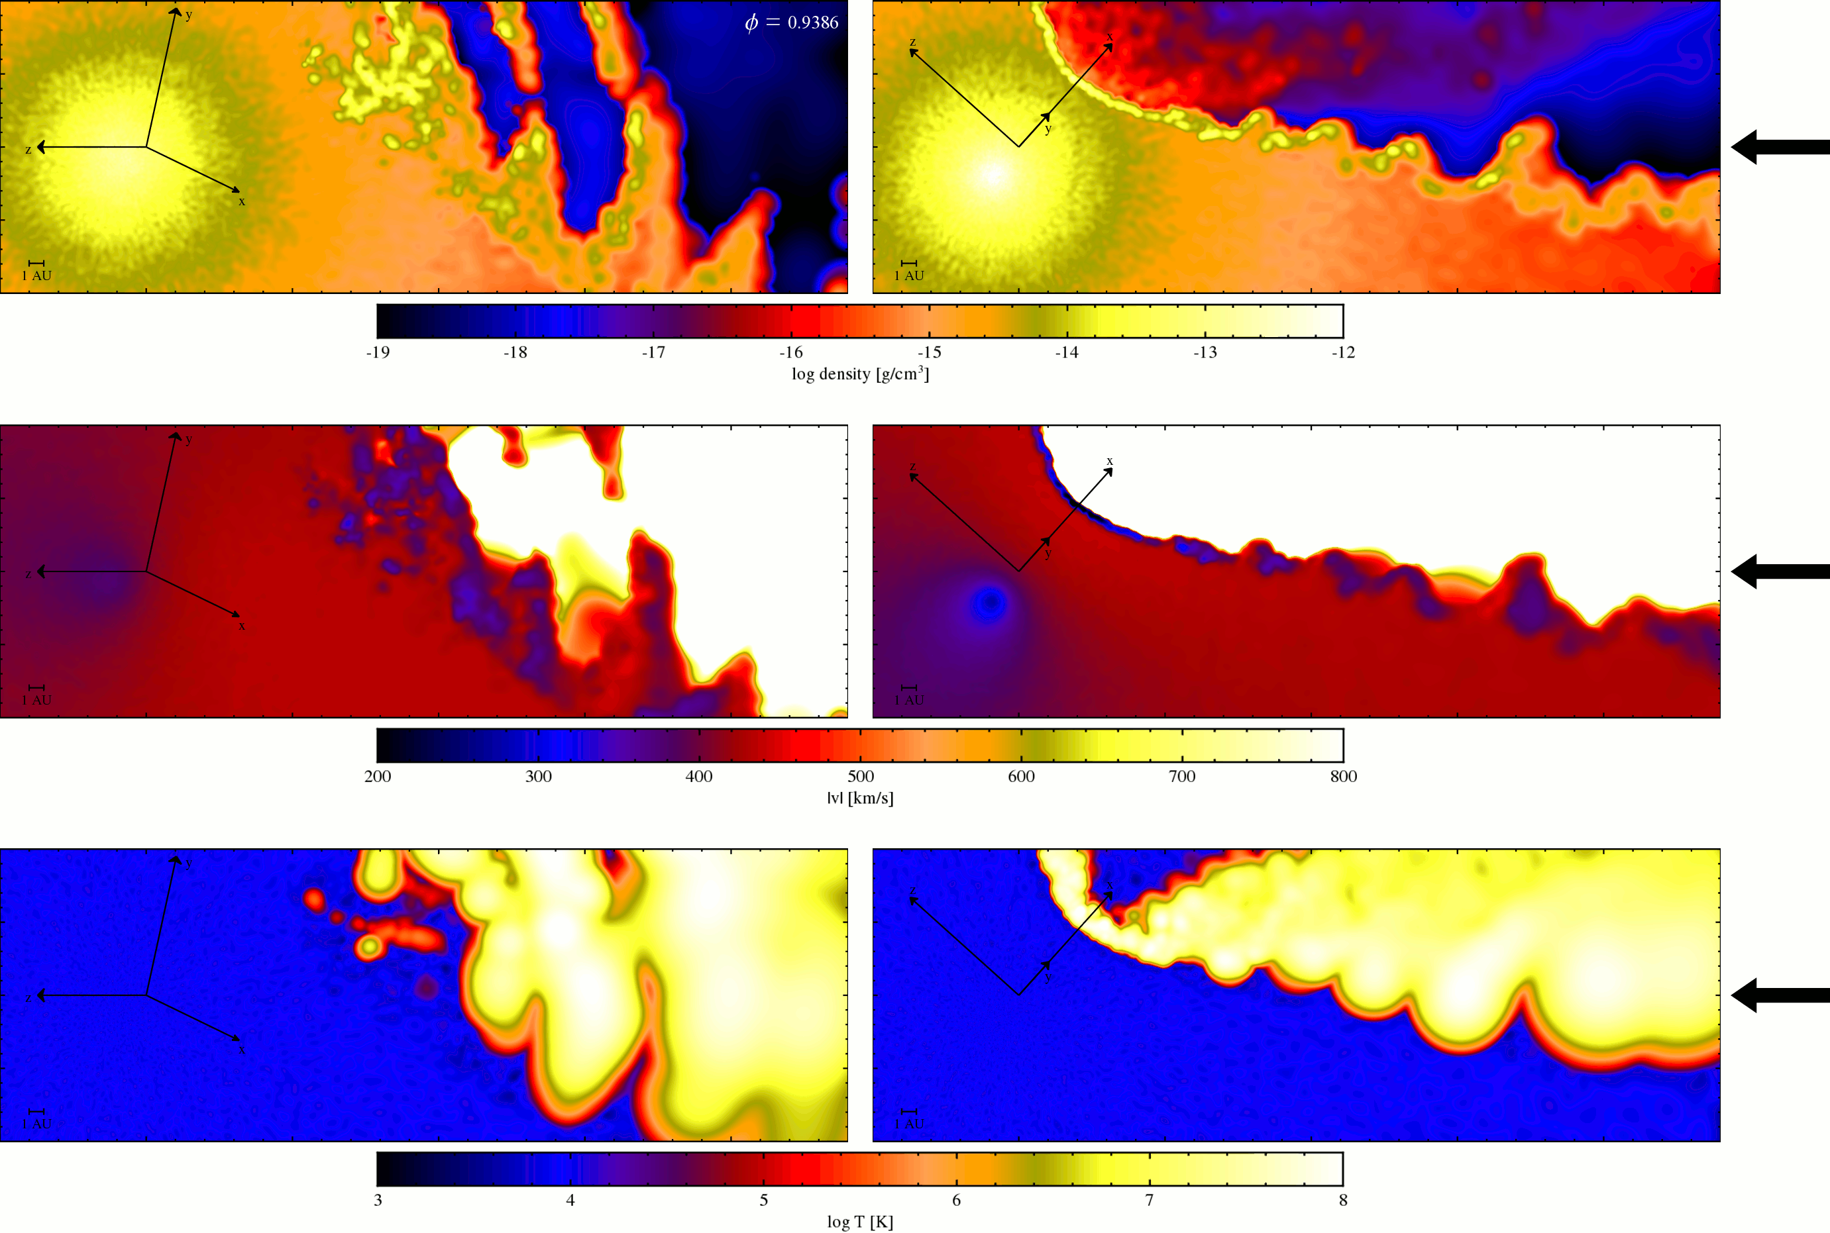
Richardson+ 2016
Notes:
0.938

Slide 21
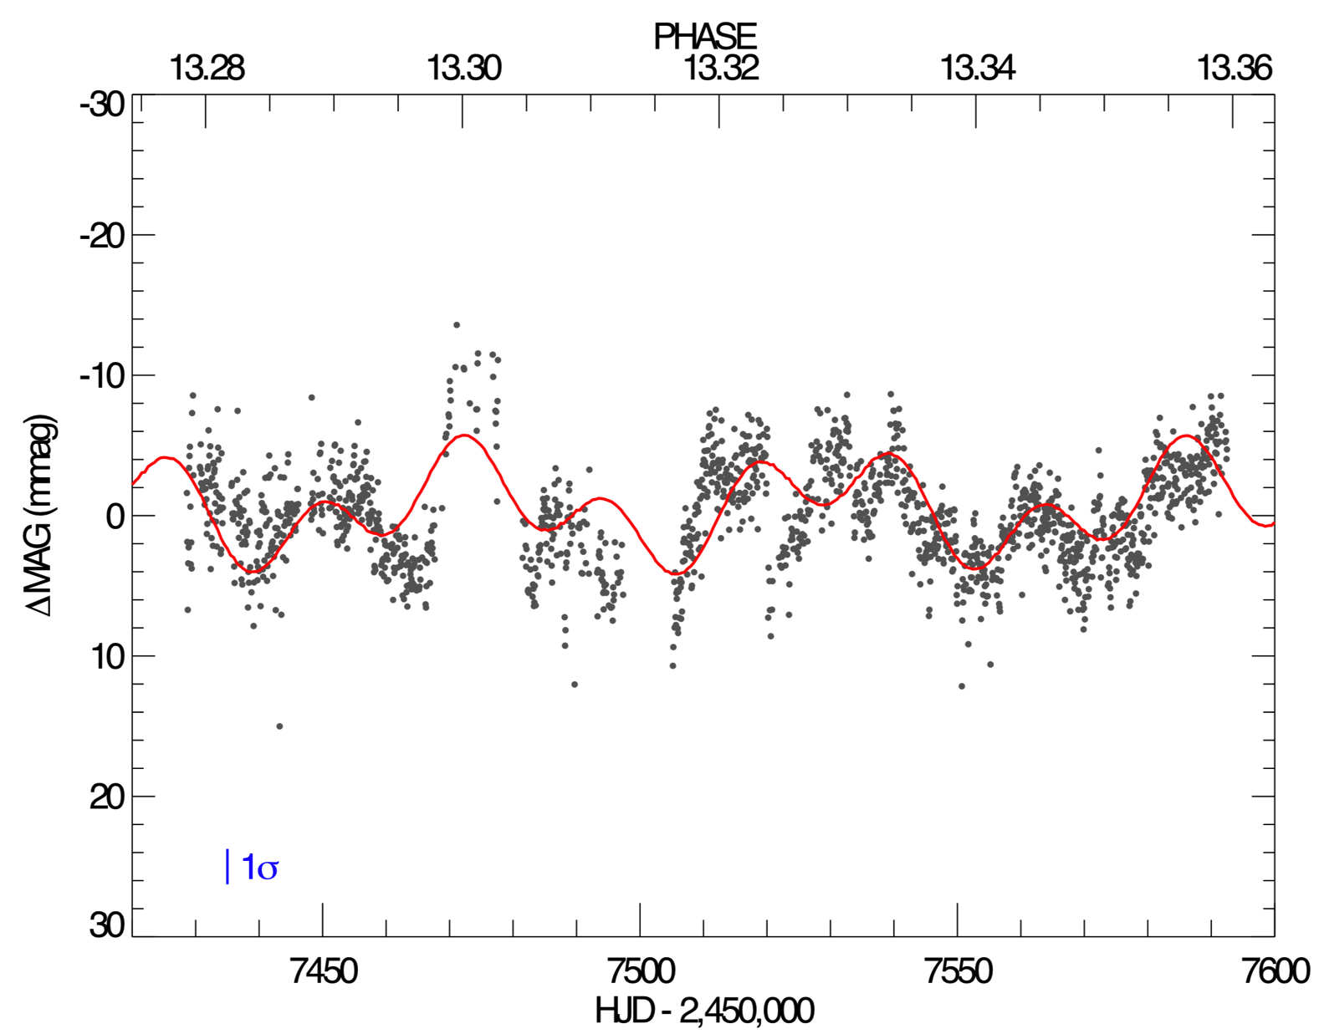
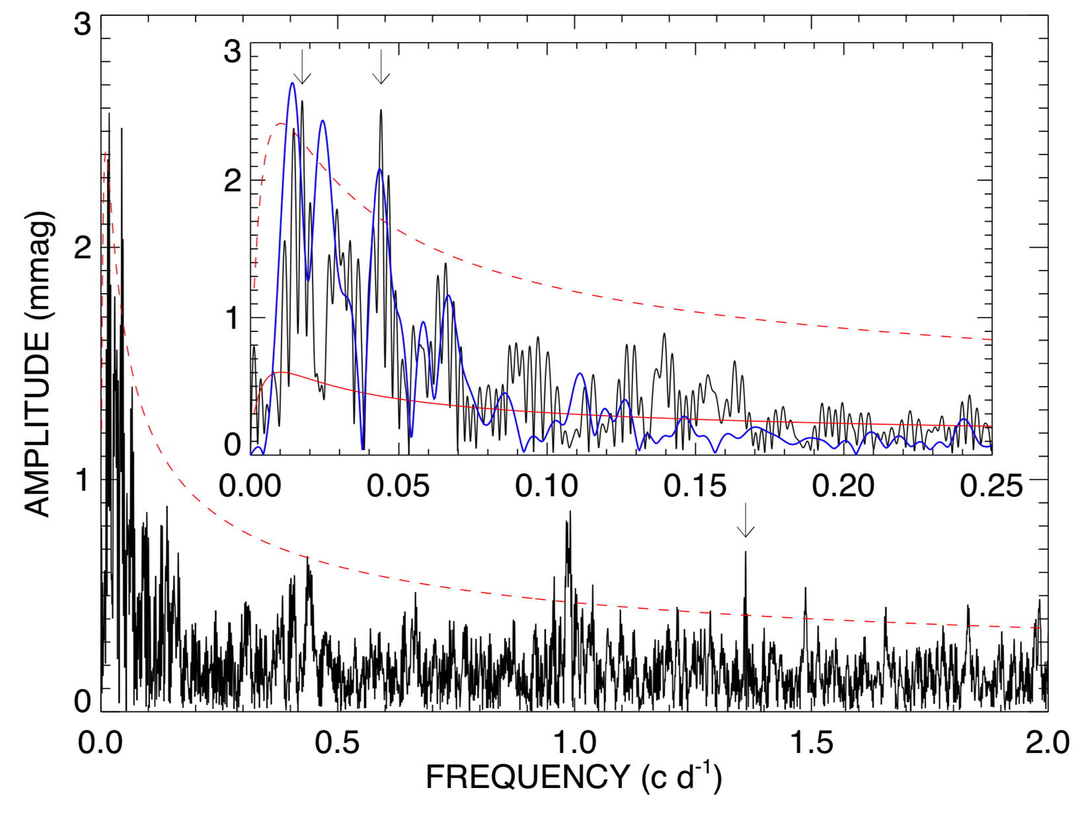
Precision Photometry reveals pulsations
Richardson+2018
Notes:
First possible explanation for these variations. Stable over ~40 years – binary driven?

Slide 22
η Carinae is an outstanding astrophysical laboratory
Massive stars
Winds
Evolution
Outbursts
Binary interactions
Interstellar medium
Outflows
Ejecta
Theoretical models and observations are finally both leading each other
Multi-wavelength observations
X-rays (shocks, orbit, mass-loss)
UV (mass loss, CS changes)
Optical (wind diagnostics, binary timing, light echos)
IR (interferometry, wind diagnostics, molecules)
ALMA + radio (molecules, ejecta studies)
We are working to piece it all together to understand SN imposter events

