Slide 1



A comprehensive population-scale modeling of Type IIb supernova progenitors
Midwest Workshop on SUPernovae and TRansients
Niharika Sravan
FEB 26, 2019
Notes:
Main point: expect EB from rates at all Z, imply weak winds

Slide 2
Stripped Envelope (SE) Sne
H
He
Core
Type II
STRIP!
SUPERNOVA
H
He
Core
SE SNe (Types IIb,Ib,Ic)
Core
Core
He
SUPERNOVA

Slide 3
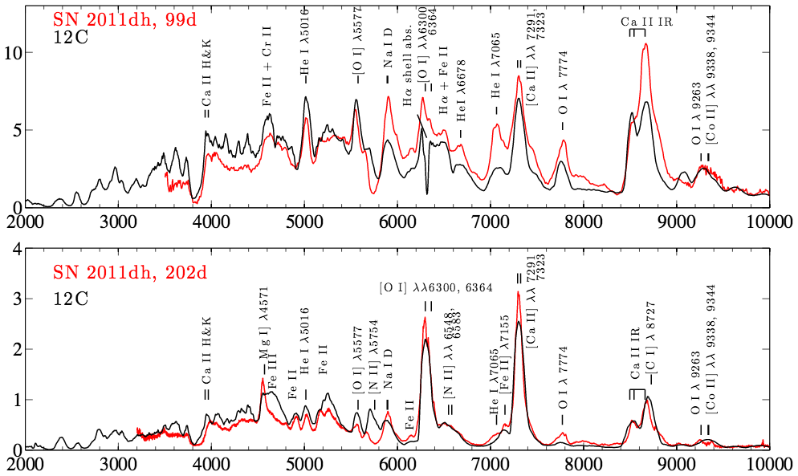
Type IIb SNe
99d
H
He
Core
time
SN 2011dh
202d
SUPERNOVA
Abundant
  ~ 10-12% ^{a,b,c} of all core-collapse SNe
  30-40% ^{a,b,c} of all SE SNe
Five with detected progenitors (SNe 1993J, 2008ax, 2011dh, 2013df, 2016gkg)
Three with evidence for binary companion (SNe 1993J, 2001ig, 2011dh)
Jerkstrand et al., 2015

Slide 4
What Drives Stripping?
Stellar Winds
Stellar Rotation
Stellar Eruptions
Binary Interactions
High binarity for massive stars (Sana et al., 2012; Kobulnicky et al. 2014; Moe & Di Stefano 2017)
Clumping in winds (Smith et al. 2014)
High SE SN fractions (Smith et al. 2011)
Low pre-SN progenitor mass (Lyman et al., 2016; Prentice et al., 2018)
High pre-SN mass loss rates (Wellons et al. 2012; Drout et al. 2016 )

Slide 5
Question:
WHAT Physics dominates Models that can explain observations

Slide 6
Models
Parameter space
 |  |  | Z☉ |  |  | Z☉/4
 |  | min | max | interval | min | max | interval
Single | M_{ZAMS}(M☉) | 16 | 31.5 | 0.0005 dex | 25 | 50 | 0.0005 dex
 | M_{1,ZAMS}(M☉) | 10 | 25 | 0.02 dex | 10 | 25 | 0.02 dex
Binary | M₂/M₁ | 0.225 | 0.975 | 0.05 | 0.225 | 0.975 | 0.05
 | P_{orb} (days) | 300 | 6300 | 0.02 dex | 10 | 500 + | 0.1 dex
 |  |  |  |  | 500 | 5000 | 0.02 dex
*Non-rotating
**Conservative and
non-conservative MT
Stellar winds:
  Hot H-rich: Vink et al., 2001
  Cool: de Jager et al., 1988 scaled (Z/Z☉)^{0.85} ; (but see van Loon et al. 2005; Goldman et al. 2017)
  Hot WR: Nugis and Lamers, 2000
SN IIb progenitor is one that reaches CC with 0.01 M☉ < M_{env}< 1 M☉

Slide 7
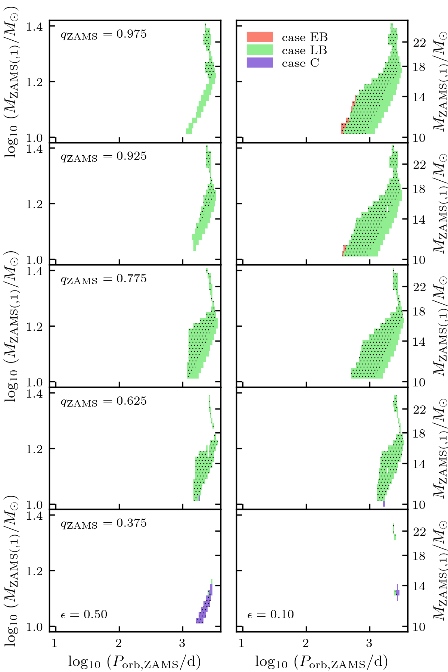
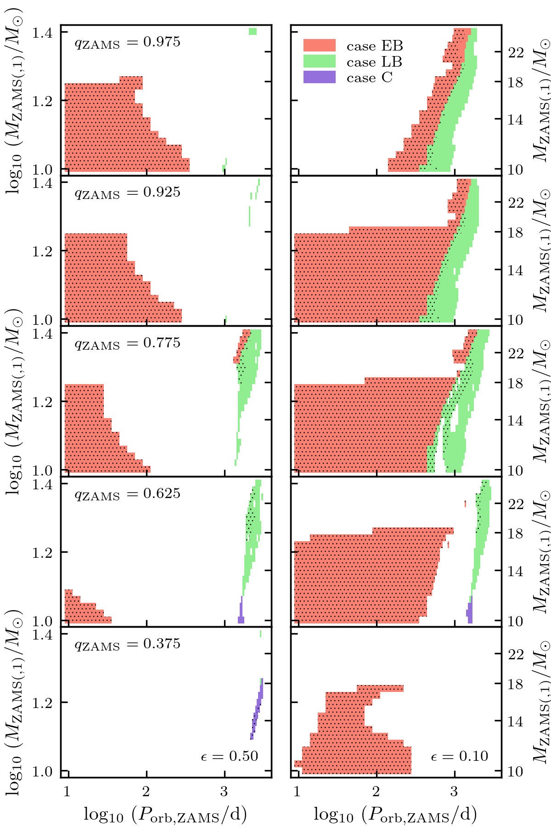
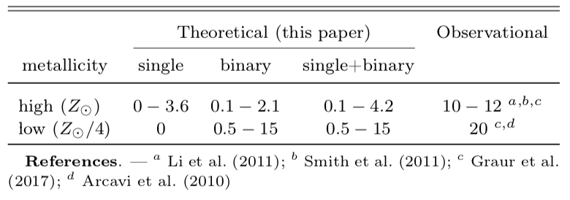
Type IIb SN PROGENITORS – Parameter Space AND RATES
Single
Z☉: 22-26M☉ Z☉/4: >50M☉*
Binary
Z☉
Z☉/4
* directly collapse
RATES
(1)
strong winds during the core helium burning successfully strip progenitor
(2)
contact
(1)
weak winds fail to complete stripping
Sravan et al., 2018
Can only account for half the IIbs at solar metallicity
Implied rates at low Z are good (need larger observational sample sizes to confirm)
Need
(1) Weaker winds at solar metallicity
AND
(2) low MT efficiency at all metallicites
Sravan et al., 2018
Notes:
Contact due to large MT rates later in HG; accretion occurs significantly faster than the thermal timescale of the secondary then the binary will enter contact.
All secs explode and none as IIb – lower limit, priors varied, all defs included
Low Z rates are lower limits as Case A not included

Slide 8
Type IIb SN PROGENITORS – STRUCTURE
Helium core constraints exclude single stars
No other strong constraint
Case EB
Sravan et al., in prep

Slide 9
Type IIb SN PROGENITORS – photometry
Current observations not particularly constraining
Blue SN IIb progenitors expected from rates
  If found at solar Z would indicate lower mass loss rates
Yellow/red companions predicted
Case EB
Sravan et al., in prep
Notes:
Although against high eps and low Z due to gap

Slide 10
Type IIb SN PROGENITORS – CSM
Mass loss rates mostly similar
Case EB not represented in current observations
  But need this population to account for rates
  Scope for eruptive mass loss
Case EB
(faster wind due to smaller radii)
Note: v_{wind} estimate is an upper limit
Sravan et al., in prep

Slide 11
Summary
We use a broad parameter space of single and binary star models to determine whether stellar winds or binary interactions dominate stripping of SN IIb progenitors
Stellar winds excluded as primary drivers from rates, constraints from light-curves (helium core mass), and photometry (luminosity/magnitude)
Binary interactions are likely primary drivers of stripping but require
  weak winds at solar metallicity
  highly inefficient MT at all metallicities
Population experiencing Case EB mass-transfer expected at all metallicities. Predicted properties:
  Blue progenitors along helium MS
  Eruptive mass loss 10-100 years before CC

