Slide 1
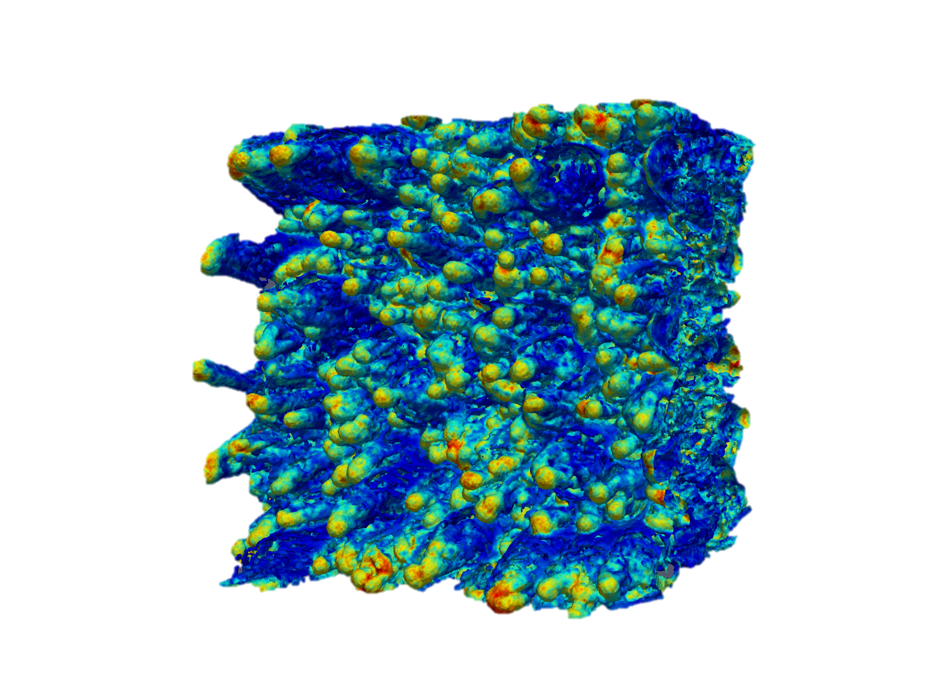
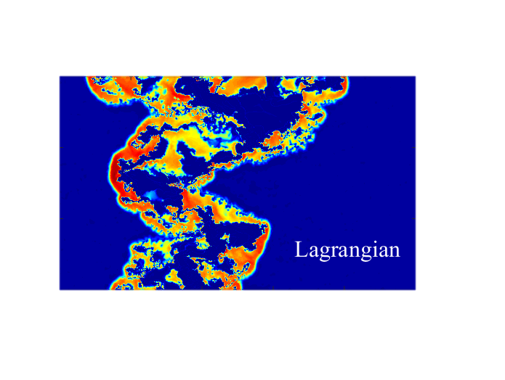
Radiative Shocks in Transient Astrophysical Events
Elad Steinberg & Brian Metzger
Columbia University
Midwest Workshop on Supernovae
and Transients
https://arxiv.org/abs/1805.03223

Slide 2
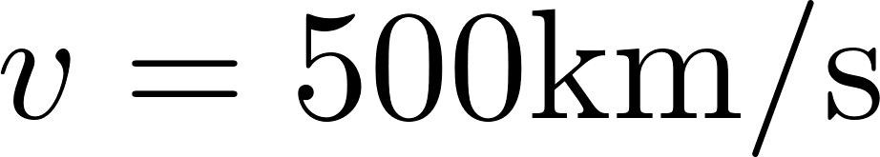

What are radiative shocks?
Head on shocks give rise to a temperature
Gas cools via line emission or free-free.
Radiative shocks:
Radiative
Adiabatic

Slide 3
Radiative Shocks are common
Type IIn Sne (e.g. Smith & McCray 2007; Chevalier & Irwin 2011). High luminosities explained by shocks.
Classical Nova (e.g. Mukai & Ishida 2001; Metzger et al 2014; Martin et al 2017).
Merger of binary stars (e.g. Metzger & Pejcha 2017; Pejcha et al 2017).
Colliding wind binaries (Pittard et al 2005, Lamberts et al 2011).
Li et al 2017
Smith et al 2008

Slide 4
1D picture
Dense cold shell surrounded by hot forward and reverse shocks.
Efficient thermal X-rays.
Ion acceleration?
Metzger et al 2014, Vlasov et al 2016, Martin et al 2018.

Slide 5
Puzzling result from classical nova
Gamma ray emission from classical nova.
Most probably arising from ion acceleration (high efficiency and magnetic field required for leptonic scenario). Efficiency 0.005 inferred from ASASSN-16ma
Ackermann et al 2014, Franckowiak et al 2018.
However, Caprioli & Spitkovsky 2014 have shown that ion acceleration requires a magnetic field parallel to the shock normal, unexpected for expanding gas.

Slide 6

Thermal instability
NTSI
Stability criteria:
Vishniac 1994, McLeod & Whitworth 2013
Chevalier & Imamura 1982

Slide 7
2D/3D picture
Corrugated shock front gives rise to lower emission temperature but enables ion acceleration.
X-ray fraction
time
Steinberg & Metzger 2018
Kee et al 2014

Slide 8
Numerical difficulties
Numerical mixing of hot and cold gas artificially enhance the cooling rate of the hot gas phase (Parkin & Pittard 2010).
Solution:
Lagrangian Voronoi Moving Mesh (Yalinewich, Steinberg & Sari 2014, Steinberg & Metzger 2018).
X-ray luminosity
Parkin & Pittard 2010

Slide 9
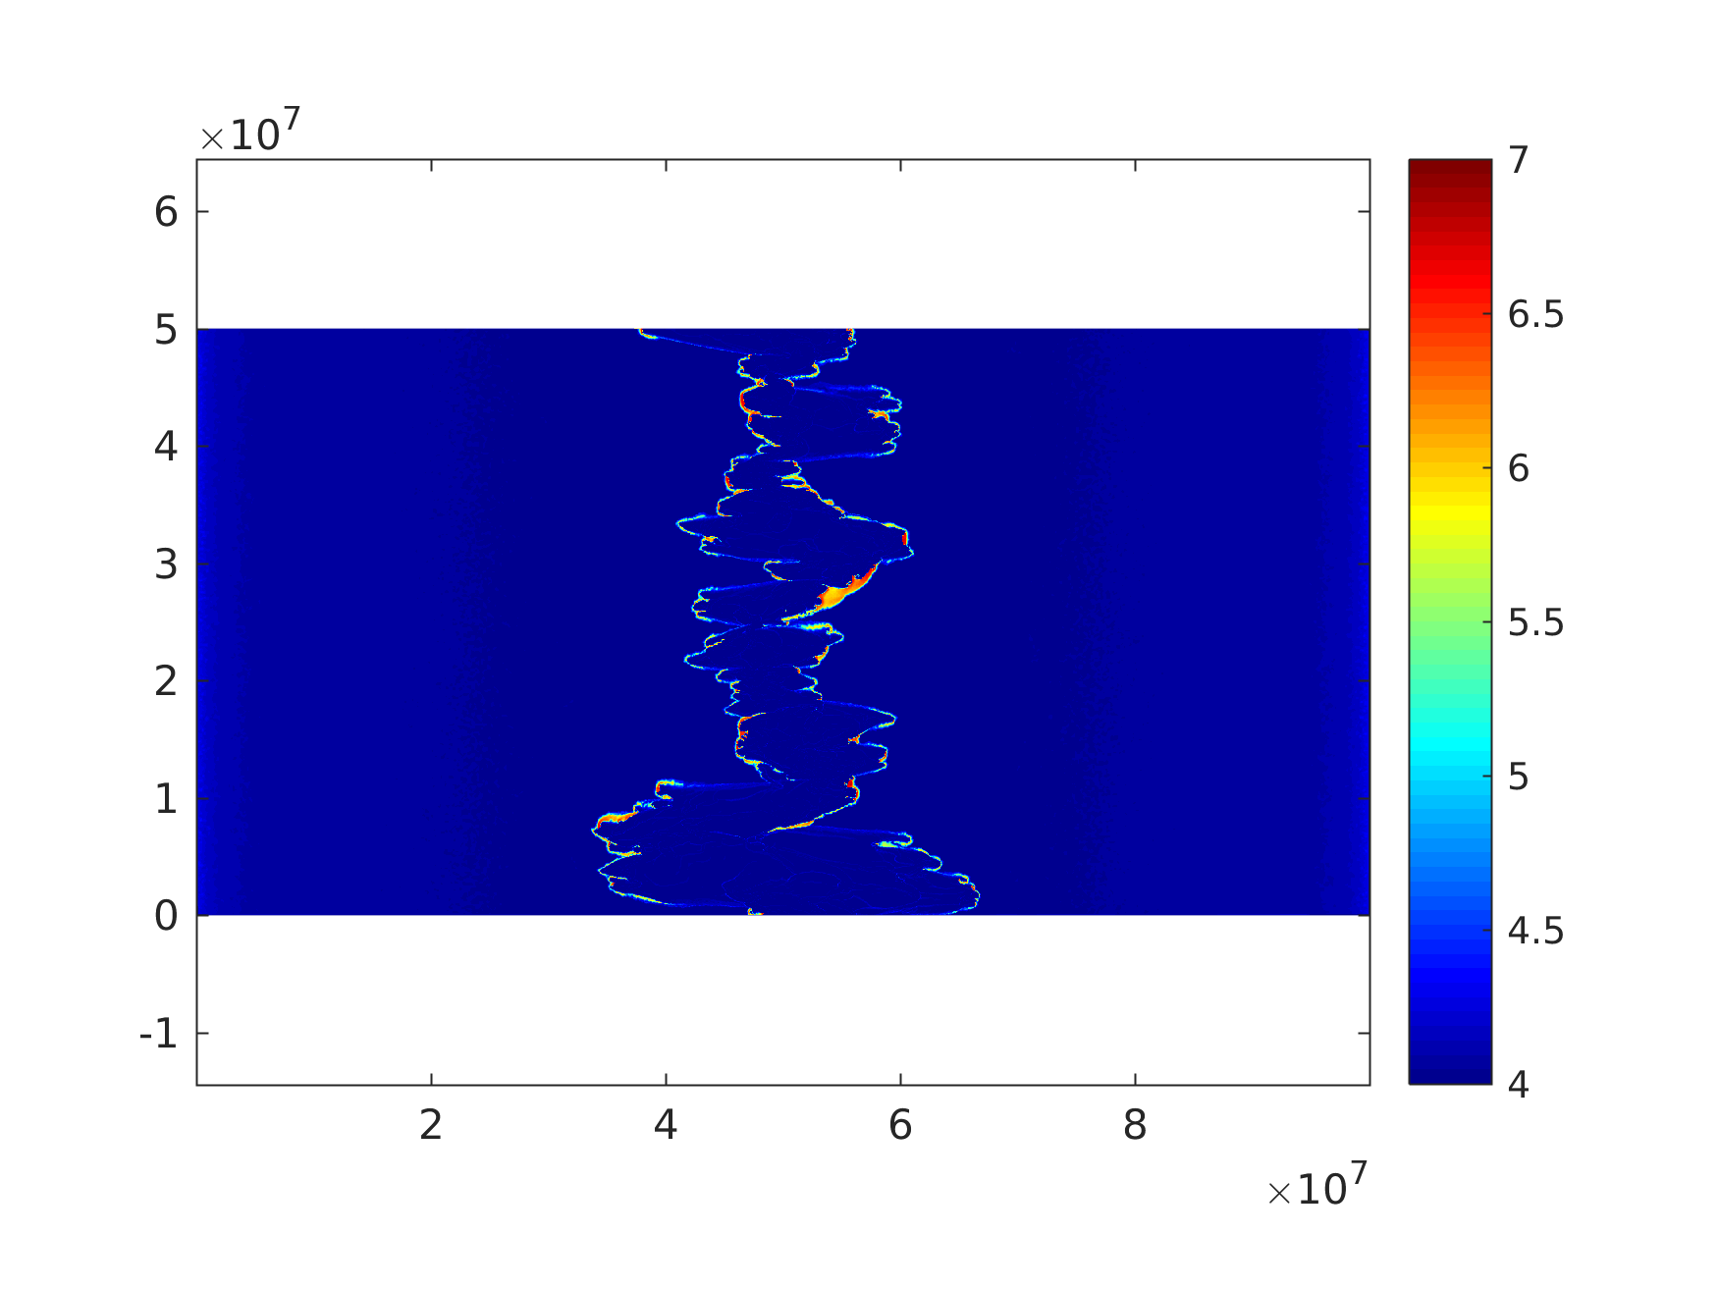
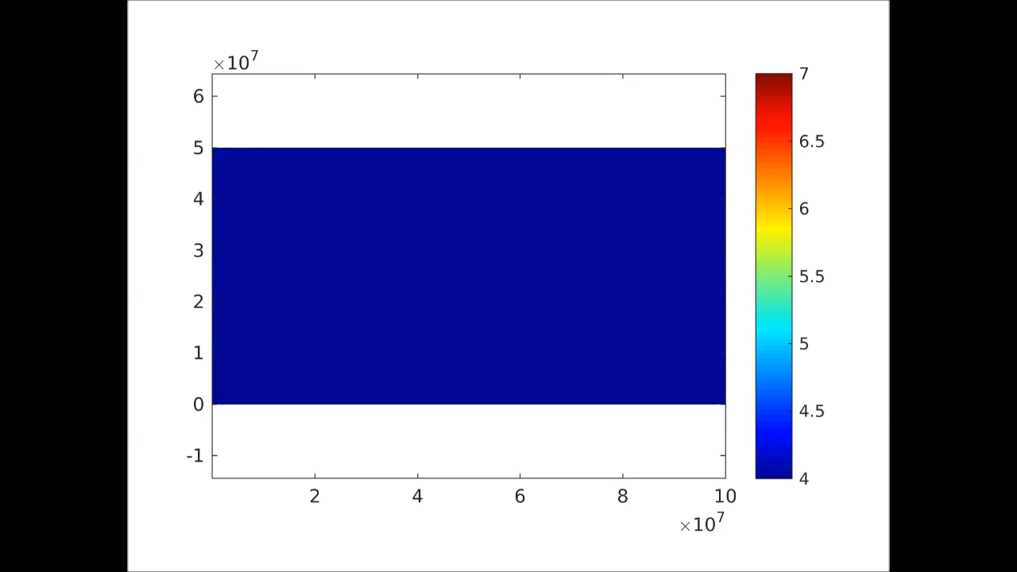
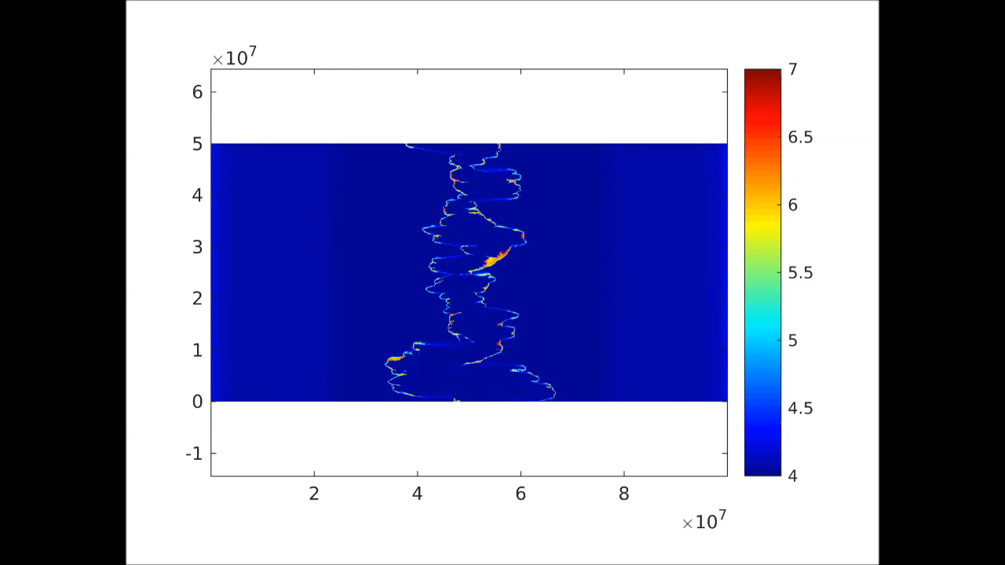
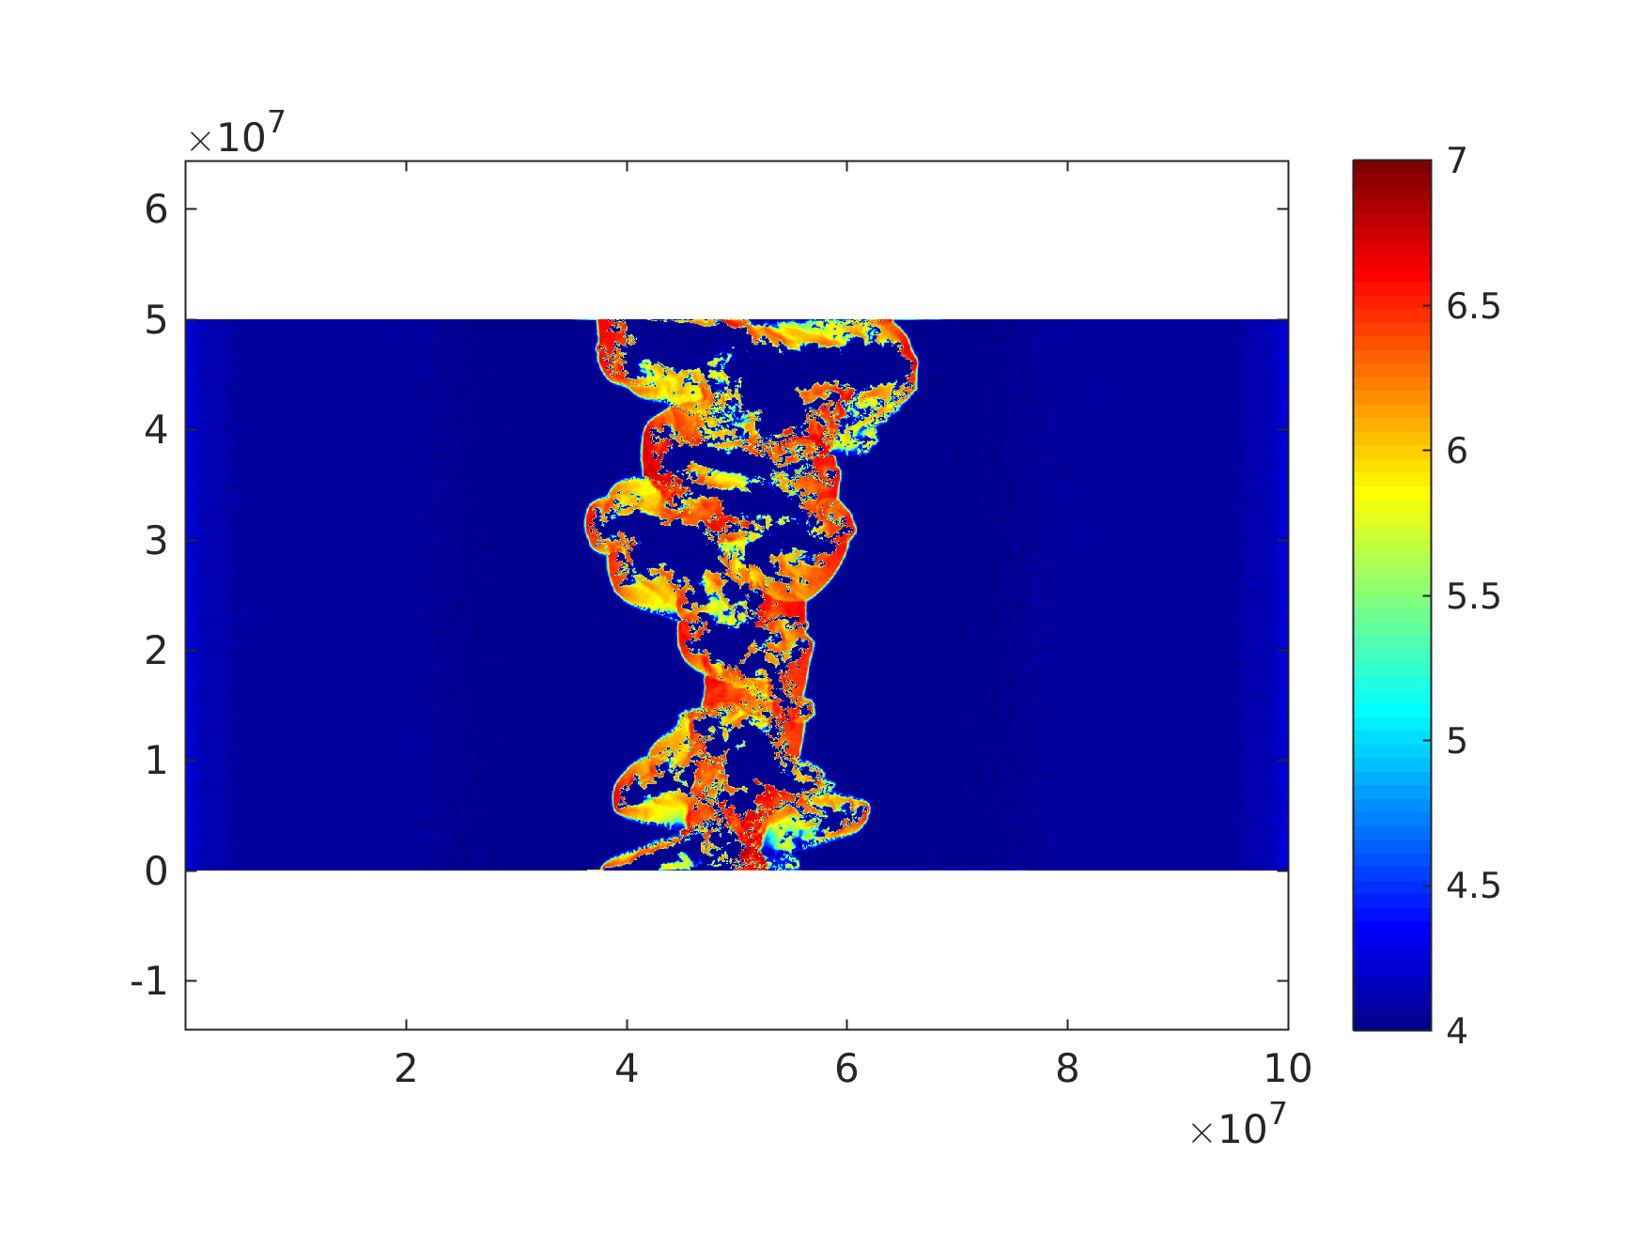
Temperature – v=500 km/s, cs=10 km/s
Lagrangian
Semi-Lagrangian

Slide 10
Results
Cold
Hot
Under Pressured
X-ray fraction
Cold
Hot
Mach
Under Pressured
Avg emitting temperature is reduced due to PdV work of hot gas on cold under pressured gas.

Slide 11
Implication for ion acceleration
Non-thermal ion acceleration efficiency
Corrugated shock structure allows efficient ion acceleration.

Slide 12
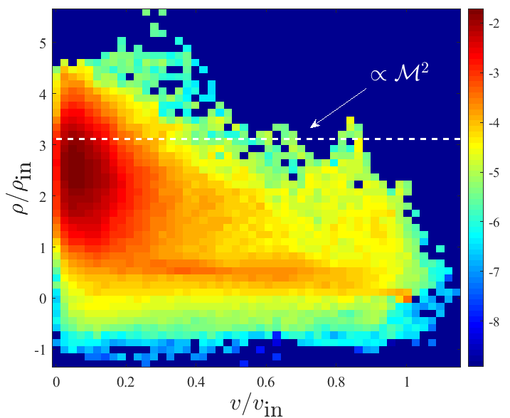
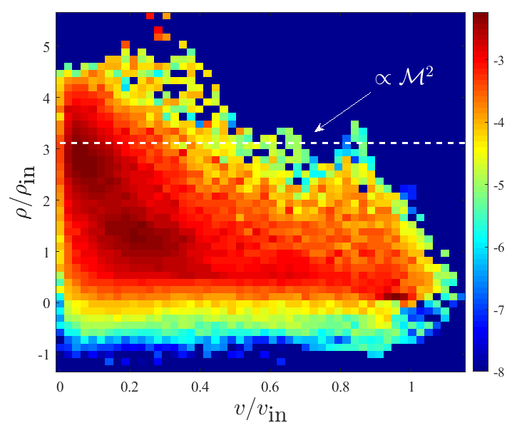
Thin Shell Gas Properties
Line widths
Dust formation
Mass weighted
Emission weighted

Slide 13

Conclusion
The novel Lagrangian Voronoi Moving Mesh method enables accurate simulations of radiative shocks.
Hydrodynamical instabilities corrugate the shock fronts.
Overpressure hot gas cools mainly by PdV work on cold gas, thus reducing the average emitted temperature, factor of 100 for Mach 100.
The corrugated shock structure enables favorable inclinations between the shock front and the magnetic field, enabling ion acceleration, .

Slide 14
Backup movies

Slide 18


Slide 19
