Slide 1
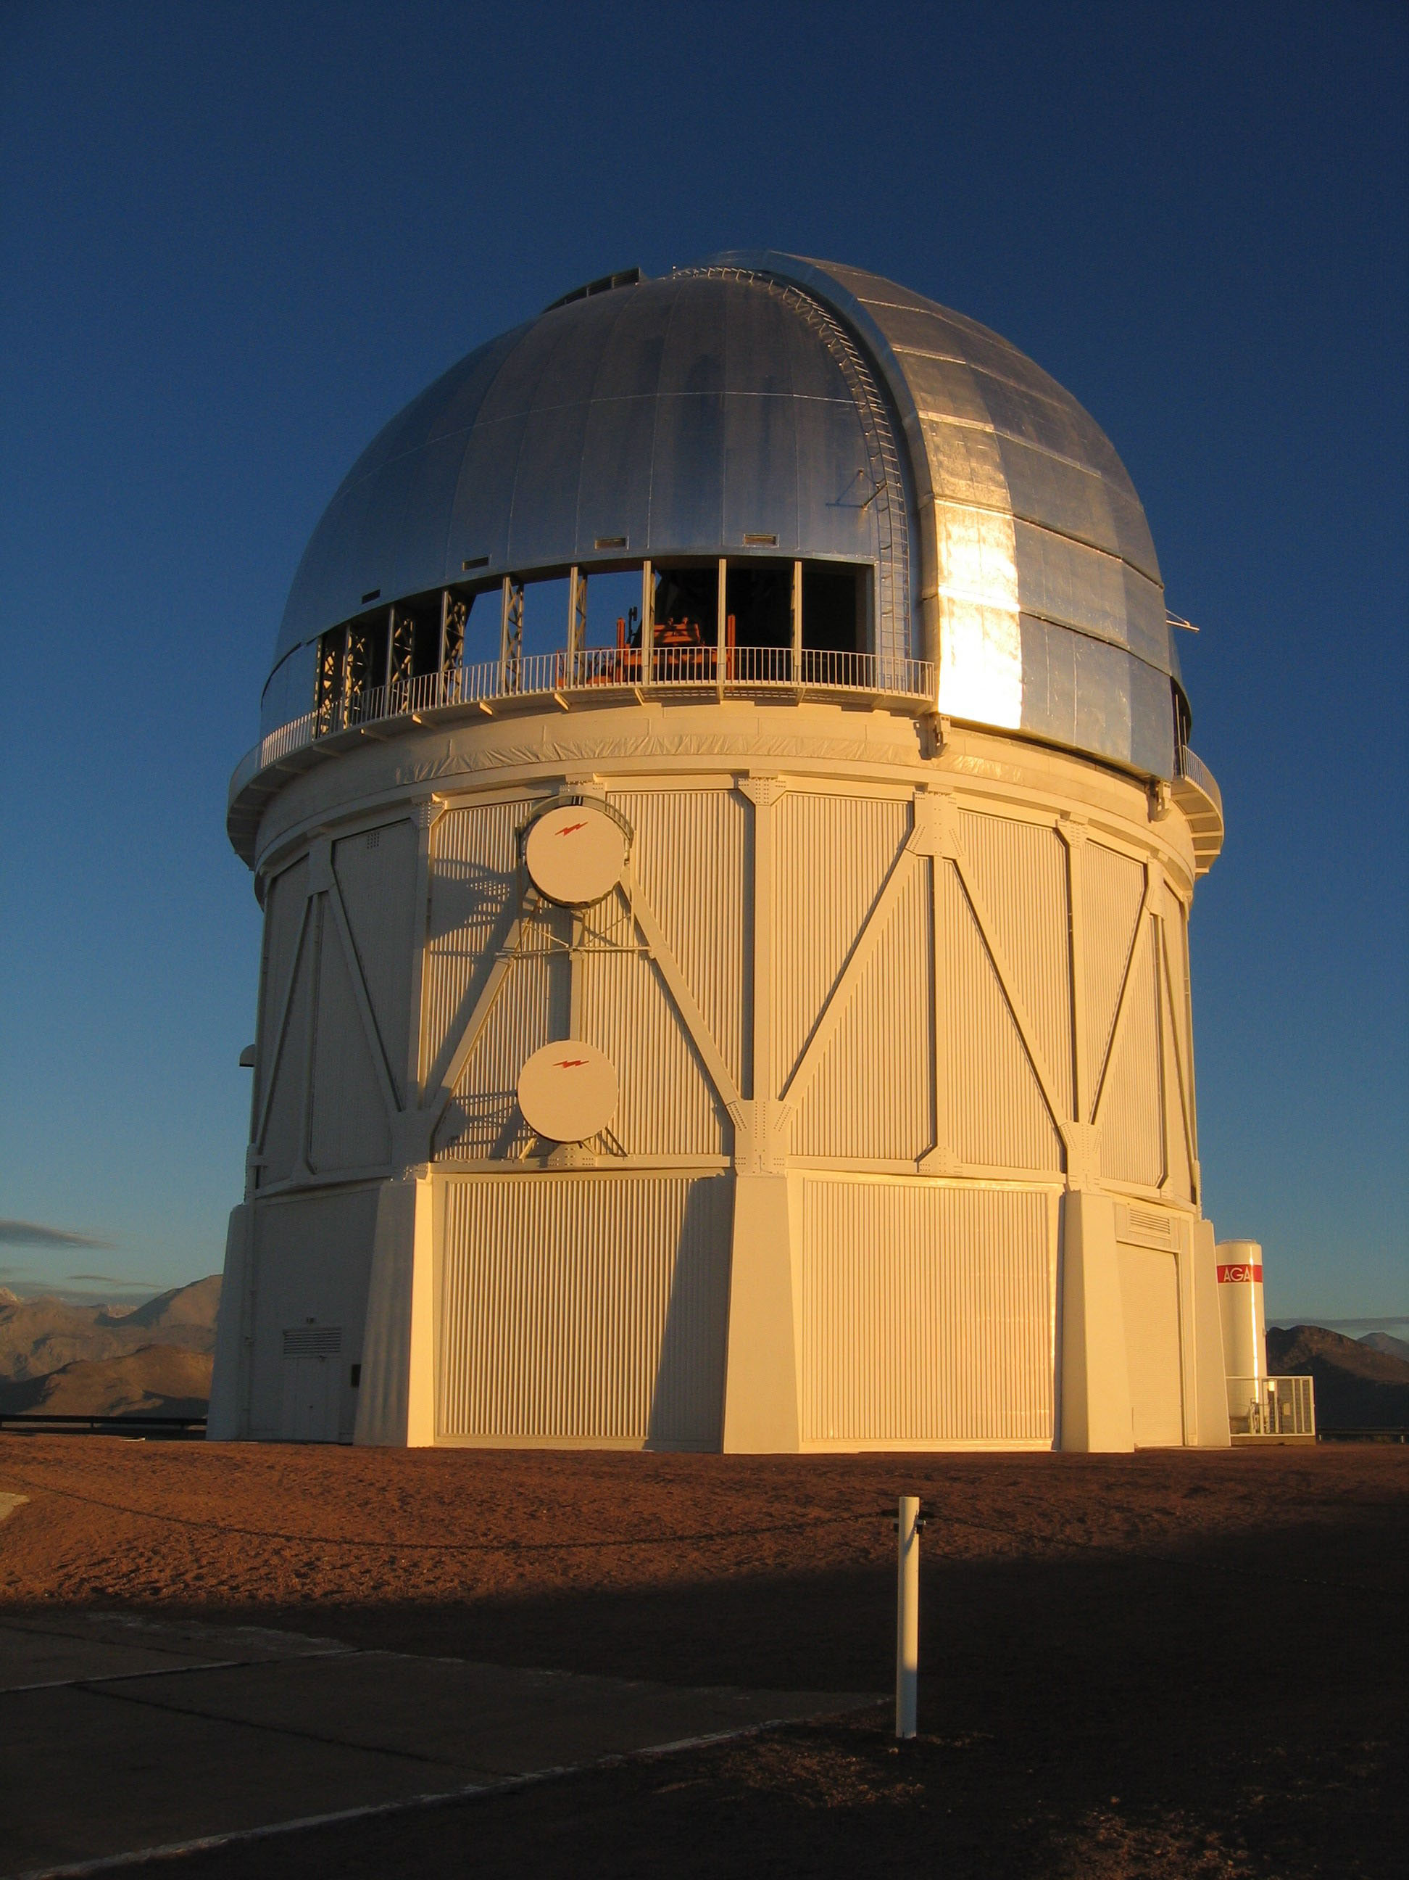
Southern Spectroscopic Survey Instrument: Programmatics
Josh Frieman, Fermilab & U. Chicago Jeff Newman, U. Pittsburgh/PITT PACC

Slide 2
Context
2015: NSF-commissioned NRC “A Strategy to Optimize the US Optical and Infrared System in the Era of LSST” (Elmegreen report) recommended wide-field, highly multiplexed spectroscopy on intermediate-to-large aperture telescope in the southern hemisphere.
2016: DOE-commissioned “Cosmic Visions Dark Energy” (Dodelson report) identified a Southern Spectroscopic Survey facility as enhancing LSST science and one of several possible projects that could go beyond Stage IV DE experiments.
2016: NOAO-Kavli-LSST community study “Maximizing Science in the Era of LSST” report due out soon, will recommend wide-field, highly multiplexed optical spectroscopy on 8m+ telescope preferably in southern hemisphere.

Slide 3
A Few Observations
Close coupling of photometric and WF spectroscopic surveys pays enormous scientific dividends: SDSS, DES/OzDES, KiDS/2dFLens, HSC/PFS, SDSS+DeCALS+DES/DESI,…, LSST/???
LSST is a fast, deep, wide survey. Spectroscopic resources are/will be in place for fast & deep spectroscopic follow-up.
Tremendous amount of (cosmic) science would be enabled by wide, multi-mega to giga-target spectroscopy of LSST objects: 3D map of ½ the sky. Follow CMB to the cosmic variance limit.
In general, for efficient (i.e., time-limited) multi-object surveys, need spectroscopic aperture ≥ photometric aperture (thousands vs few photons at mag limit for medium-res spectroscopy).
What follows are unendorsed personal views, and some numbers are at best educated guesses.

Slide 4
Programmatics
Explore constrained, multi-dimensional trade space of:
Telescope+instrument desiderata/design
• aperture, #fibers, λ range and resolution, FOV
Cost
Costs for fiber-fed (prime-focus) spectrographs primarily driven by fibers/positioners and spectrographs—relatively weak scaling with telescope aperture. DESI: 5000 fibers on 4m: ~$75M; PFS: 2400 fibers on 8m: ~$65M
Timescales (construction, operation, funding)
Science capabilities/goals (previous talks)
Resource availability (may trump all others)
Partner/stakeholder interests (agencies, communities,
international)

Slide 5
Agency Issues
DOE is a mission-driven agency that builds & operates experiments with well-defined science goals and requirements. In our case, this means cosmic frontier science as (narrowly) described in the P5 report. It does not fund astronomy.
Traditionally, astronomers have built multi-purpose facilities/instruments that enable a broad mix of science programs.
Multiple funding/partnership models possible, e.g.,:
Time in exchange for instrument on existing telescope (e.g., DES)
More time in exchange for instrument + telescope operations costs (e.g., DESI)
Interagency or public-private partnership for new facility (e.g., LSST, SDSS)

Slide 6
Blanco telescope, Chile
Same telescope used for DES: 4m diameter, currently w/ 3 deg² FOV
Successful experience with DOE/NSF/NOAO partnership
Clone or move DESI: 5000x multiplexing, ~7 deg² FOV
~few M$ for move or ~60M$ for clone
DESpec: 5000x, 3 deg² FOV with existing corrector, interchangeable w/ DECam:
~40M$

Slide 7
Blanco telescope, Chile
Pros:
Largest field of view w/ DESI move or clone
Moving DESI cheapest option for an SSSI; mid-2020s possible
Cons:
Small aperture requires long survey times
Earthquake safety of DESI corrector?
Kavli/NOAO/LSST report will recommend DECam stay on Blanco at minimum 3 years into LSST survey; would delay SSSI deployment unless DESpec option

Slide 8
Magellan telescope, Chile
Two 6.5 diameter telescopes
Potential f/3 secondary would match DESI input beam and enable 1.5-2 deg diameter field of view with 3000-6000 positioners
New secondary would cost ~$few M million, plus ~$75M+(?) for instrument
Magellan institutions with majority of time interested in partnership: successful model with SDSS4/APOGEE-South
SSSI instrument could form the basis of a SDSS6 survey; potential public/private partnership

Slide 9
Magellan telescope, Chile
Pros:
Larger collecting area
Existing telescope makes earlier schedule possible: mid-2020s?
Cons:
Would prefer even larger aperture, >8m (Kavli/NOAO/LSST)
If use an existing Magellan telescope, must navigate politics of Magellan institutions, time access likely limited.
Build a 3rd Magellan telescope for this? Add $75M+ and additional construction time.

Slide 10
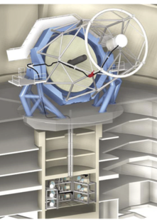
Gemini telescope, Chile
8m telescope, US(NSF)-led international consortium
Current FOV is small
With ~$50M upgrade, could get 1.5 deg FOV, plus ~$75M instrument: WFMOS redux.
Pros:
Larger collecting area; US-led
Cons:
Total cost >~$125M
Gemini-South desired lead role in LSST transient follow-up. Probably not available before late 2020s.
Gemini-North might be more available, but in wrong hemisphere.

Slide 11
Mayall Telescope, Arizona
4m diameter
Latitude 32N
Could use (possibly upgraded) DESI instrument from mid-2020s
Pros:
Enables SSSI science without new instrument
Cons:
Northern hemisphere, can access only ½ of LSST area
Very large amounts of time required to do SSSI program on 4m
Gets worse at the higher airmasses required to reach into LSST footprint from Kitt Peak

Slide 12
Telescopio San Pedro Mártir, Mexico
Magellan clone, 6.5m diameter
Latitude 30N
Might begin construction 2017 (finish FY23), funding decision imminent
$74M projected telescope budget, plus ~$75M+(?) for instrument
Pros:
Simpler politics than Magellan, enthusiasm of partners to host an SSSI-like instrument
Cons:
Northern hemisphere
Smaller than some other options
Not yet certain to be built, time access likely limited.

Slide 13
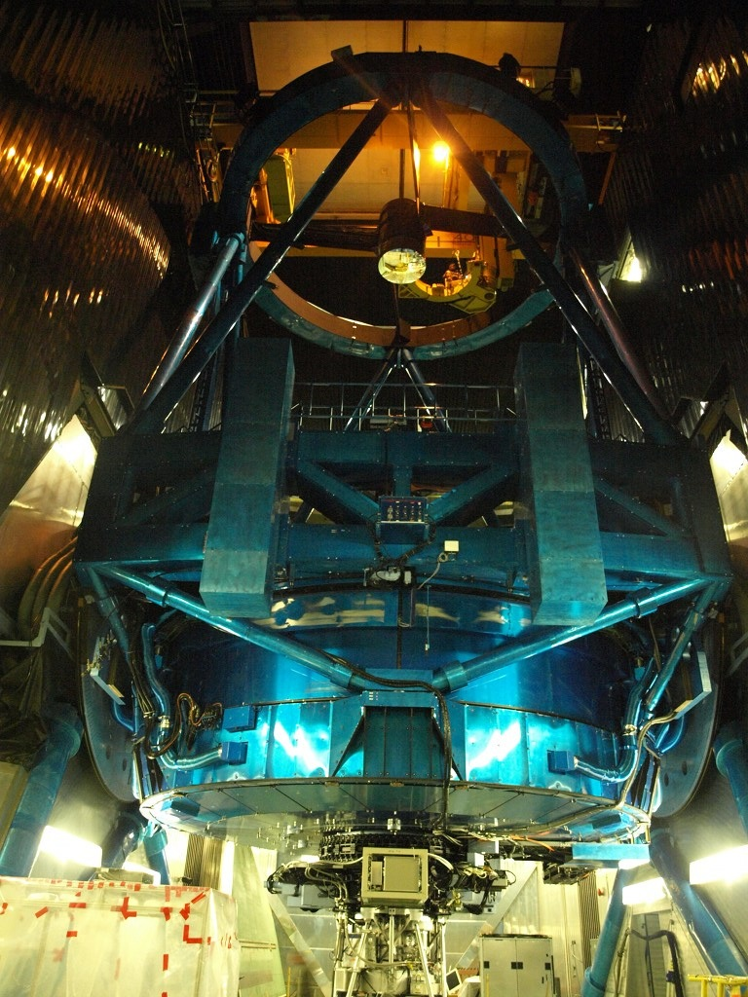
Subaru (+PFS spectrograph), Hawai'i
8m diameter, wide-field telescope
PFS spectrograph, 2400 fibers over 1.3 deg, under construction, commissioning to be completed 2019
Pros:
Enables SSSI without new instrument
Cons:
Northern hemisphere, but can access majority of LSST footprint
Limited time access: must compete with other Japanese priorities and potential time allocations for WFIRST
Subaru relatively expensive to build + operate

Slide 14
Keck (+FOBOS spectrograph), Hawai'i
10m diameter, narrower-field telescope
FOBOS: proposed 500-object spectrograph
Designed for high efficiency: could have comparable survey speeds to PFS
Pros:
Large telescope aperture
Could enable kinematic weak lensing via mini-IFUs
Cons:
Northern hemisphere, but accesses majority of LSST footprint
Very limited multiplexing and FOV
Limited time available: largest Keck programs to date have been ~100 nights

Slide 15
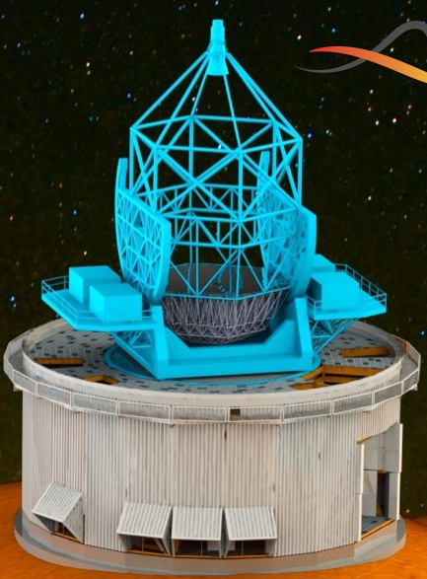
Mauna Kea Spectroscopic Explorer, Hawai'i
11m diameter telescope with 1.5 degree field of view, replacing CFHT
Designed solely for spectroscopy with an SSSI-like (3200-fiber) instrument
Pros:
Large aperture, wide field, very high survey speed
Enthusiastic about collaborating
Cons:
Northern hemisphere, but accesses majority of LSST footprint
Not yet funded; timescale?
Cost to join: $50 million (in-kind via instrument construction?)
Note: similar telescope concepts for South under ESO discussion.

Slide 16
New 8m WF Telescope in Chile
Strawman 8m+ telescope with >1.5 degree field of view
Designed ab initio for WF, highly multiplexed spectroscopy
Pros:
Large aperture, wide field, very high survey speed, access, LSST overlap
Cons:
Cost and timescale?

Slide 17
Budget scenarios
~$5-10M:
Upgrade DESI in North, or upgrade and move to South
~$40M:
DESpec on Blanco
~$75M+:
New instrument for existing or funded 6-10m telescope
Join existing or planned facility (PFS, MSE,…)
~$125-150M+:
New instrument on upgraded Gemini
~$250M+:
New instrument on new 8m+ in the south
Large uncertainties in the larger numbers, depending on design details, partnership arrangements, etc.
DES and DESI were/will be ~10 yrs from conception to survey start. LSST ~25 yrs. More ambitious projects will be on-sky well after mid-2020s.

Slide 18
Potential Partners
Astronomy community has identified SSSI-like instrument as a priority, but will want to enable non-cosmic science.
NASA could be interested in partnering for WFIRST photo-z training/calibration?
Private consortia with existing or to-be-built 6-10m telescopes may be interested in partnering for cash or instrument.
The international community also recognizes and is discussing the potential benefits for such a capability in the LSST era. International partnerships possible and may be necessary for larger-scale implementations of SSSI.

