Slide 1
Probing fundamental physics with CMB B-modes
Cora Dvorkin
IAS Harvard (Hubble fellow)
Status and Future of Inflationary Theory workshop
August 2014, KICP

Slide 2
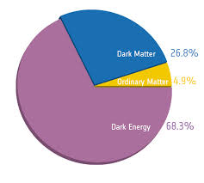
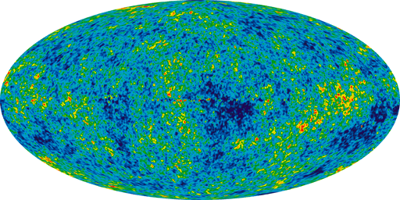
Standard Model of Cosmology (before March 2014)
Homogeneous background
Perturbations
Baryonic matter: 5%
Cold dark matter: 27%
Dark energy: 68%
Nearly scale-invariant
Gaussian

Slide 3
After March 2014 (BICEP2): Are there more parameters needed?
Homogeneous background
Perturbations
, r, n_{t}?
Baryonic matter: 5%
Cold dark matter: 27%
Dark energy: 68%
Nearly scale-invariant
Gaussian

Slide 4
From Temperature Anisotropies to Polarization
Polarization is generated
by Thomson scattering:
Local temperature quadrupole
Linear polarization
W. Hu & M.White

Slide 5
CMB polarization: E-B decomposition
Represent CMB polarization on the sky by a traceless symmetric tensor
E-mode: “curl-free” field
B-mode: “divergence-free” field
This is the analog of the gradient/curl decomposition of a vector field

Slide 6
Generation of B-modes
Polarization is a spin-2 field:
• Scalar sources + linear evolution E-modes
• Tensor sources or non-linear evolution B-modes

Slide 7
CMB power spectra

Slide 8
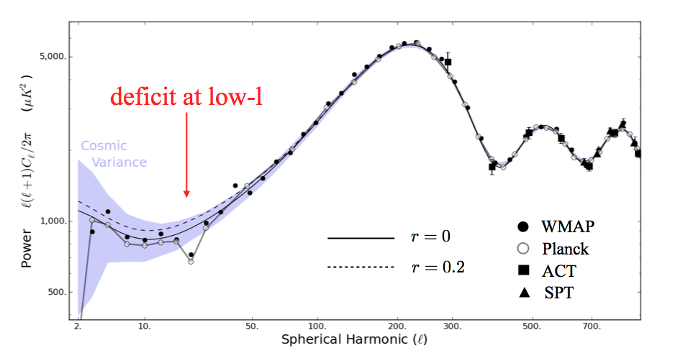
Planck/BICEP2 tension
If the BICEP2 signal is confirmed, it produces an excess in the
temperature spectrum that is not observed (r<0.11 at the 95% CL).
K. M. Smith, C. Dvorkin, L. Boyle, N. Turok, M. Halpern, G. Hinshaw, B. Gold, PRL (2014)

Slide 9
Polarization Predictions
(matching tensor excess in E-modes)
K. M. Smith, C. Dvorkin, L. Boyle, N. Turok, M. Halpern, G. Hinshaw, B. Gold, PRL (2014)

Slide 10
Polarization Predictions
K.M. Smith, C. Dvorkin, L. Boyle, N. Turok, M. Halpern, G. Hinshaw, B. Gold, PRL (2014)

Slide 11
Polarization Predictions
If the scalars are suppressed by a feature, we expect
a compensated signal in the E-modes as well.
V. Miranda, W. Hu, P. Adshead (2014)

Slide 12
New physics in the matter
content of LCDM?

Slide 13
Neutrinos + r:
new concordance model?
• Adding neutrinos to the LCDM model relaxes the tension between temperature
and B-mode polarization data by allowing a change in the tilt, which suppresses
the excess in the temperature large-scale power.
nurLCDM
(Planck+WP+ACT/SPT)
rLCDM
C. Dvorkin, M. Wyman, D. Rudd, and W. Hu (2014)

Slide 14
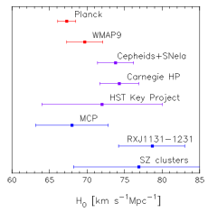
An old tension between
the CMB and local data
Planck paper XVI (2013)

Slide 15
Neutrinos + r:
new concordance model?
• A massive sterile neutrino of 0.5 eV suppresses structure and fixes H₀.
(Planck+WP+ACT/SPT+BICEP2)
C. Dvorkin, M. Wyman, D. Rudd, and W. Hu (2014)
Previously pointed out (without tensors) in M. Wyman, D. Rudd, A. Vanderveld and W. Hu (2013)

Slide 16
Neutrinos + r:
new concordance model?
• A massive sterile neutrino of 0.5 eV suppresses structure, fixes H₀
and the tensor excess.
(Planck+WP+ACT/SPT+BICEP2+H0+BAO+clusters)
(Planck+WP+ACT/SPT+BICEP2)
C. Dvorkin, M. Wyman, D. Rudd, and W. Hu (2014)

Slide 17
Neutrinos + r:
inflationary implications
• Nearly scale-invariant potentials are required in this scenario.
(Planck+WP+ACT/SPT+BICEP2+H0+BAO+clusters)
C. Dvorkin, M. Wyman, D. Rudd, and W. Hu (2014)

Slide 18
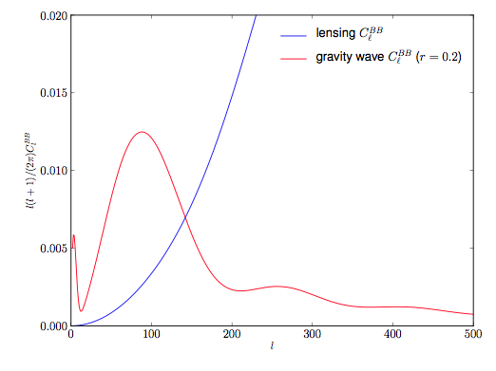
What’s next?
On CMB scales, the tensor power spectrum is predicted to be almost
a power-law in most models of inflation:
Cosmic variance limit for B-modes
( ) compares to
the prediction from the “single
field consistency relation”
for a value of r=0.2:

Slide 19
Delensing
Delensing is an algorithm that can statistically separate the lensing B-modes (non-Gaussian) from the tensor B-modes (Gaussian), lowering the effective lensing background.
L. Boyle, K. M. Smith, C. Dvorkin, N. Turok, submitted to PRL (2014)

Slide 20
Delensing
We might be able to distinguish the consistency relation from scale invariance
with a futuristic experiment such as the proposed “CMB Stage IV”.
L. Boyle, K. M. Smith, C. Dvorkin, N. Turok, submitted to PRL (2014)

Slide 21
Gravity waves in Large-Scale Structure
Gravitational waves also affect large-scale structure
observables.
Due to the entirely different foregrounds and systematics,
the cross correlation with the CMB provides a very clean
test of the primordial origin of the B-modes.
Can we use LSS observables to confirm or rule out a
primordial gravitational wave?

Slide 22
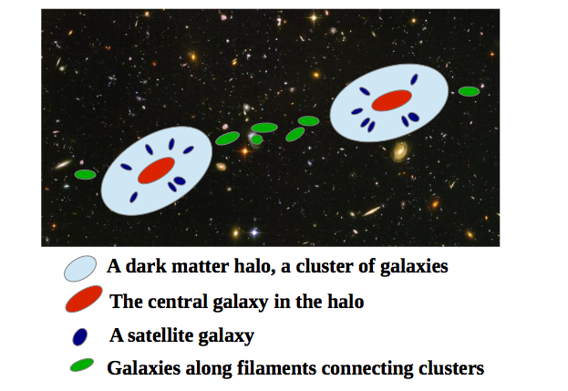
Intrinsic Alignments: the big picture
• Intrinsic Alignments: tidal fields (anisotropic gravitational potential)
tend to align galaxies.

Slide 23
Intrinsic Alignments
• Linear alignment model:
• Consistent with the observed alignments of LRG’s on large scales.
P. Catelan, M. Kamionkowski and R. Blandford, MNRAS (2001)
Observed galaxy-intrinsic ellipticity correlation:
(Measurements from
Okumura and Jing, 2009)
N.E. Chisari and C. Dvorkin, JCAP (2013)

Slide 24
Shear vs. Intrinsic Alignments
Tensor mode contribution to B-mode power spectrum (r=0.1)
N. E. Chisari, C. Dvorkin, and F. Schmidt, PRD (2014)
• Intrinsic Alignments dominate over the lensing signal.

Slide 25
Cross-correlating galaxy shapes
with CMB B-modes
Cross-correlation coefficient
N. E. Chisari, C. Dvorkin, and F. Schmidt, PRD (2014)
[S. Dodelson (2010) previously studied the correlation between shear produced by lensing and
the CMB B-modes.]
• Only very large-scale modes contribute to the cross-correlation due to the
significant separation between the reionization surface and the source
galaxies at z ≤ 2.

Slide 26
Can we confirm or rule out the detection of gravitational waves from inflation using galaxy shapes?
ruling out r=0 with
“CMB Stage IV”
ruling out r=0 with
10x(CMB noise)
detecting shear B-mode
auto-power spectrum
ruling out foregrounds
N. E. Chisari, C. Dvorkin, and F. Schmidt, PRD (2014)

Slide 27
Conclusions
• Planck will soon release its polarization data, from which we expect to
have a better understanding of foregrounds.
• If the tensor-to-scalar ratio is still large:
• Planck should provide a conclusive test through its E-mode
polarization data.
• Planck/BICEP2 tension between temperature data and tensors can
be alleviated with an extra relativistic species.
• Many more experiments will measure CMB B-modes soon (BICEP3/Keck
array, Planck, SPTpol, POLARBEAR, ACTpol, SPIDER, CLASS, EBEX, ABS).
We may be able to measure the inflationary consistency relation with a
more futuristic experiment such as the proposed “CMB Stage IV”
using delensing algorithms.
• Future weak lensing surveys should be able to detect the cross-
correlation between CMB B-modes and galaxy shapes.

Slide 28
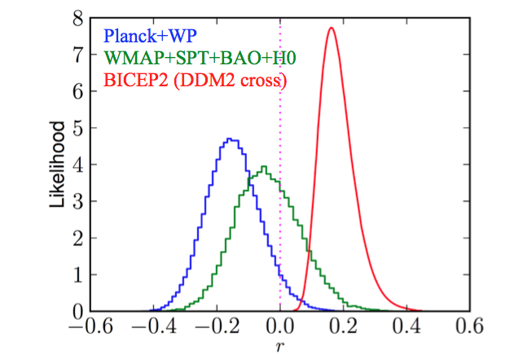
Planck/BICEP2 tension
K. M. Smith, C. Dvorkin, L. Boyle, N. Turok, M. Halpern, G. Hinshaw, B. Gold, PRL (2014)
Negative r does not make sense physically but it is a way of parameterizing
TT power deficit without making a posteriori choice of l-weighting.

Slide 29
New concordance model and BBN
C. Dvorkin, M. Wyman, D. Rudd, and W. Hu (2014)

