Slide 1


Phenomenology of beyond Horndeski theories
Kazuya Koyama University of Portsmouth

Slide 2
Job opening at University of Portsmouth
Dennis Sciama fellowship (three years)
Three year postdoc position on “Cosmological tests of Gravity”
Deadline 18 December 2015
Contact me Kazuya.Koyama@port.ac.uk for details
Visit http://www.icg.port.ac.uk/

Slide 3
Recent progress
Horndeski theory
the most general 2nd order scalar-tensor theory
Horndeski ‘74
Deffayet, Gao, Steer and Zahariade ’11; Kobayashi, Yamaguchi and Yokoyama ‘11

Slide 4


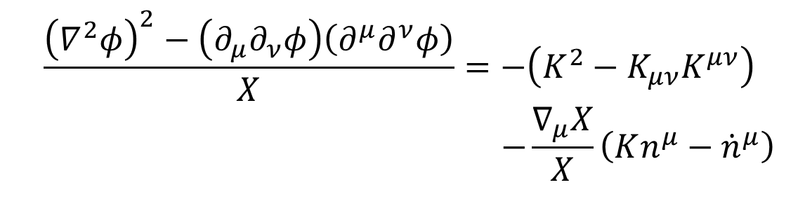


Horndeski in the unitary gauge
Gleyzes, Langlois, Piazza, Vernizzi ‘14
$$L_{4}^{H}=G_{4}\left(φ,X\right)R−2G_{4X}(φ,X)\left[{\left(∇^{2}φ\right)}^{2}−\left(∂_{μ}∂_{ν}φ\right)\left(∂^{μ}∂^{ν}φ\right)\right]$$
Unitary gauge
This terms is problematic as this includes
$φ=φ(t)$ ${ds}^{2}=−N^{2}{dt}^{2}+h_{ij}\left({dx}^{i}+N^{i}dt \right)\left({dx}^{j}+N^{j}dt \right)$
$$n^{μ}=−\frac{∂_{μ}φ}{\sqrt{−X}}$$
$$\dot{N}{\dot{h}}_{ij}$$

Slide 5
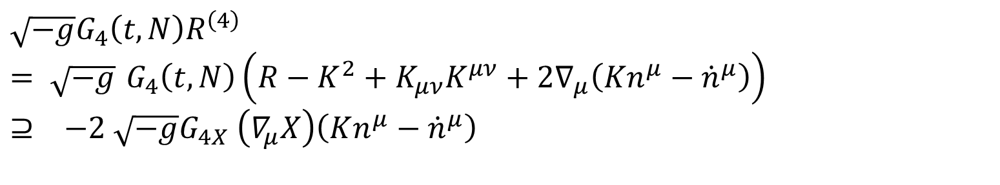
Counter term
Horndeski
Beyond Horndeski
$$\sqrt{−g}G_{4}\left(t,N\right)R^{\left(4\right)}$$
$= \sqrt{−g}$ $G_{4}\left(t,N\right)\left(R−K^{2}+K_{μν}K^{μν}+2∇_{μ}\left(Kn^{μ}−{\dot{n}}^{μ}\right)\right)$
$$⊇ −2 \sqrt{−g}G_{4X} \left(∇_{μ}X\right)\left(Kn^{μ}−{\dot{n}}^{μ}\right)$$
$$L_{4H}=G_{4}\left(φ,X\right)R−2G_{4X}(φ,X)\left[{\left(∇^{2}φ\right)}^{2}−\left(∂_{μ}∂_{ν}φ\right)\left(∂^{μ}∂^{ν}φ\right)\right]$$
$$\frac{2}{X^{2}}\left(∂^{μ}φ∂^{ν}φ∇_{μ}∂_{ν}φ∇^{2}φ−∂^{μ}φ∇_{μ}∂_{ν}φ∂_{λ}φ∇^{λ}∂^{ν}φ\right)=−\frac{\left(∇_{μ}X\right)\left(Kn^{μ}−{\dot{n}}^{μ}\right)}{X}$$

Slide 6
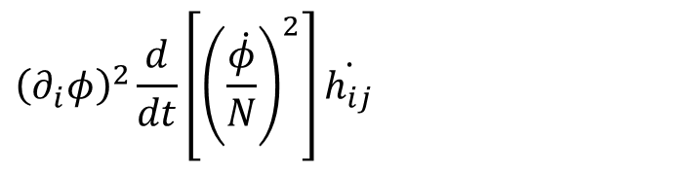
Beyond Horndeski
Remarks
  Away from unitary gauge
  e.o.m contain higher derivatives
  however, it has been shown that this does not lead to a ghost
  Decoupling limit in the Minkowski
  the same as Horndeski – differences appears around cosmological backgrounds
$$L_{4}^{BH}=−2\left(∂^{μ}ϕ∂^{ν}ϕ∇_{μ}∂_{ν}ϕ∇^{2}ϕ−∂^{μ}ϕ∇_{μ}∂_{ν}ϕ∂_{λ}ϕ∇^{λ}∂^{ν}ϕ\right)+X\left[{\left(∇^{2}φ\right)}^{2}−\left(∂_{μ}∂_{ν}φ\right)\left(∂^{μ}∂^{ν}φ\right)\right]$$
$${\left(∂_{i}φ\right)}^{2}\frac{d}{dt}\left[{\left(\frac{\dot{φ}}{N}\right)}^{2}\right]\dot{h_{ij}}$$
Deffayet, Esposito-Farese, Steer 1506.01974
KK, Niz, Tasinato ‘14
Gleyzes, Langlois, Piazza, Vernizzi ‘14

Slide 7

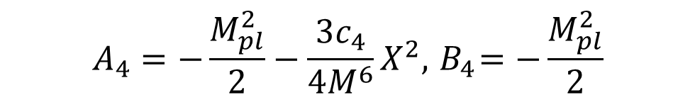
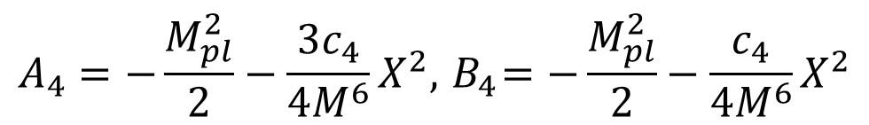
Covariant v Covariantised Galileon
Unitary gauge
  Horndeski
  covariant Galileon
  Beyond Horndeski
  covariantised Galileon
$$L_{4}=A_{4}\left(t,N\right)\left(K^{2}−K_{ij}K^{ij}\right)+B_{4}\left(t,N\right)R^{\left(3\right)}$$
$$A_{4}={−B}_{4}+2 X B_{4 X}$$
Deffayet, Epsosito-Farese, Vikram ‘09, Deffayet, Deser, Epsosito-Farese ‘09
$$A_{4}=−\frac{M_{pl}^{2}}{2}−\frac{3c_{4}}{4M^{6}}X^{2},{ B}_{4}=−\frac{M_{pl}^{2}}{2}−\frac{c_{4}}{4M^{6}}X^{2}$$
Gleyzes, Langlois, Piazza, Vernizzi ‘14
$$A_{4}=−\frac{M_{pl}^{2}}{2}−\frac{3c_{4}}{4M^{6}}X^{2},{ B}_{4}=−\frac{M_{pl}^{2}}{2}$$

Slide 8
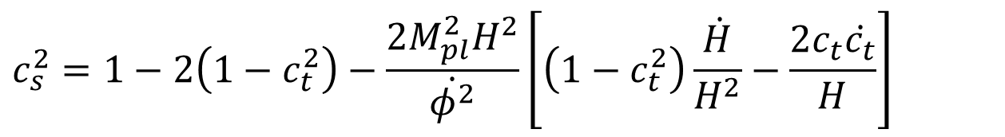


Toy model
De Felice, KK, Tsujikawa, 1503.06539
Quitessece in beyond Horndeski
Background
exactly the same as GR
Perturbations
tensor sound speed
scalar sound speed
$$L=−\frac{1}{2}X+V\left(φ\right)+L_{4}+L_{m}$$
$$L_{4}=A_{4}\left(K^{2}−K_{ij}K^{ij}\right)+B_{4}R^{\left(3\right)}$$
$$A_{4}=−\frac{1}{2}M_{pl}^{2}, B_{4}=\frac{1}{2}M_{pl}^{2} F\left(φ\right)$$
$$c_{t}^{2}=−\frac{B_{4}}{A_{4}}$$
$$c_{s}^{2}=1−2\left(1−c_{t}^{2}\right)−\frac{2M_{pl}^{2}H^{2}}{\dot{φ^{2}}}\left[\left(1−c_{t}^{2}\right)\frac{\dot{H}}{H^{2}}−\frac{2c_{t}\dot{c_{t}}}{H}\right]$$

Slide 9
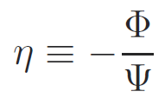

Tensor sound speed and anisotropic stress
Horndeski
matter domination
no restriction in beyond Horndeski
$$A_{4}={−B}_{4}+2 X B_{4 X}$$
$X B_{4 X}≪B_{4 } c_{t}^{2}=1$
It is possible to suppress the growth
Tsujikawa, 1505.02459

Slide 10


Non-linear interactions
Covariantised Galileon
Around cosmological background
Kobayashi, Watanabe and Yamauchi, 1411.4130
$$\sim$$
$$≫$$

Slide 11
Equations of motion
Kobayashi, Watanabe and Yamauchi, 1411.4130
KK, Sakstein 1502.06872
Equations of motion
Spherically symmetric solutions

Slide 12
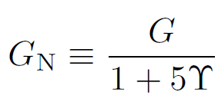
Breaking of Vainshtein mechanism
Kobayashi, Watanabe and Yamauchi, 1411.4130
KK, Sakstein 1502.06872
Second order equation
Vainshtein solutions
Vainshtein mechanism is broken inside matter source

Slide 13

Stellar structure
KK, Sakstein 1502.06872
Saito, Yamauchi, Mizuno, Gleyzes, Langlois 1503.01448
Hydrostatic equation
It is possible to weaken gravity
$$P=P_{gas}+P_{rad}=\left(1−β\right)P_{rad}$$
1 solar mass
0.3
0.2
0.1

Slide 14





HR diagram
KK, Sakstein 1502.06872
1 solar mass star
modified MESA code
Weak gravity raises the minimal mass for hydrogen burning . The observations of low mass M-dwarf stars could give a very strong constraint
Sakstein in preparation
GR

Slide 15
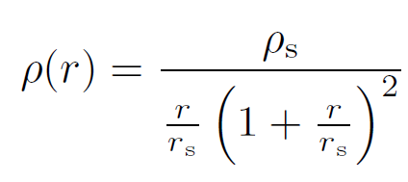

Dark matter halos
KK, Sakstein 1502.06872
NFW profile
Milyway-like dark matter halo $r_{s}=20 kpc ρ_{s}=6.68$
0.1
0.3
0.5
GR
0.3,
0.5
Rotation curve
Lensing potential/ gravitational potential

Slide 16
Cosmology
Covariant galileon
  Planck 2015 (+BAO+CMB lensing)
  requires massive neutrinos
  ISW cross correlation can excludes
  the models
Time dependent Newton constant
  For quartic/qunitc Galileon, the Vainshtein
  mechanism fails to suppress time dependent Newton constant
Covariantised galileon
  quintic galileon is unstable during MD era
Barreira et.al. 1406.0485
Kase and Tsujikawa 1407.0794

Slide 17

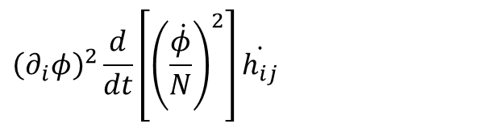
Some remarks
Non-linear structure formation
  The Vainshtein mechanism is broken inside matter distribution
Relativistic stars
  Neutron stars
Non-ghost
  Connection between Horndeski and beyond Horndeski
  the problematic term can be removed by a re-definition of variable
Gleyzes, Langlois, Piazza, Vernizzi ‘14

