Slide 1
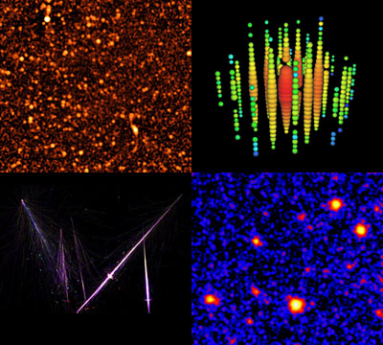

Combined
Energy Spectra of
Flux and Anisotropy
Identifying Anisotropic Source Populations of Gamma-rays or Neutrinos
High Energy Messengers: Connecting the Non-Thermal
Extragalactic Backgrounds
KICP Workshop June 9-11, 2014
Sheldon Campbell
The Ohio State University

Slide 2
Outline
Methods for identifying unresolved sources.
  Flux Spectrum
  Angular Power Spectrum
Combining Flux and Angular techniques for a spectral line search.
Some new discoveries presented here first.

Slide 3
How to Identify
Unresolved Sources of Radiation?
Spectral Analyses of Diffuse Radiation
  Flux Spectrum
    New features over the energy range of the unresolved sources.
    Constrains the source emission and mean number distribution.
  Angular Power Spectrum
    Additionally constrains the angular distribution of the sources.

Slide 4
Example: “Discovering” Dark Matter
Requires establishing a framework that accounts for:
  the astrophysical dark matter content.
  the dark matter particle properties.
  the dark matter clustering properties.
Dark matter “hint” features make good case studies.
These methods are applicable to any
anisotropy measurements and analyses
of the detection of “events”
from anisotropic sources.

Slide 5
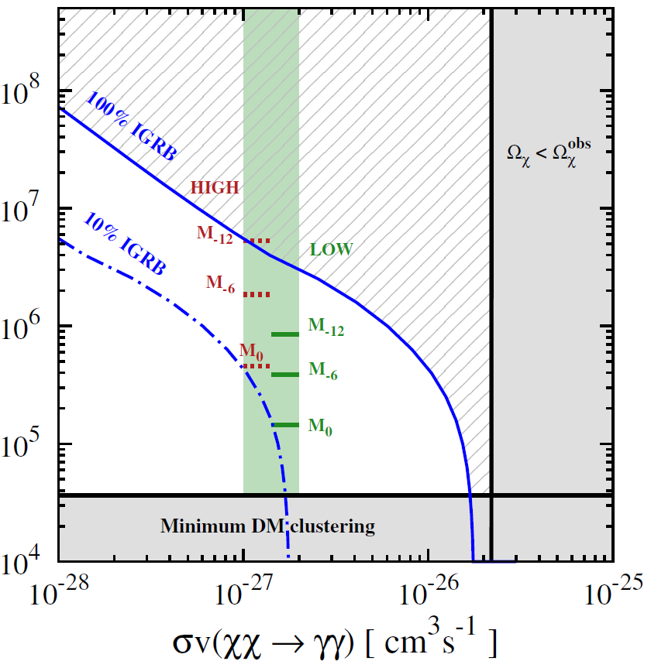
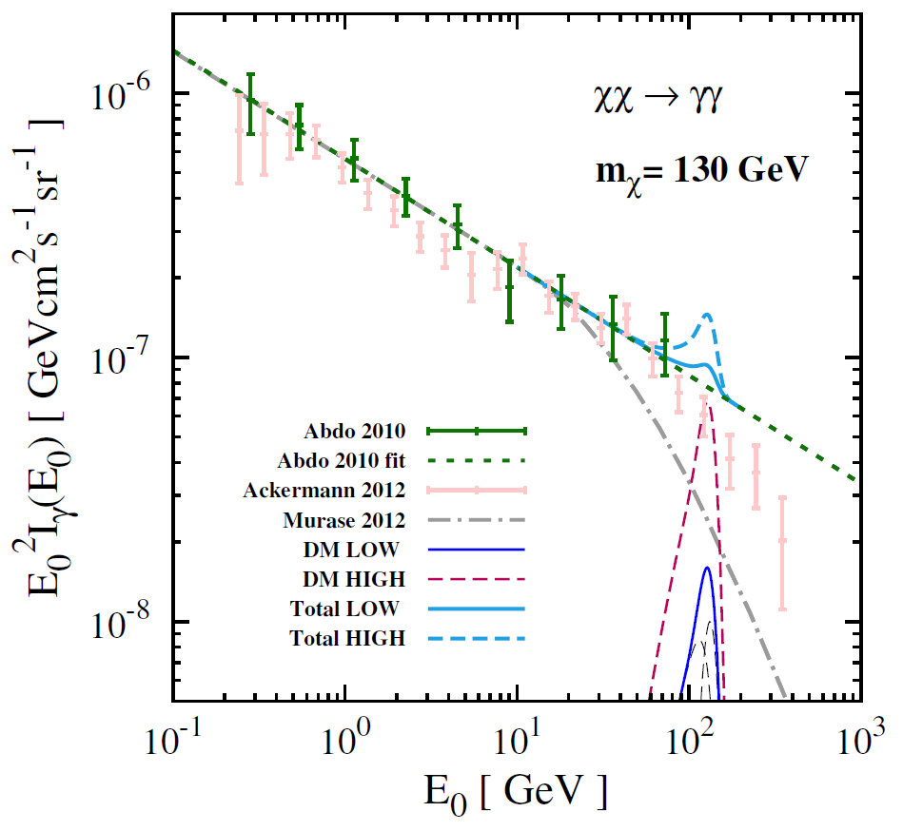
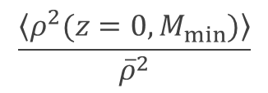
Flux Methodology: Spectral Line
$$\frac{\left\langle ρ^{2}(z=0,M_{min})\right\rangle }{{\overline{ρ}}^{2}}$$
Ng, Laha, SC, et al. (2014)
The lack of a 135 GeV line in the diffuse gamma-ray background for high substructure
content further strains the plausibility of a dark matter interpretation.

Slide 6
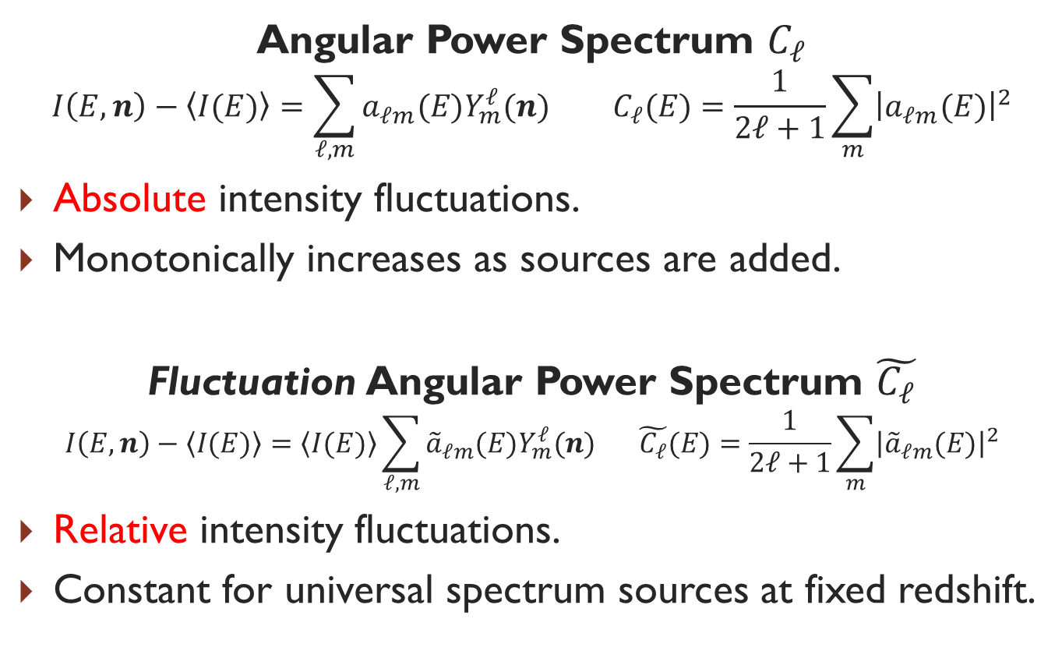
Complementary Approach: Anisotropies
Angular Power Spectrum $C_{ℓ}$
$$I\left(E,n\right)−\left\langle I(E)\right\rangle =\sum_{ℓ,m}{a_{ℓm}(E)Y_{m}^{ℓ}(n)} C_{ℓ}(E)=\frac{1}{2ℓ+1}\sum_{m}{{\left|a_{ℓm}(E)\right|}^{2}}$$
Absolute intensity fluctuations.
Monotonically increases as sources are added.
Fluctuation Angular Power Spectrum $\tilde{C_{ℓ}}$
$$I\left(E,n\right)−\left\langle I(E)\right\rangle =\left\langle I(E)\right\rangle \sum_{ℓ,m}{{\tilde{a}}_{ℓm}(E)Y_{m}^{ℓ}(n)} \tilde{C_{ℓ}}(E)=\frac{1}{2ℓ+1}\sum_{m}{{\left|{\tilde{a}}_{ℓm}(E)\right|}^{2}}$$
Relative intensity fluctuations.
Constant for universal spectrum sources at fixed redshift.

Slide 7
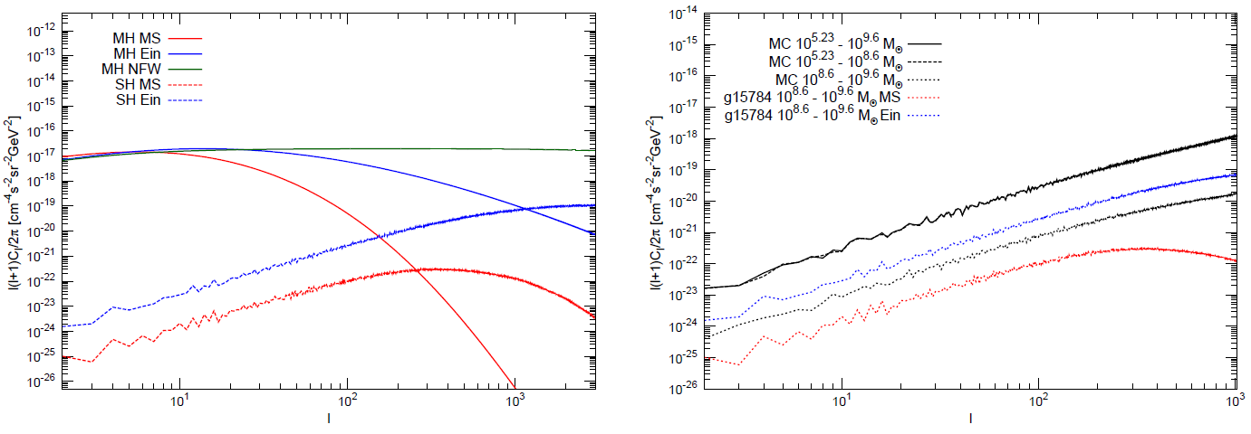

$\tilde{C }$is sensitive to DM clustering properties
Calore et al. (2014)
Sensitive to the density profile of the Galactic halo and subhalos (simulations).
Sensitive to the subhalo abundance and mass range (simulations).

Slide 8
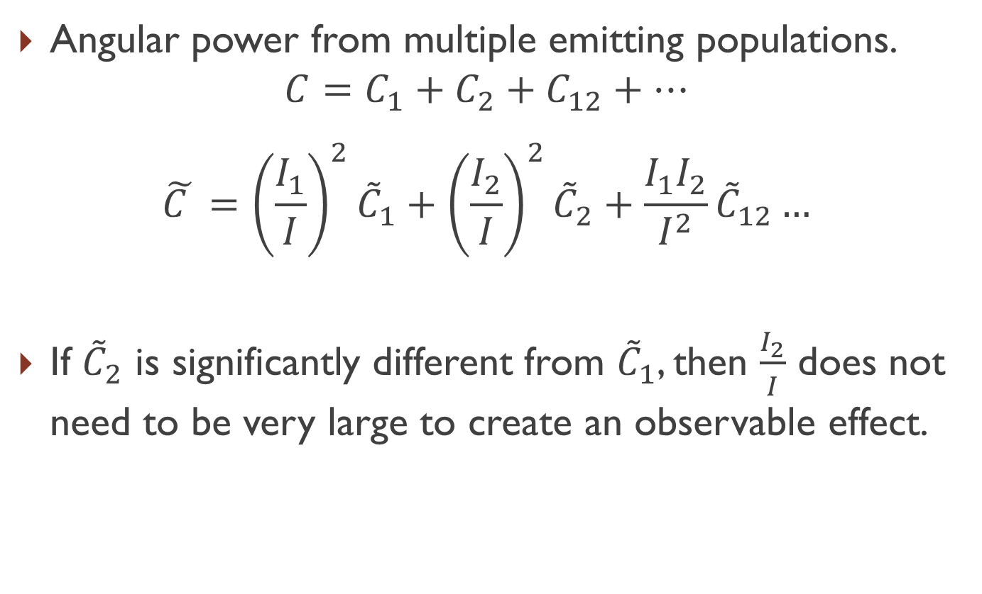
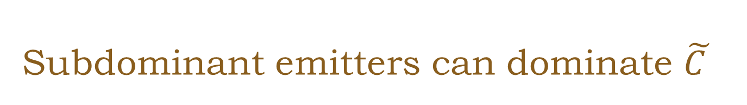
Subdominant emitters can dominate $\tilde{C }$
Angular power from multiple emitting populations.
$$C=C_{1}+C_{2}+C_{12}+…$$
$$\tilde{C }={\left(\frac{I_{1}}{I}\right)}^{2}{\tilde{C}}_{1}+{\left(\frac{I_{2}}{I}\right)}^{2}{\tilde{C}}_{2}+\frac{I_{1}I_{2}}{I^{2}}{\tilde{C}}_{12}…$$
If ${\tilde{C}}_{2}$ is significantly different from ${\tilde{C}}_{1}$, then $\frac{I_{2}}{I}$ does not need to be very large to create an observable effect.

Slide 9
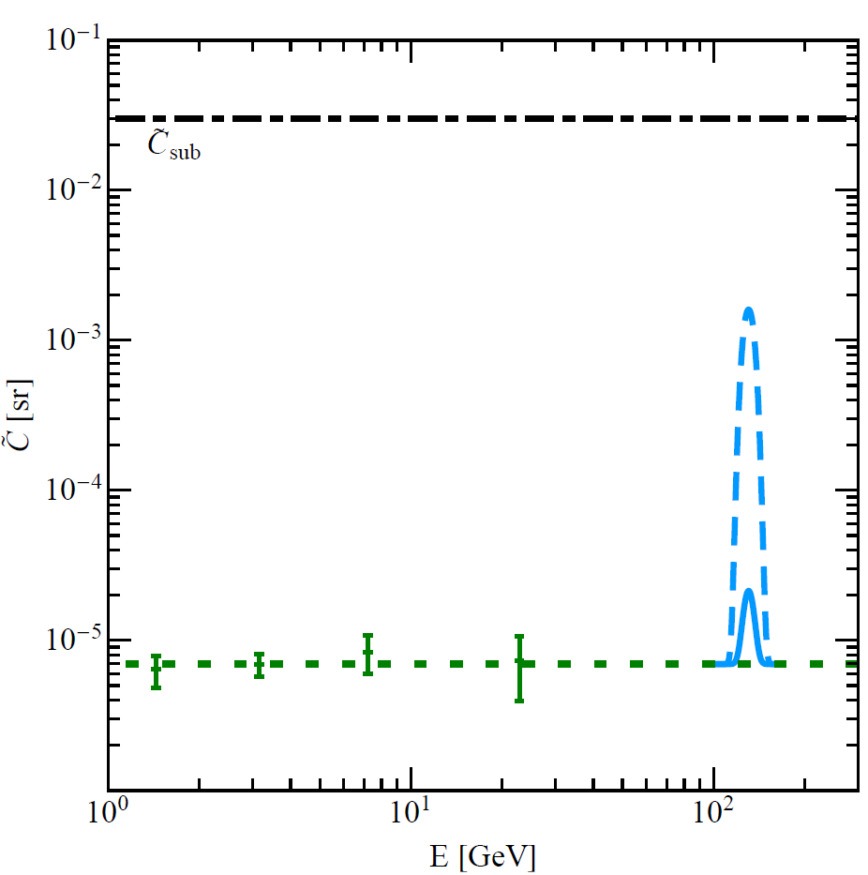
Anisotropy of a Spectral Line
SC, CETUP Proceedings (2014)

Slide 10
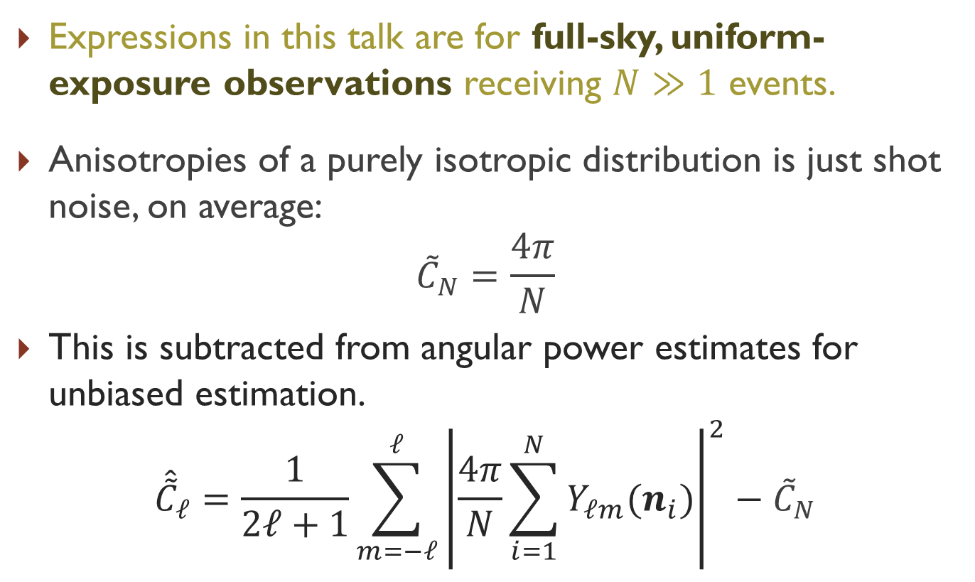
Unbiased Estimator of Angular Power
Expressions in this talk are for full-sky, uniform-exposure observations receiving $N≫1$ events.
Anisotropies of a purely isotropic distribution is just shot noise, on average:
$${\tilde{C}}_{N}=\frac{4π}{N}$$
This is subtracted from angular power estimates for unbiased estimation.
$${\hat{\tilde{C}}}_{ℓ}=\frac{1}{2ℓ+1}\sum_{m=−ℓ}^{ℓ}{{\left|\frac{4π}{N}\sum_{i=1}^{N}{Y_{ℓm}(n_{i})}\right|}^{2}}−{\tilde{C}}_{N}$$

Slide 11
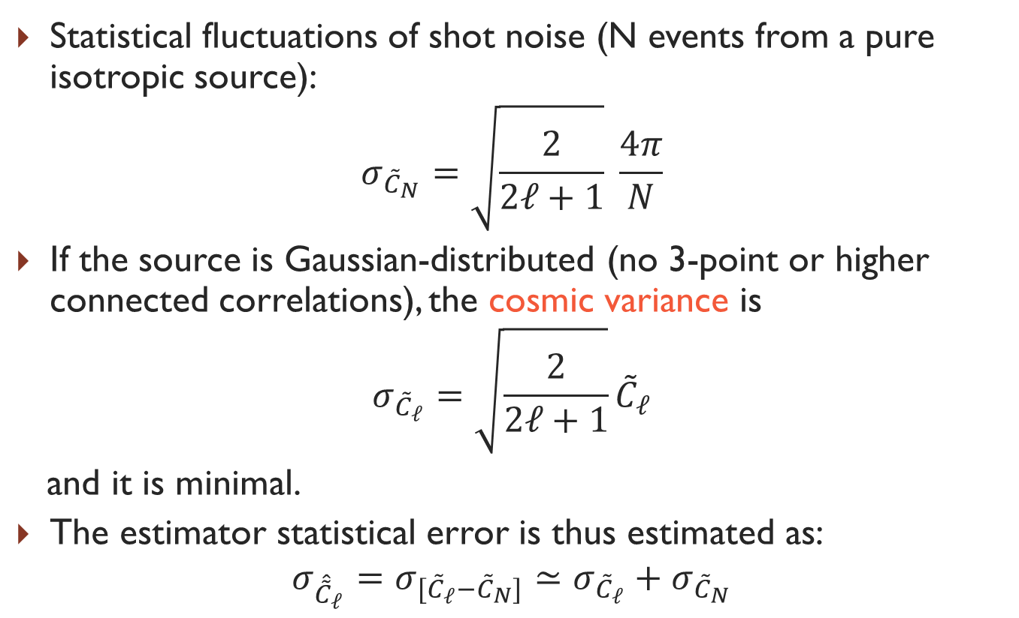
Usual Statistical Error Estimate
Statistical fluctuations of shot noise (N events from a pure isotropic source):
$$σ_{{\tilde{C}}_{N}}=\sqrt{\frac{2}{2ℓ+1}} \frac{4π}{N}$$
If the source is Gaussian-distributed (no 3-point or higher connected correlations), the cosmic variance is
$$σ_{{\tilde{C}}_{ℓ}}=\sqrt{\frac{2}{2ℓ+1}}{\tilde{C}}_{ℓ}$$
and it is minimal.
The estimator statistical error is thus estimated as:
$$σ_{{\hat{\tilde{C}}}_{ℓ}}=σ_{{[\tilde{C}}_{ℓ}−{\tilde{C}}_{N}]}≃σ_{{\tilde{C}}_{ℓ}}+σ_{{\tilde{C}}_{N}}$$

Slide 12
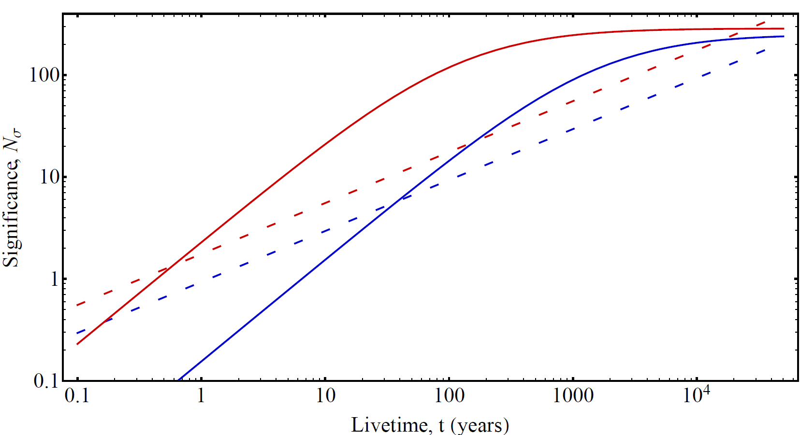
Event-Limited Experiments are
Shot-Dominated

Slide 13
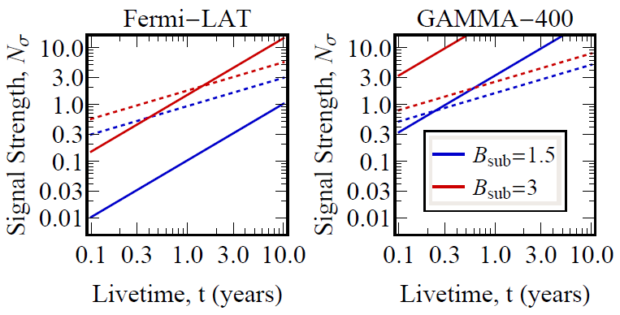
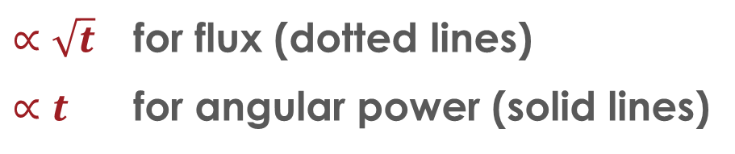

Growth of Signal Strength
E.g., A 135 GeV Line
Signal Strength = Signal / Measurement Uncertainty
SC, Beacom (2013)
$B_{sub}$ is the factor of
intensity boost over a smooth halo signal, due to galactic subhalos.
$∝\sqrt{t}$ for flux (dotted lines)
$∝t$ for angular power (solid lines)

Slide 14
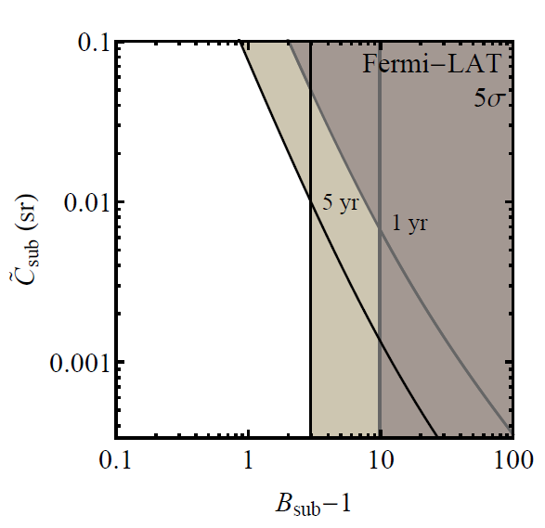
Complementary Flux/Anisotropy
130 GeV Line Search in the Diffuse Bkg.
The Fluctuation Angular Power Spectrum (Clustering) vs. Substructure Intensity Boost
SC, Beacom (2013)
This is the first
joint flux/anisotropy analysis
to constrain both the
intensity and angular distribution
of a spectral feature.
New research results modify this
anisotropy sensitivity.

Slide 15
Improving Our Understanding of the
Statistical Variance
Some conceptual difficulties with using the cosmic variance as we did.
  Cosmic variance is a theoretical error, which applies when making physical inferences about our models based on data.
  The angular power spectrum measurement should be able to be made independently of any model.
  We should not need to assume the signal is Gaussian-distributed.
Investigations have lead to a new formula for the model-independent statistical variance of the angular power spectrum of events from a background distribution.

Slide 16
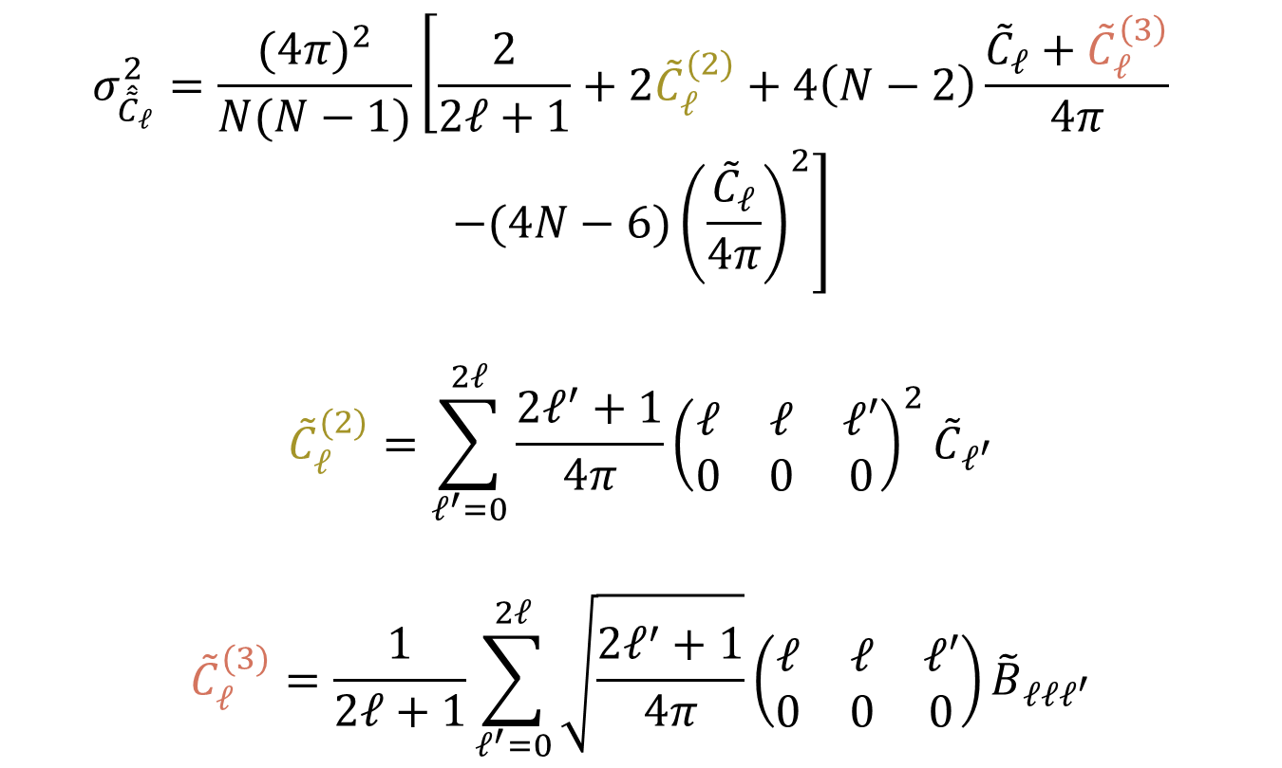

The Frequentists’ Statistical Uncertainty of ${\hat{\tilde{C}}}_{ℓ}$ (Preliminary)
$$σ_{{\hat{\tilde{C}}}_{ℓ}}^{2}=\frac{{(4π)}^{2}}{N(N−1)}\left[\frac{2}{2ℓ+1}+2{\tilde{C}}_{ℓ}^{(2)}+4\left(N−2\right)\frac{{\tilde{C}}_{ℓ}+{\tilde{C}}_{ℓ}^{\left(3\right)}}{4π} \right.$$
$$\left.−(4N−6){\left(\frac{{\tilde{C}}_{ℓ}}{4π}\right)}^{2}\right]$$
$${\tilde{C}}_{ℓ}^{(2)}=\sum_{ℓ^{′}=0}^{2ℓ}{\frac{2ℓ^{′}+1}{4π}{\left(\begin{matrix}ℓ & ℓ & ℓ′ \\ 0 & 0 & 0\end{matrix}\right)}^{2}{\tilde{C}}_{ℓ^{′}}}$$
$${\tilde{C}}_{ℓ}^{(3)}=\frac{1}{2ℓ+1}\sum_{ℓ^{′}=0}^{2ℓ}{\sqrt{\frac{2ℓ^{′}+1}{4π}}}\left(\begin{matrix}ℓ & ℓ & ℓ′ \\ 0 & 0 & 0\end{matrix}\right){\tilde{B}}_{ℓℓℓ^{′}}$$

Slide 17
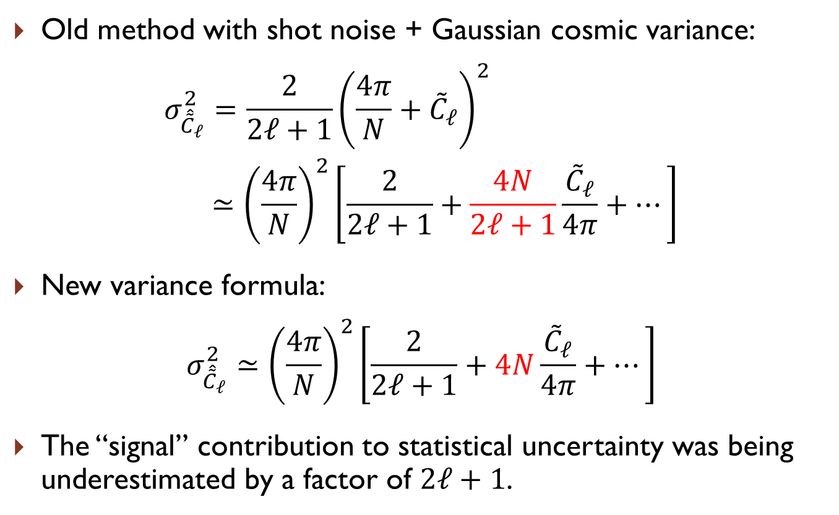
Compare to Gaussian Cosmic Variance
Old method with shot noise + Gaussian cosmic variance:
$$σ_{{\hat{\tilde{C}}}_{ℓ}}^{2}=\frac{2}{2ℓ+1}{\left(\frac{4π}{N}+{\tilde{C}}_{ℓ}\right)}^{2} \\ ≃{\left(\frac{4π}{N}\right)}^{2}\left[\frac{2}{2ℓ+1}+\frac{4N}{2ℓ+1}\frac{{\tilde{C}}_{ℓ}}{4π}+…\right]$$
New variance formula:
$$σ_{{\hat{\tilde{C}}}_{ℓ}}^{2}≃{\left(\frac{4π}{N}\right)}^{2}\left[\frac{2}{2ℓ+1}+4N\frac{{\tilde{C}}_{ℓ}}{4π}+…\right]$$
The “signal” contribution to statistical uncertainty was being underestimated by a factor of $2ℓ+1$.

Slide 18
Conclusions
Distinguishable components of astrophysical radiation may be separated through different emission features, or different spatial morphologies.
Combining both search techniques increases sensitivity to weak signals.
An corrected statistical variance of the angular power spectrum of events is presented. This is applicable to experiments of high energy gamma-rays, cosmic rays, neutrinos, and cosmological galaxy surveys.

Slide 19
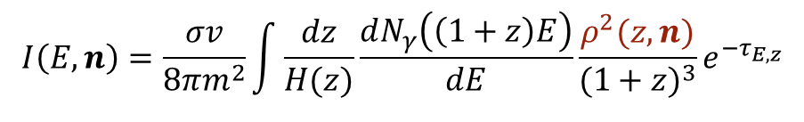
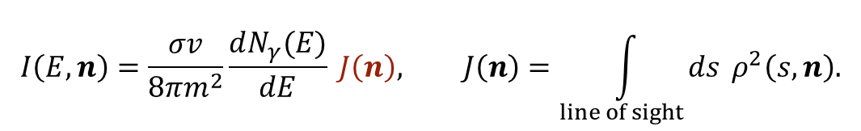

What is a Good Way to Turn an Indirect Detection Hint to Dark Matter Discovery?
We’ve seen a hint. Now that we know where to look,
go for the diffuse signal!
  It verifies the particle properties observed with the hint.
  It establishes the clustering properties of dark matter—heretofore unobserved.
S-wave annihilation intensity in direction $n$:
$$I\left(E,n\right)=\frac{σv}{8πm^{2}}\int{\frac{dz}{H(z)}}\frac{dN_{γ}\left(\left(1+z\right)E\right)}{dE}\frac{ρ^{2}(z,n)}{{(1+z)}^{3}}e^{−τ_{E,z}}$$
Ambiguity between $σv$ and substructure contribution to $\left\langle ρ^{2}(z)\right\rangle$.
For local annihilations:
$$I\left(E,n\right)=\frac{σv}{8πm^{2}}\frac{dN_{γ}(E)}{dE} J\left(n\right), J\left(n\right)=\int_{line of sight}{ds} ρ^{2}\left(s,n\right).$$
Ambiguity between $σv$ and substructure contribution to the $J$-factor.

Slide 20
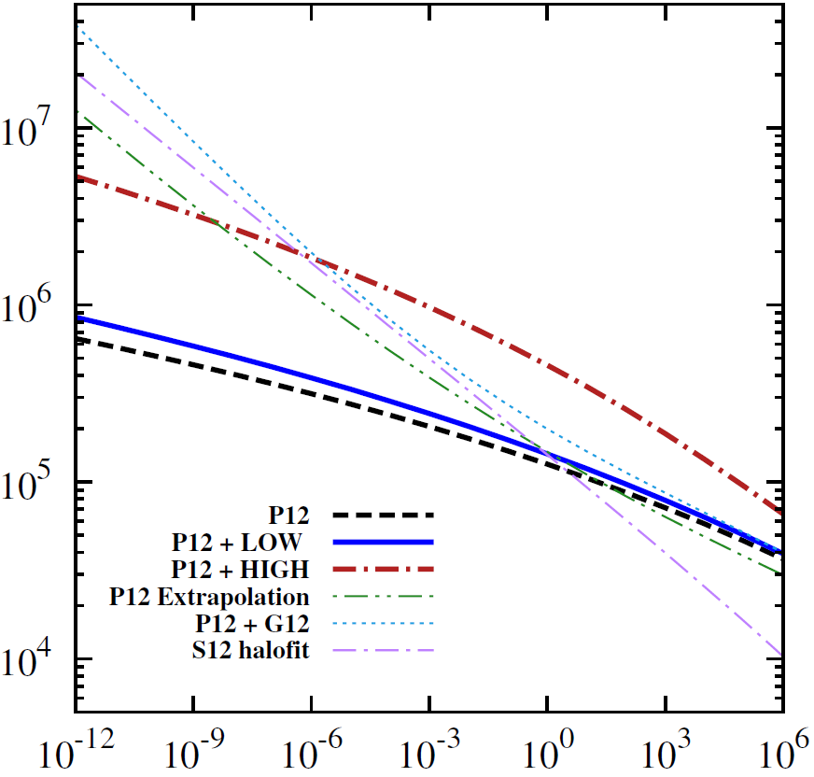
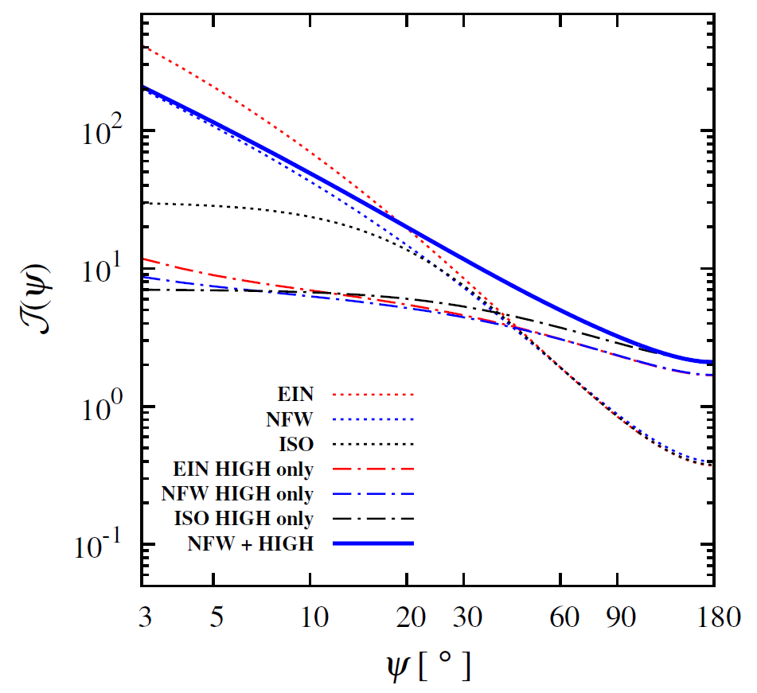


Need Consistent DM Distribution for Observed Scenario
Ng, Laha, SC, et al. (2014)
$$\frac{\left\langle ρ^{2}(z=0,M_{min})\right\rangle }{{\overline{ρ}}^{2}}$$
$$M_{min} (M_{⨀})$$

Slide 21
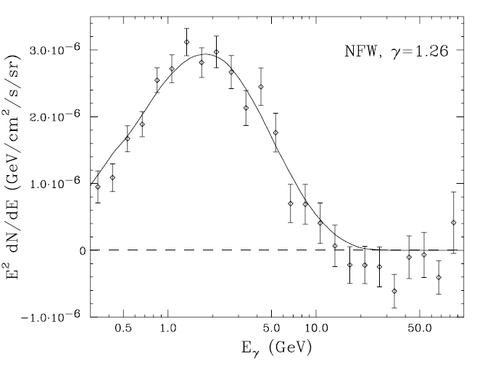
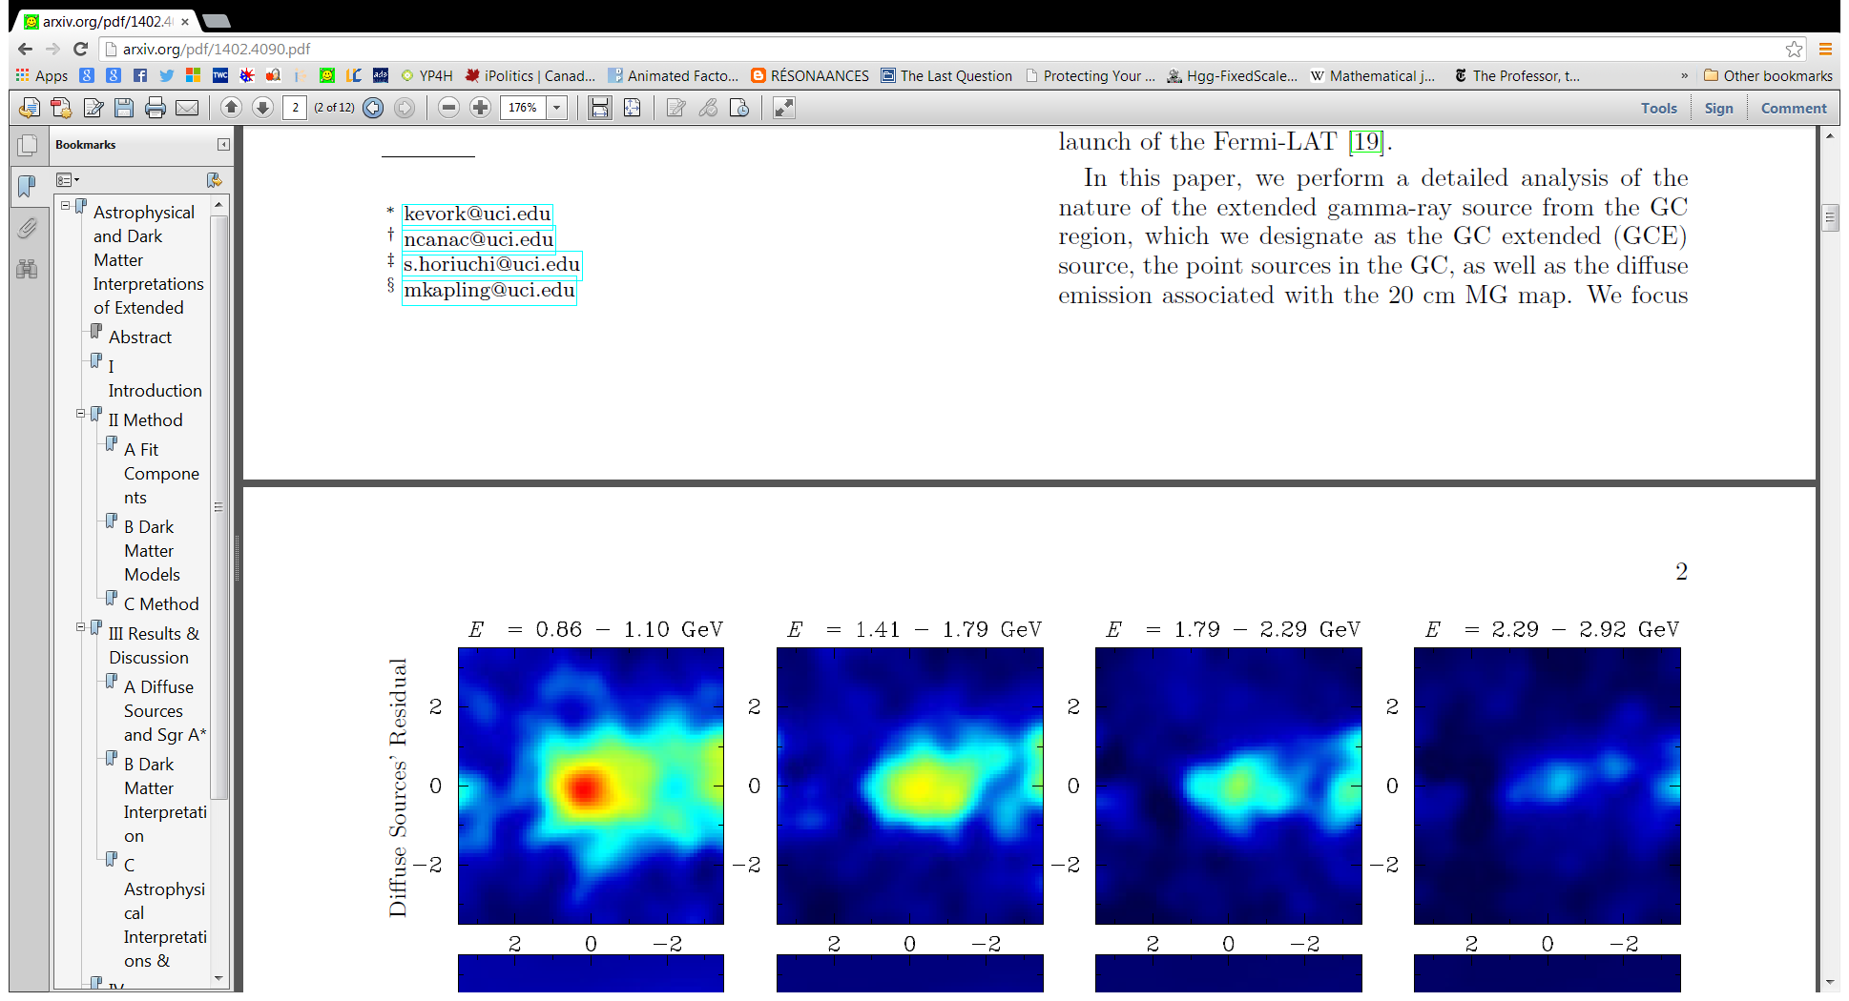
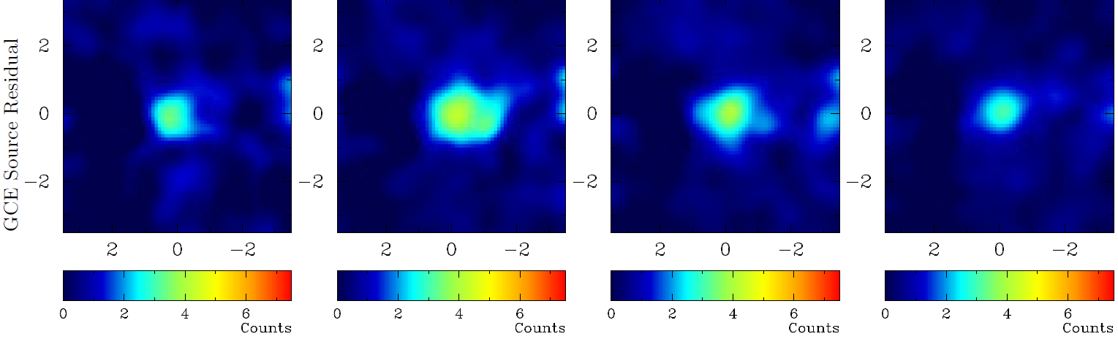

Case Study 1: GeV Galactic Center Excess
Extended gamma-ray signal
$0.1<E<1 GeV$
Inconsistent with stellar morphology, and molecular gas morphology.
Consistent with spherical, cuspy morphology of dark matter halos.
Should expect abundant halo substructure.
Daylan et al. (2014)
Abazajian et al. (2014)

Slide 22
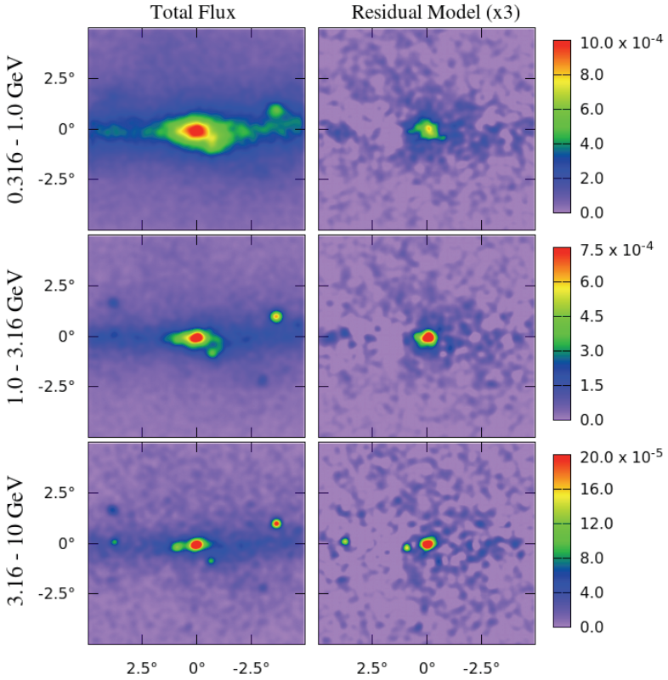
Case Study 1: GeV Galactic Center Excess
We have a signal consistent with:
  thermal relic annihilation,
  annihilation to heavy quarks and/or leptons,
  a 10-30 GeV WIMP.
First detection of WIMP at a cuspy galactic center is the textbook expectation.
In this scenario, the distributions of Milky Way and M31 satellites are unusual.
Prediction for diffuse background?

Slide 23
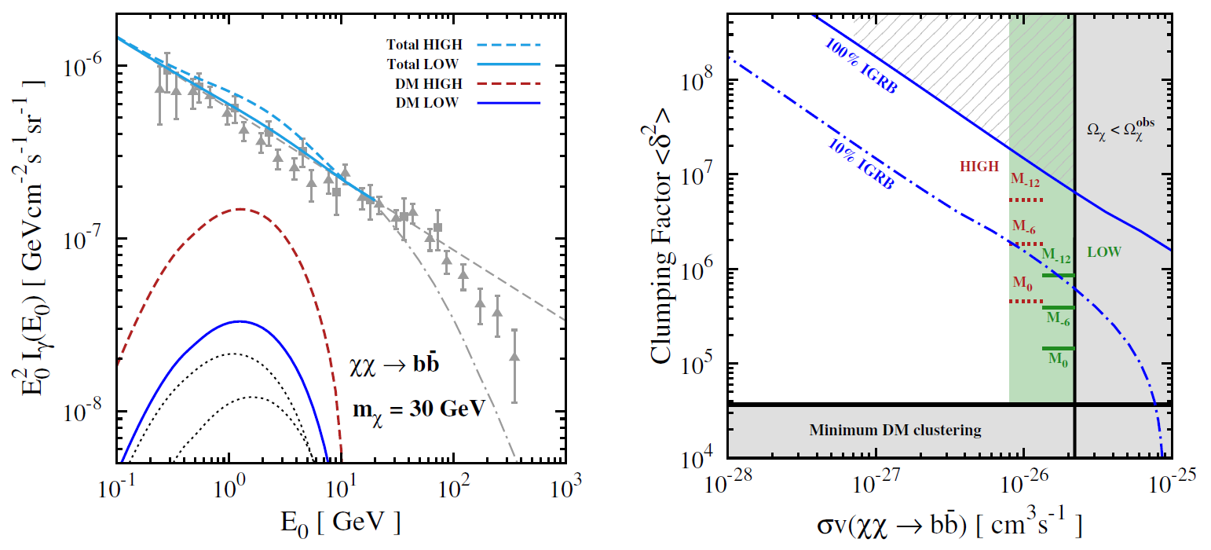
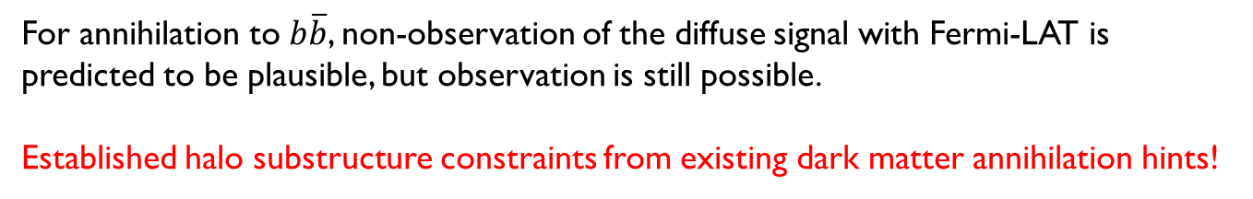
Flux Methodology: GeV GC Excess
Ng, Laha, SC, et al. (2014)
For annihilation to $b\overline{b}$, non-observation of the diffuse signal with Fermi-LAT is predicted to be plausible, but observation is still possible.
Established halo substructure constraints from existing dark matter annihilation hints!

Slide 24
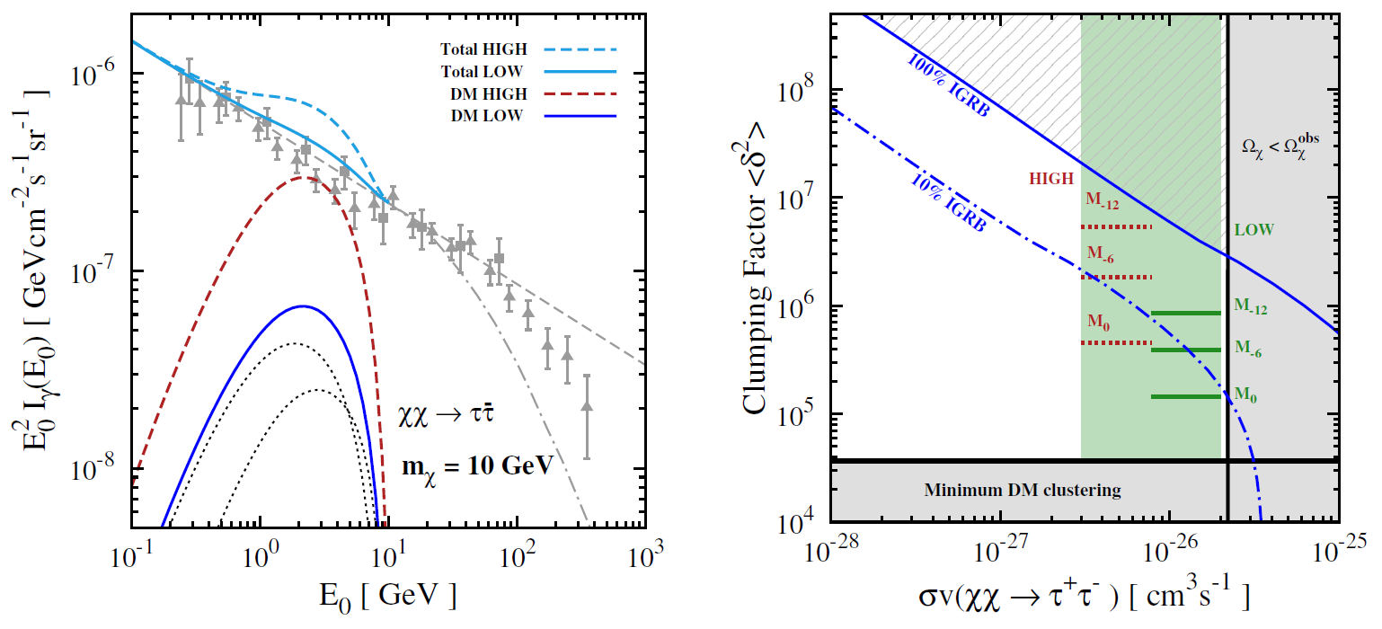
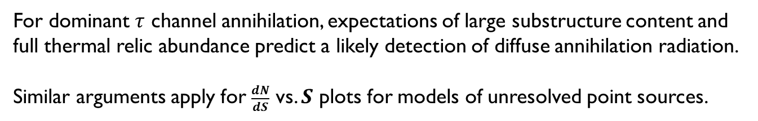
Flux Methodology: GeV GC Excess
Ng, Laha, SC, et al. (2014)
For dominant $τ$ channel annihilation, expectations of large substructure content and
full thermal relic abundance predict a likely detection of diffuse annihilation radiation.
Similar arguments apply for $\frac{dN}{dS}$ vs. $S$ plots for models of unresolved point sources.

Slide 25
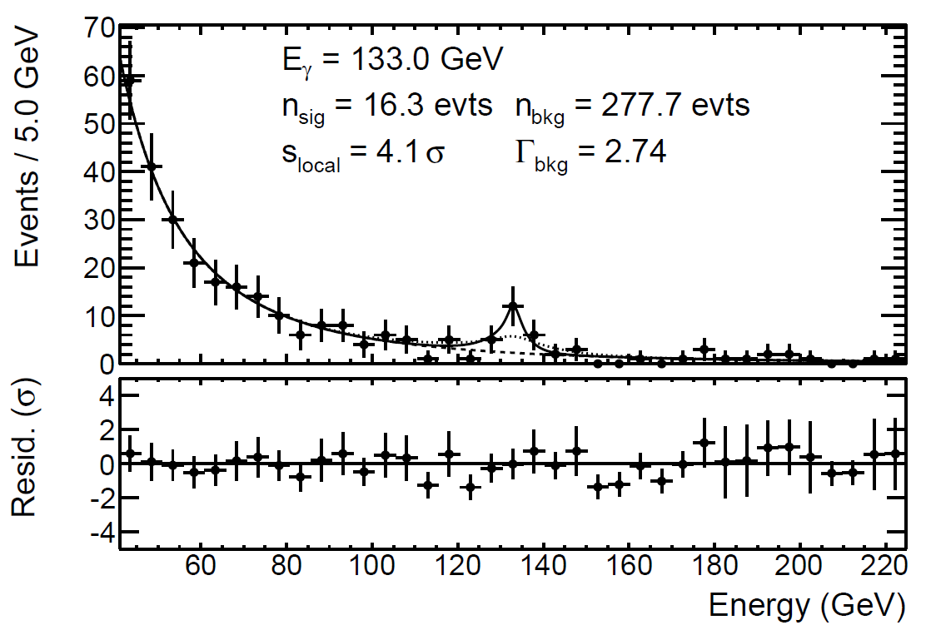

Case Study 2: The 135 GeV $γ$-ray Line
Gamma-ray excess from Galactic center.
~4 standard deviations above background.
Source morphology consistent with spherical cusp.
Fermi-LAT Collaboration (2013)
Some features of the signal made the dark matter explanation less compelling:
  spectral line feature was narrower than the energy resolution.
  a similar, though smaller, line in the Earth limb.

Slide 26
Case Study 2: The 135 GeV $γ$-ray Line
Predictions:
If due to a systematic effect
  the apparent signal will persist in all regions until the source is determined.
If the signal is dark matter annihilation
  the line will broaden and its significance will grow.
  the line may be observed in other dark matter regions.
If the signal is a statistical fluctuation
  the signal will shrink and disappear.

Slide 27
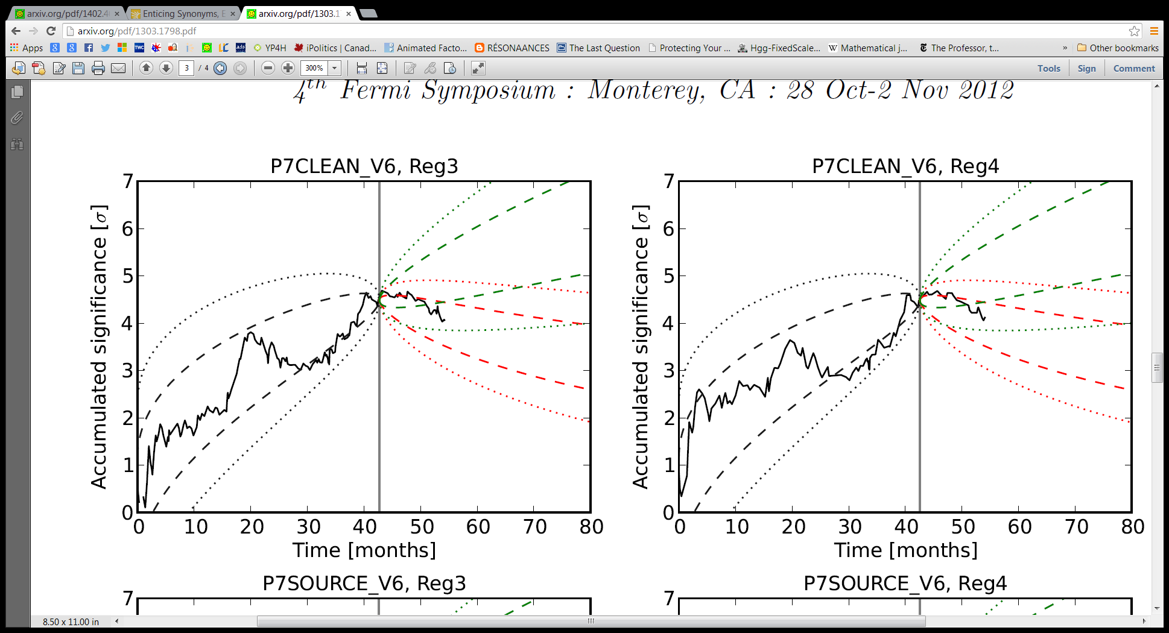
Case Study 2: The 135 GeV $γ$-ray Line
The fulfillment of the 3rd prediction gives support to the hypothesis that the line was a statistical fluctuation.
Weniger (2012)

Slide 28
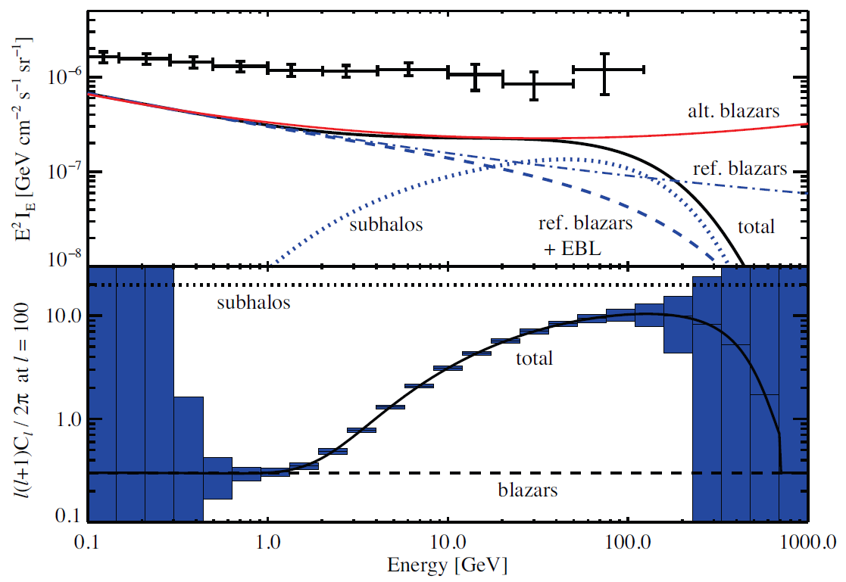
Anisotropy with Continuous Annihilation Spectra
Siegal-Gaskins, Pavlidou, PRL 102 (2009) 241301

Slide 29
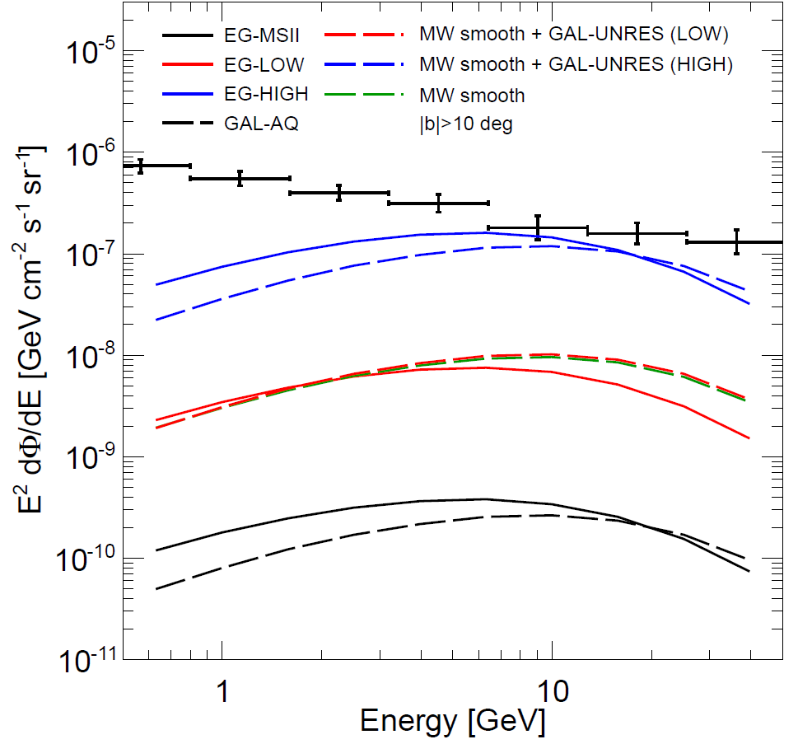
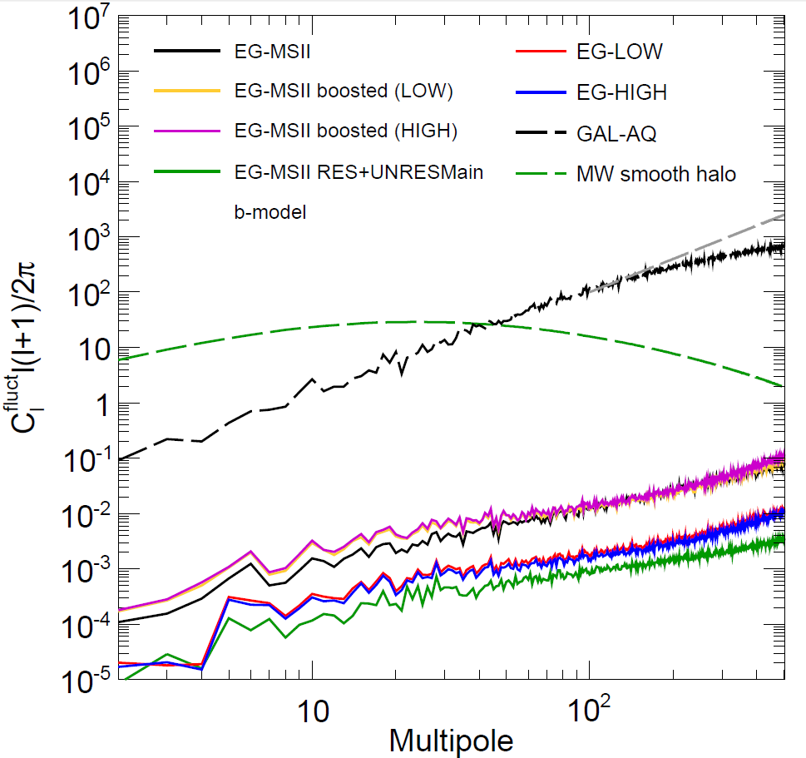
Fluct. Angular Power Spectra from DM
Fornasa et al., arXiv:1207.0502

Slide 30

Weighted Average Power Spectrum
$$155=ℓ_{1}≤ℓ≤ℓ_{2}=504$$
$$\tilde{C}=\frac{\sum_{ℓ=ℓ_{1}}^{ℓ_{2}}{\frac{{\tilde{C}}_{ℓ}}{σ^{2}}}}{\sum_{ℓ=ℓ_{1}}^{ℓ_{2}}{\frac{1}{σ^{2}}}}$$
$$σ_{\tilde{C}}≃\frac{2{\tilde{C}}_{N}}{\sqrt{f_{sky}}}\frac{σ_{b}e^{σ_{b}^{2}ℓ_{1}^{2}}}{\sqrt{1−\exp\left[−2σ_{b}^{2}\left(ℓ_{2}^{2}−ℓ_{1}^{2}\right)\right]}}, N≪\frac{4πf_{sky}}{{\tilde{C}}_{ℓ_{1}}}e^{σ_{b}^{2}ℓ_{1}^{2}}$$

