Slide 1
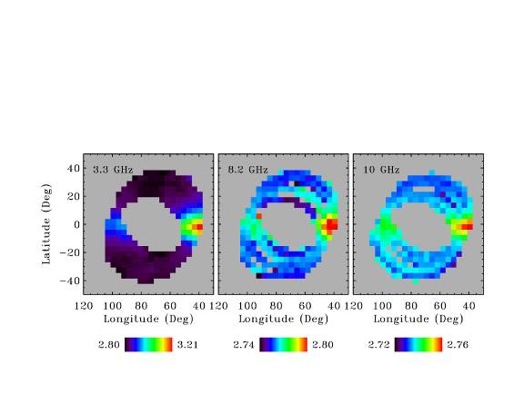
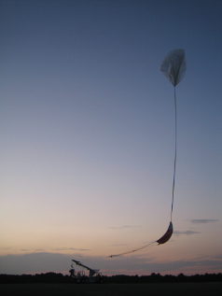
The Cosmic Radio Background Five Years of an Enigma
Jack Singal
University of Richmond
HEM Workshop
KICP, U Chicago

Slide 2
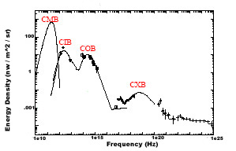
The EM backgrounds
What about over here?
From Hasinger (2000) astroph/0001360
Starlight
Thermal dust
AGN +?
CGB
Last scattering
AGN + Star formation (?)

Slide 3
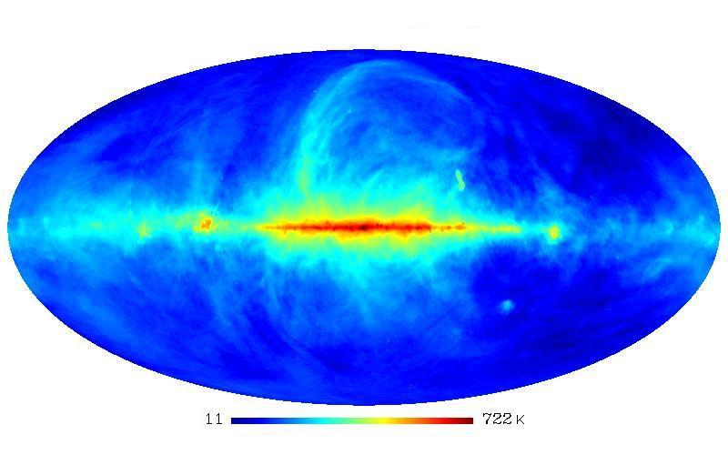
The Isotropic Radio Sky
• Absolutely calibrated single dish all-sky maps at low frequencies (e.g. Haslam et al., 1982, A&A, 47, 1) and ARCADE 2 measurements at higher frequencies (Fixsen et al., 2011, ApJ, 734, 5) agree that there is a significant radio monopole [(~4x) brighter than was once expected]
• The radio emission has a synchrotron-like spectrum
• It is isotropic on >1 deg scales
Haslam 408 MHz all-sky map

Slide 4
The Isotropic Radio Sky
• There is a significant synchrotron radio monopole
• The only dispute is whether it is in the Galactic halo or extragalactic
• You can’t tell the difference just by looking out
Haslam 408 MHz all-sky map

Slide 5
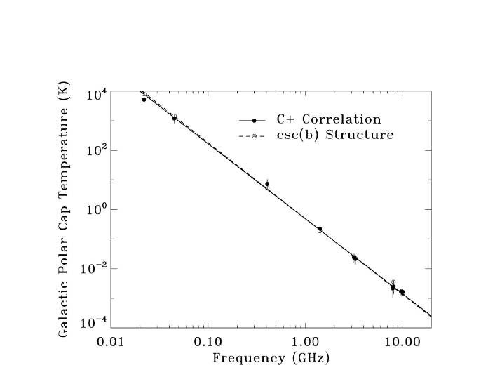
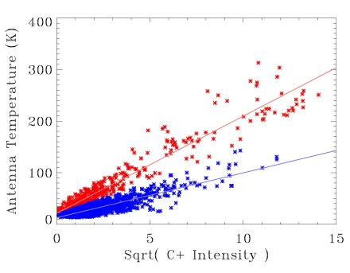
The Isotropic Radio Sky
How to distinguish (from maps alone) between Galactic monopole and extragalactic component?
1) Model Galactic radio emission with some function of latitude
2) Correlate Galactic radio emission with some other emission of known spatial structure
See Kogut et al. (2011, ApJ, 734, 4)

Slide 6
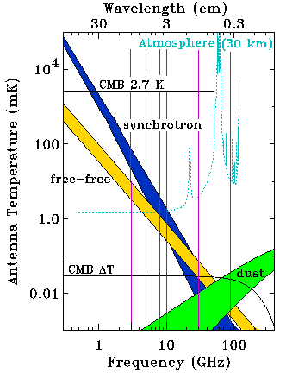
The Isotropic Radio Sky
How to distinguish between Galactic monopole and extragalactic component?
This modeling places around ¼ of the total isotropic signal into a Galactic halo and the rest into extragalactic
CRB
Extragalactic component from this modeling: 67 mk @ 3 GHz and 3.725 K @ 670 MHz
Ok, assuming extragalactic for a minute…

Slide 7
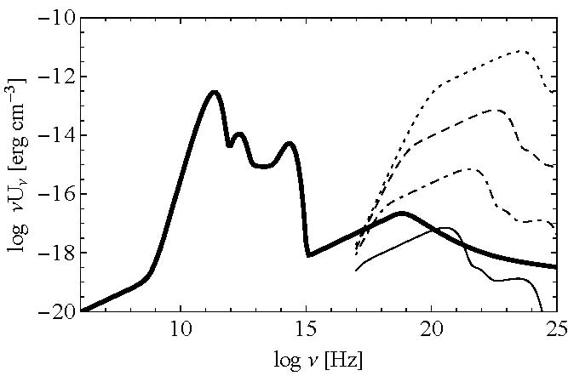
Our Take
• In Singal et al. (2010, MNRAS, 409, 1172) we considered several limitations
1) The electrons that produce the radio emission through synchrotron cannot overproduce another background via inverse-Compton – places a lower limit on the magnetic field in the emitting regions
1 nG
Observed EBL
1 μG

Slide 8
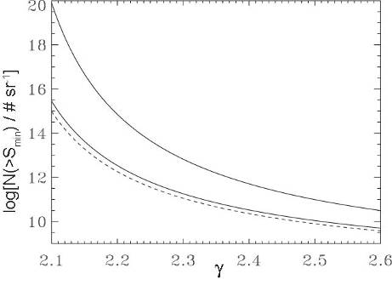
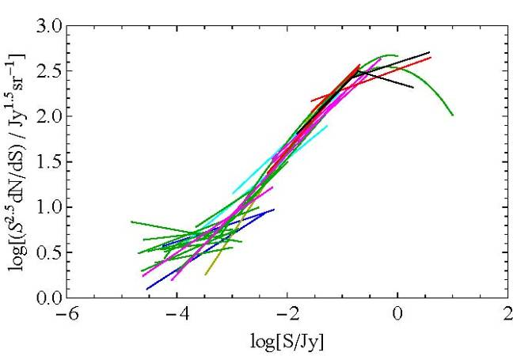
Our Take
• In Singal et al. (2010, MNRAS, 409, 1172) we considered several limitations
2) If it is a sum of discrete sources, there has to be a lot of them at low fluxes (because radio source counts at resolved fluxes > ~10 μJy only account for ~1/4)
Radio source counts
RQ quasars and ordinary galaxies
# of low flux objects needed
Flux limit of surveys
Large radio
galaxies
Source counts power law slope

Slide 9
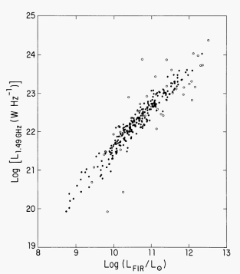
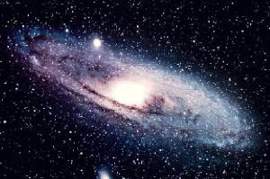
Our Take
• In Singal et al. (2010, MNRAS, 409, 1172) we considered several limitations
3) Ordinary galaxies are numerous enough but if they follow the radio – FIR correlation of the local Universe they would overproduce the infrared background

Slide 10
The Case For Extragalactic
• If the CRB is from galaxies we would need the radio – FIR correlation (FRC) to have evolved by a factor of ~5 (intrinsic) between redshift 0 and ~1
Evidence for the FRC evolving (but not by enough) reported in:
- R. Ivison et al., 2010, MNRAS, 402, 245 "BLAST - The Far-infrared/radio Correlation in Distant Galaxies"
- R. Ivison et al., 2010, A&A, 518, L31, "The Radio/Far Infrared Correlation as Probed By Herschel"
Generally consistent conclusions in:
T. Vernstrom, D. Scott, & J. Wall, 2011, MNRAS, 415, 3641
A. Draper, S. Northcott, & D. Ballantyne, 2011, ApJ, 741:L39

Slide 11
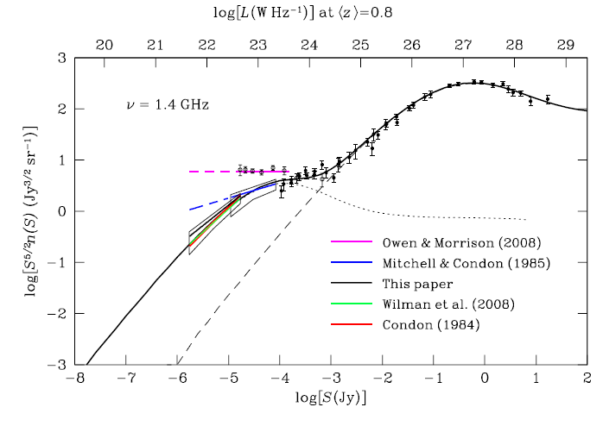
The Case Against Extragalactic
There are many problems with an extragalactic origin
Models for radio source counts that fall too low:
[from infrared counts and applying FRC]
- P. Ponente et al., 2011, MNRAS, 419, 691
- N. Ysard & G. Lagache, 2012, A&A, 547
[P(D) analysis to probe radio source counts to very low fluxes]
- J. Condon et al., 2012, ApJ, 758, 23

Slide 12
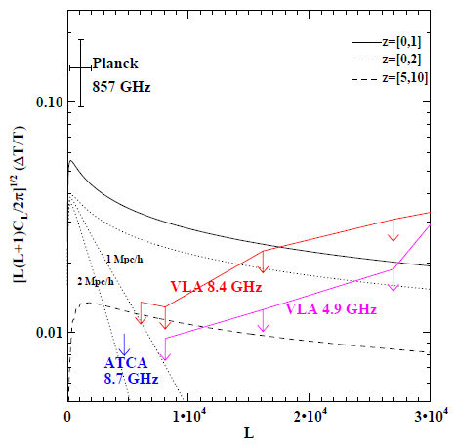
The Case Against Extragalactic
There are many problems with an extragalactic origin
- G. Holder (2014, ApJ, 780, 112) "The Unusual Smoothness of the Extragalactic Unresolved Radio Background"
Arcminute-scale fluctuations seen at 4.86 and 8.4 GHz are so small that the Radio Background sources must not be clustered like large scale structure
However if the mechanism is z>5, then these constraints are evaded

Slide 13
The Case Against Extragalactic
There are many problems with an extragalactic origin
- J. Cline & A, Vincent, 2013, JCAP, 02, 011C "Cosmological Origin of Anomolous Radio Background"
Building on Holder they consider cosmological (high z) injections of photons (can't do) and electrons (needed mag field is too high).

Slide 14
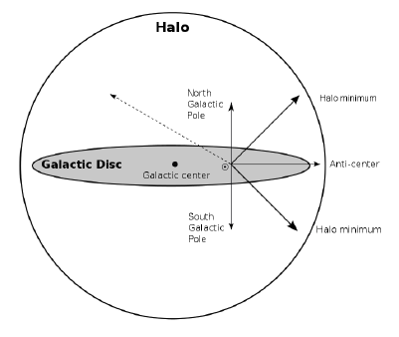
The Case For Galactic
R. Subrahmanyan & R. Cowsik, 2013, ApJ, 776, 42 "Is there an unaccounted excess Extragalactic Cosmic Radio Background?"
They use a 2-component 5-parameter vs frequency Galactic spatial model for radio emission to get a much higher halo component.
(But see test of this model discussed in A. Kogut’s talk)

Slide 15
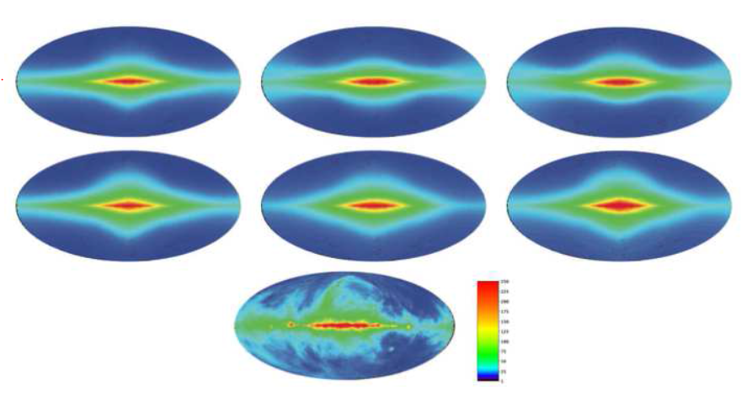
The Case For Galactic
E. Orlando & A. Strong, 2013, MNRAS, 436, 2127 “Galactic Synchrotron Emission with Cosmic Ray Propagation"
They present new models of Galactic synchrotron obtained by considering CR propagation with GALPROP.
Can reproduce level (?) of radio background at 408 MHz with a 10 kpc cosmic ray halo.

Slide 16
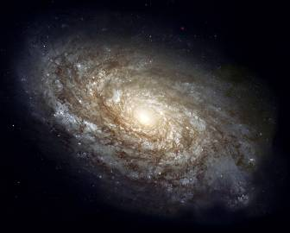
The Case Against Galactic
The same X-ray inverse-Compton argument applies to our Galactic halo, where FR measures show the mag field is ~1 μG (Taylor et al, 2009, ApJ, 702, 1230) and optical/UV flux is higher
The local Radio-FIR correlation can be applied to the COBE-FIRAS measured level of high latitude infrared Galactic emission and it comes out much lower than the radio background
Large scale Galactic radio emission is well fit by a csc(b) spatial model, and a correlation of radio with C+ emission at 158 µm agrees
Recent paper by Fornengo et al. (2014, JCAP, accepted, arXiv:1402.2218) with detailed Galactic synchrotron modeling
(See talk by A. Kogut for further discussion)

Slide 17
Ok, More Exotic Explanations?
If our Galaxy doesn’t work, and other galaxies don’t work…
Annihilating Dark Matter:
N. Fornengo R. Lineros, M. Regis, & M. Taoso, 2011, PRL, 271302 "Possibility of a Dark Matter Interpretation for the Excess in Isotropic Radio Emission Reported by ARCADE"
Dark matter in filaments decays into e- for synchrotron but I think the needed magnetic field is too high
D. Hooper et al., 2012, PRD, 863, 003H “The Isotropic Radio Background and Annihilating Dark Matter”
If annihilating DM is responsible for radio background, it is responsible for part of gamma-ray background too
Y. Yang et al, 2013, PRD, 083519, “Contribution of Ultracompact Dark Matter Minihalos to the Isotropic Radio Background”
DM in UCMHs can produce CRB but would overproduce X-ray background through inverse-Compton

Slide 18
Ok, More Exotic Explanations?
If our Galaxy doesn’t work, and other galaxies don’t work…
Or…:
K. Lawson & A. Zhitnitsky, 2012, arXiv: 1210.2400 “Isotropic Radio Background from Quark Nugget Dark Matter”
Nuggets of dense matter and antimatter form the Dark Matter. They are heated by annihilations with visible matter and have thermal emission which is essentially flat with frequency. The thermal temperature changes over time and given that and the redshift distribution of the DM density, they calculate a resulting spectrum which can match the CRB.
D. Spolyar, P. Bodenheimer, K. Freese, & P. Gondolo, 2009, ApJ, 705, 1031 "Dark Stars: A New Look at the First Stars in the Universe"
Dark stars (early stars supported against collapse by annihilating DM) make big black holes which could lead to an explosion of synchrotron in the early Universe

Slide 19
Ok, More Exotic Explanations?
If our Galaxy doesn’t work, and other galaxies don’t work…
Or Pop III Supernovae
Beirmann et al., 2014, MNRAS, submitted
“Cosmic Backgrounds Due to the Formation of the First Generation of Supermassive Black Holes”
Use assumption that radio background is due to synchrotron from Pop III supernovae to recover rate of SMBH formation consistent with SMBH abundance.
Would evade all constraints discussed so far (high redshift, high mag. fields, large # of sources, no radio-FIR because little dust). However disagrees with simulated rates of Pop III supernovae from Wise & Abel (2005, ApJ, 525, 615).

Slide 20
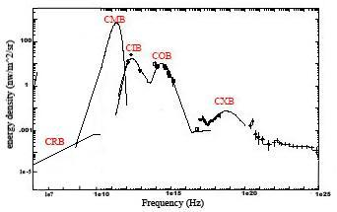
The EM backgrounds
Assuming radio monopole is ~1/4 Galactic and the rest CRB

Slide 21
Conclusions
• The radio sky has a bright isotropic synchrotron component which is either Galactic or extragalactic
• It must originate from regions of relatively high magnetic field strength (~1 μG)
• If from z<5 it should be from in or near galaxies, and with those galaxies characterized by an evolving radio far-infrared correlation (but this may lead to a background that is clumpier than limits)
• Synchrotron from Pop III supernovae is an intriguing possibility
• If Galactic, it must be either from the halo in regions with a strangely high magnetic field, or more locally with inexplicably low polarization
• The preponderance of the evidence favors the extragalactic scenario (segue to A. Kogut talk)

