Slide 1



The Radio Background:
Recent estimates from discrete and extended sources
Tessa Vernstrom, Douglas Scott, & Jasper Wall (UBC)
Jim Condon, Bill Cotton, Ed Fomalont, & Ken Kellermann (NRAO/CV)
Rick Perley (NRAO/Soc), Neal Miller (U. Maryland), Ray Norris (CSIRO)

Slide 2
Cosmic Radio Background
Milky Way
CMB
Extragalactic Sources
Discrete
Extended
Notes:
Image courtesy of NRAO

Slide 3
Discrete
Extended
Point source emission:
Starburst (star-forming galaxies)
Active Galactic Nuclei (AGN)
Other: spirals, ellipticals, etc.
New ??
Diffuse low surface brightness emission:
Galactic Halos
  Starburst
  AGN
Cluster Emission
  Giant/mini radio halos
  Radio relics
  Inter-cluster medium
Other: dark matter annihilation ??
Notes:
Image courtesy of NRAO

Slide 4
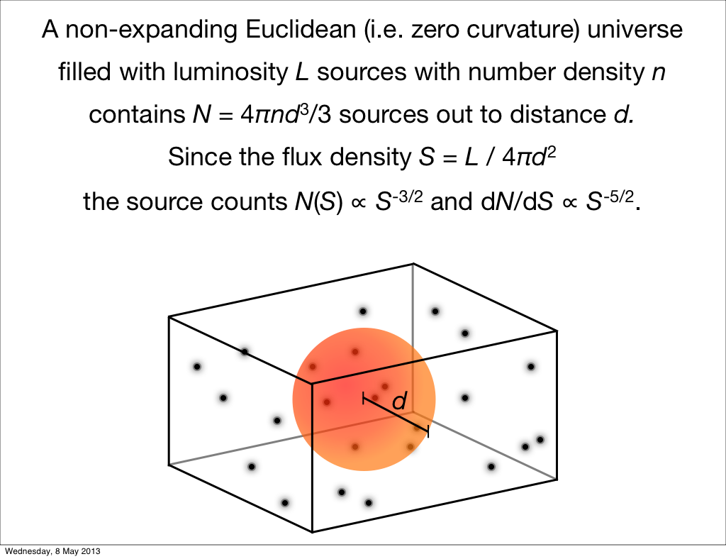
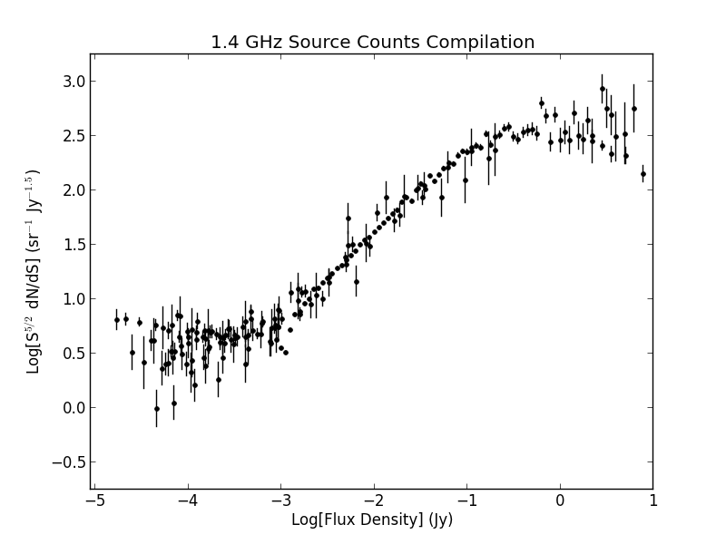
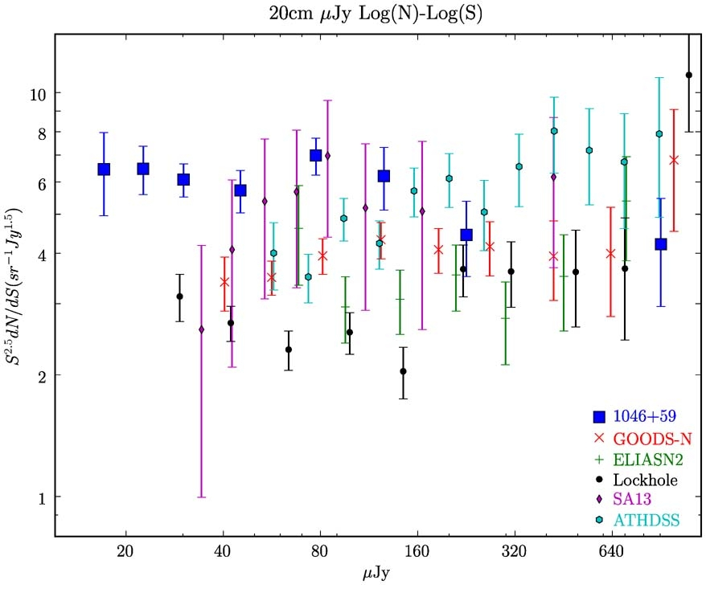
Source Counts

Slide 5
Background Temperature
Background temperature, T_{b}, from extragalactic sources by integration source count
Previous estimates (Vernstrom et al., 2011, Gervasi et. al, 2008)
  1.4 GHz: 110 +/- 20 mK
  4.8 GHz: 3.2 +/- 0.2 mK

Slide 6
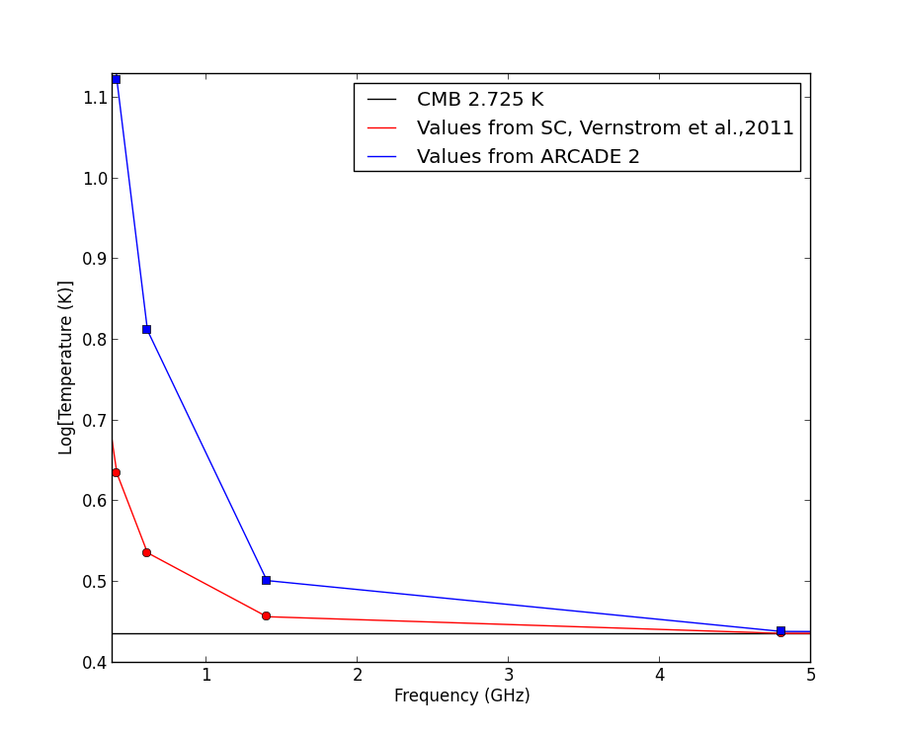
ARCADE 2
Balloon experiment measuring absolute temperature at multiple frequencies
Reported value of
T_{b}=55 mk at 3.3 GHZ

Slide 7
Source Count Methods
Direct counting: count sources in survey with S>5σ
Model fitting/Statistical Estimate:
  Physical models: Luminosity functions
  Non-physical model: Power laws, modified power laws, polynomials, Gaussians, etc.
  Confusion analysis → not limited by S>5σ

Slide 8
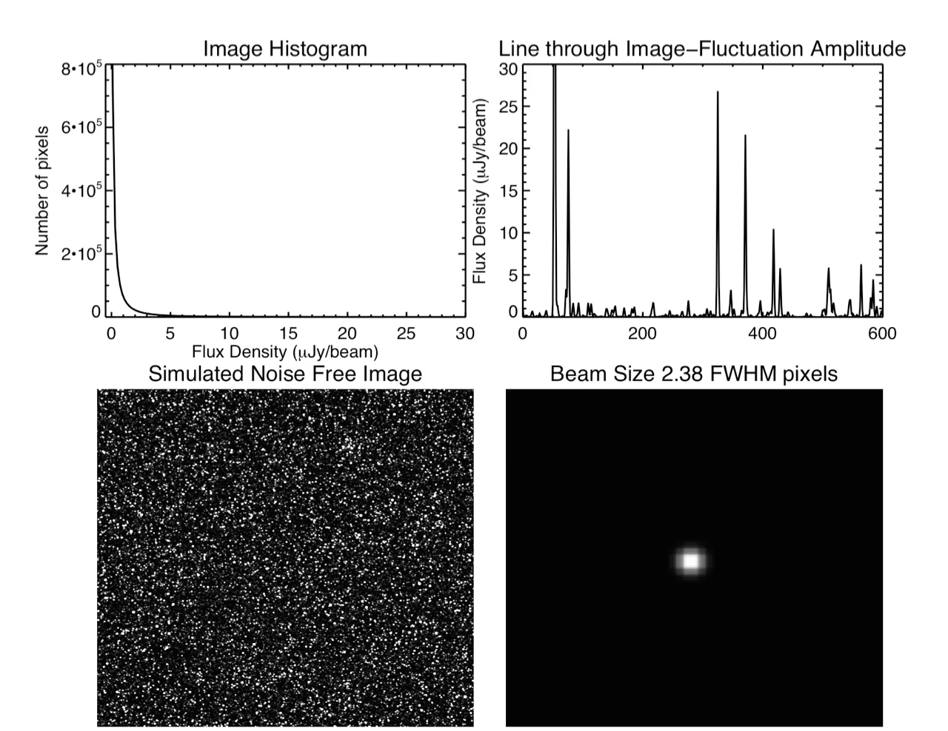
Confusion
Confusion = Blending of faint sources in beam
σ_{c} governed by beam and source count
PDF of histogram from confusion known as P(D)
  Pixel histogram
Want to know P(D)

Slide 9
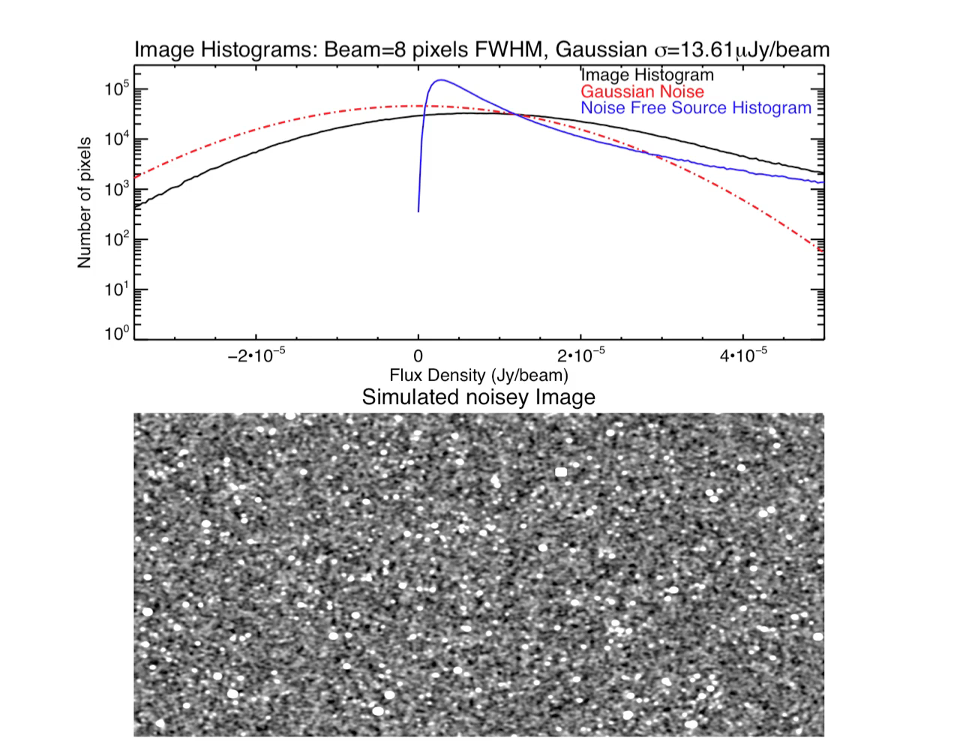



Probability of Deflection P(D)
Fitting of Image histogram → statistical estimate of source counts as faint as σ_{c}
Input:
  source count model
  pixel size, beam size
  instrumental noise
Mean density of observed flux, x
P(D) is then:
Want σ_{c} > σ_{n}

Slide 10
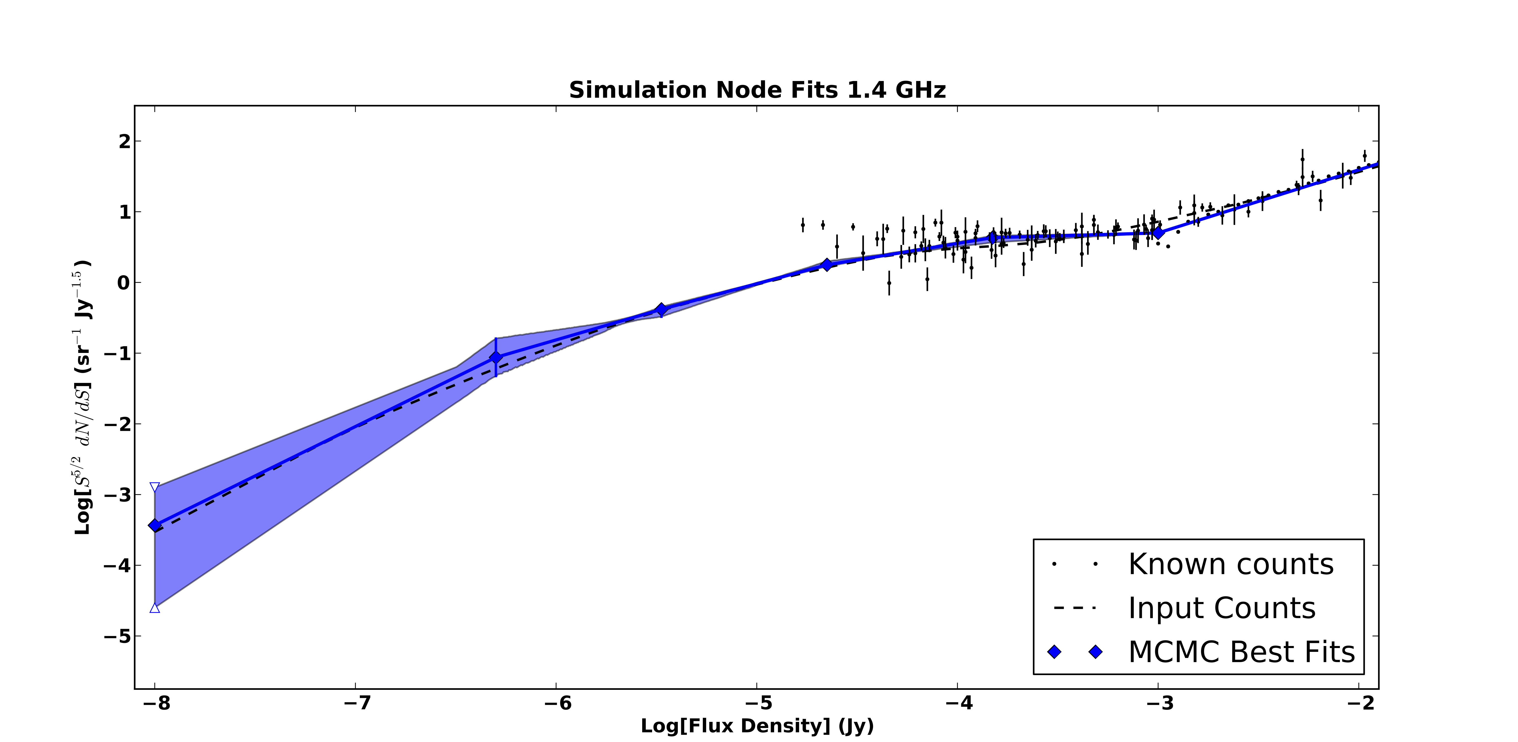
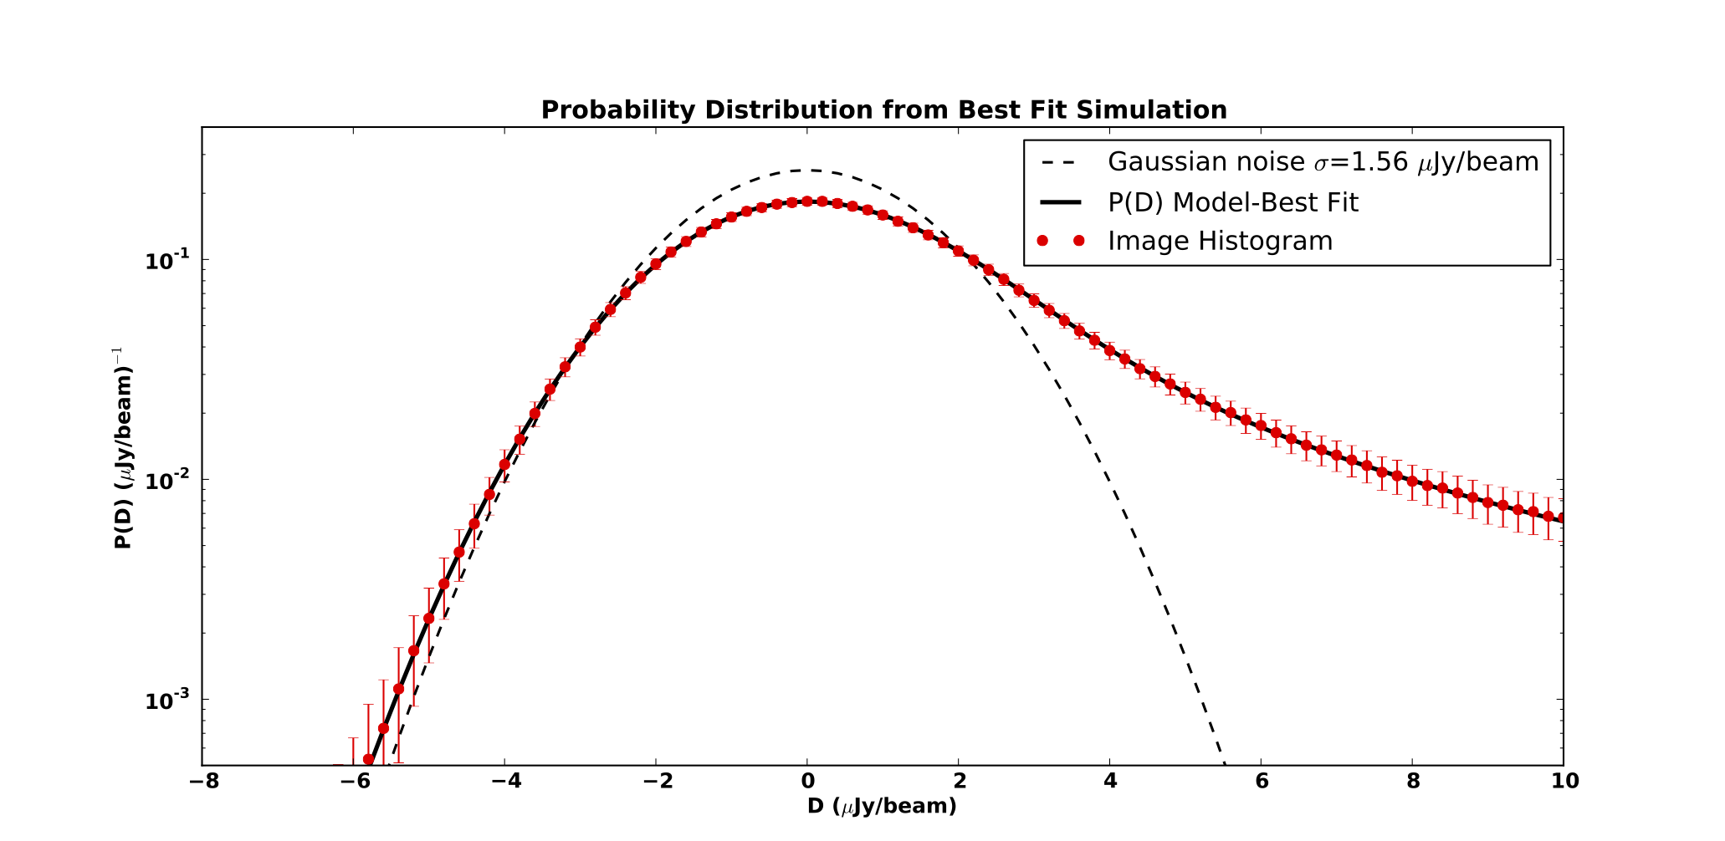
Probability of Deflection P(D)
Can be computed analytically for single power law (Condon, 1974)
Node Method (Patanchon, 2009):
  Fixed node position in Log(S)
  Fit amplitudes in Log(dN/dS)
  Interpolate between nodes
  Use MCMC to find minimum log likelihood
Example: Simulation data from Wilman et al., 2008
  1 square degree
  1.4 GHz
  Gaussian noise = 1.56 μJy/bm

Slide 11
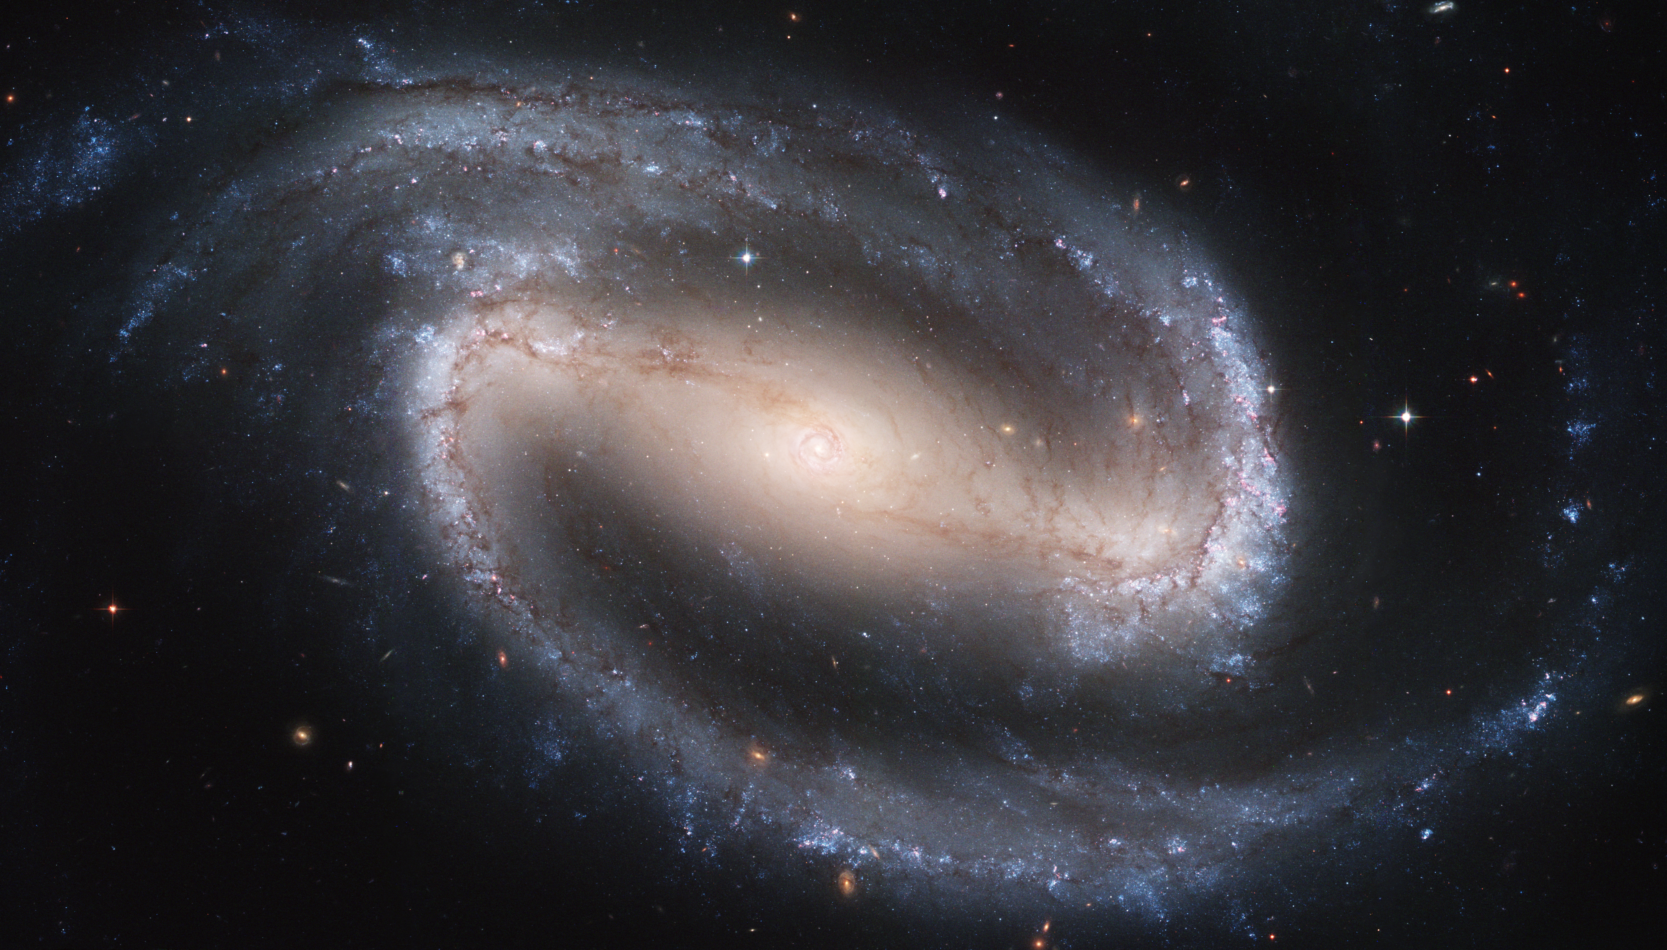
Discrete Sources

Slide 12
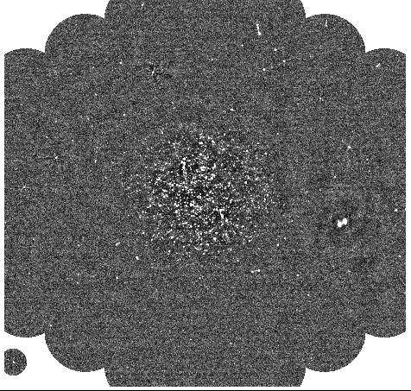
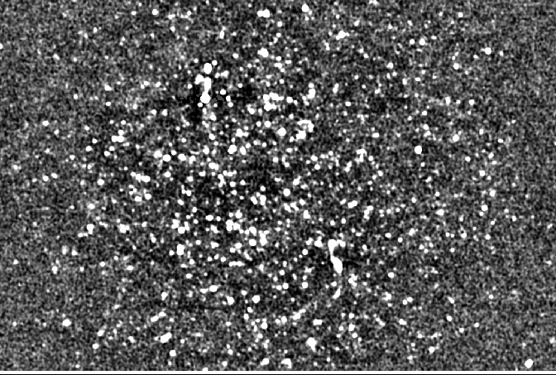
Data : Observations
JVLA
  Lockman “Owen” Hole: J2000 161.5, 59.01
  Configuration: C
    max baseline ~ 3.4 km
    Beam size – 8 arcsec
  S Band: 2 - 4 GHz
  On source time: 50h
  # of antennas: 21

Slide 13
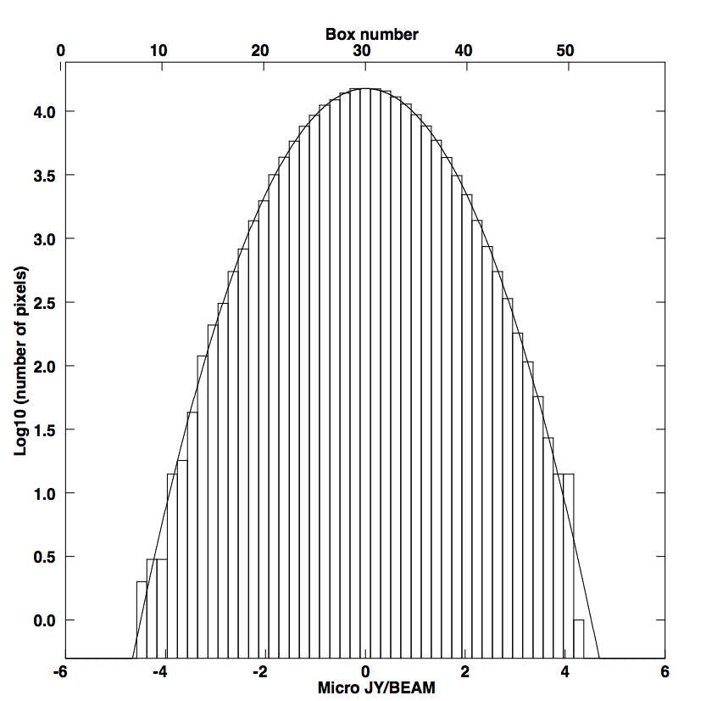
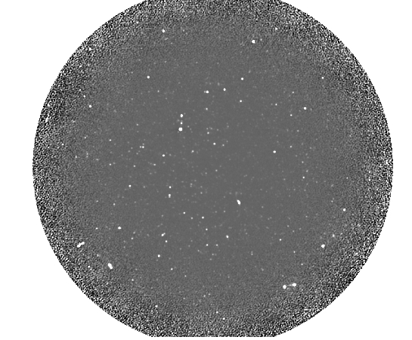
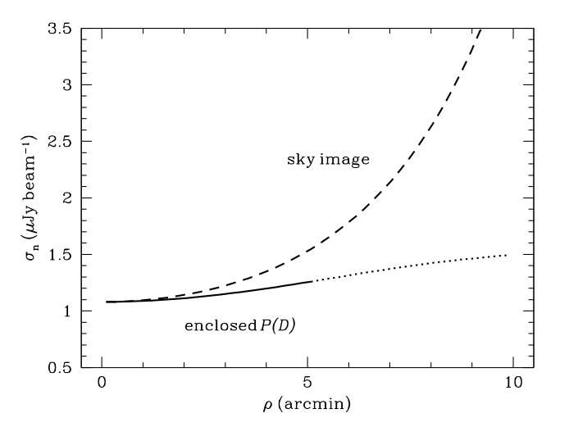
Data : Imaging
18 arcmin
Before primary beam
σ_{n}=1.012 μJy/bm
Noise at 5’
σ_{n}=1.44 μJy/bm
Weighted noise in central 5’
σ_{n}=1.255 μJy/bm

Slide 14
Results: Source Count

Slide 15
Results: Source Count

Slide 16
Results: Temperature
Can integrate from each step in chain to get background temperature
Parameter
Node Position (uJy)
P1 | P2 | P3 | P4 | P5
0.02 | 0.5 | 2.9 | 17.2 | 100.
Marginalized 1 & 2 Parameter likelihood distributions
~15 mK
~15 mK

Slide 17
Results: ARCADE Source Count

Slide 18
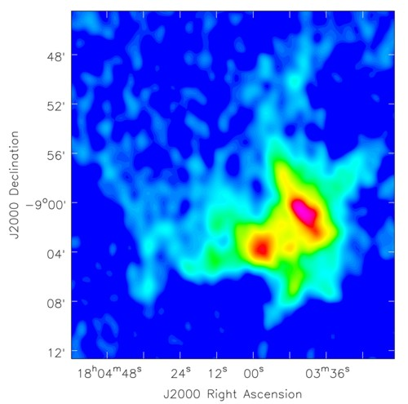
Extended Sources

Slide 19
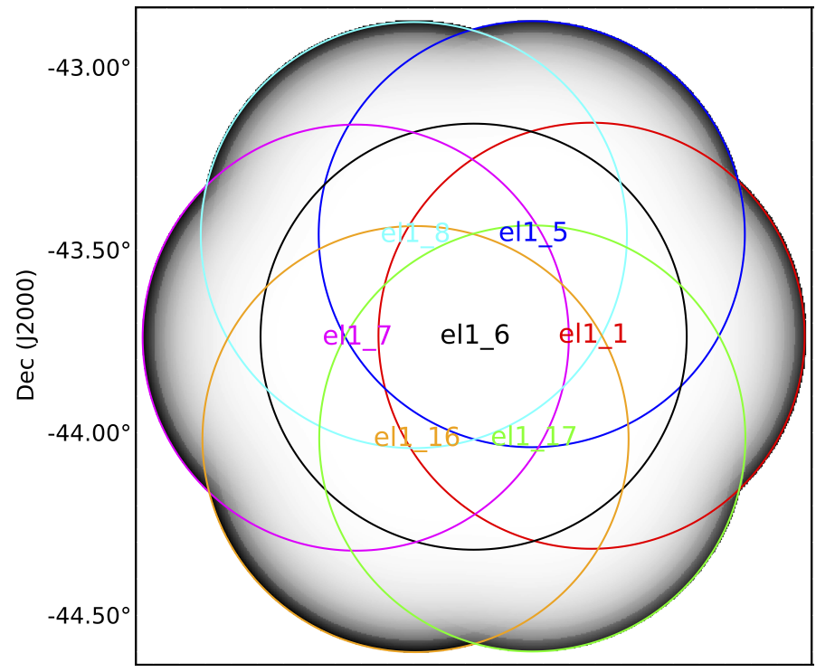
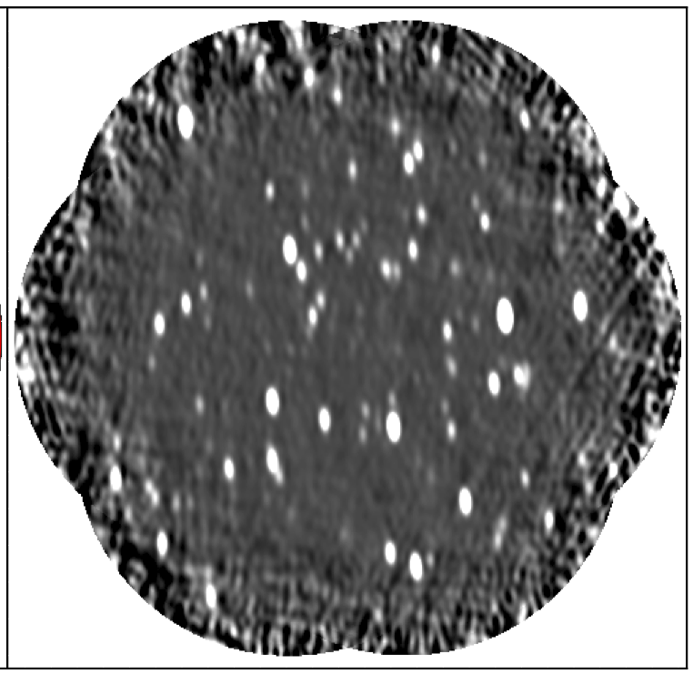
Data : Observations
ATCA
  7 pointing mosaic
  ELAIS S1: J2000 8.4625, -43.75
  Configuration: EW352
    max baseline ~ 352 m
  L Band: 1.1-3.1 GHz
  On source time: 12h
  # of antennas: 5

Slide 20
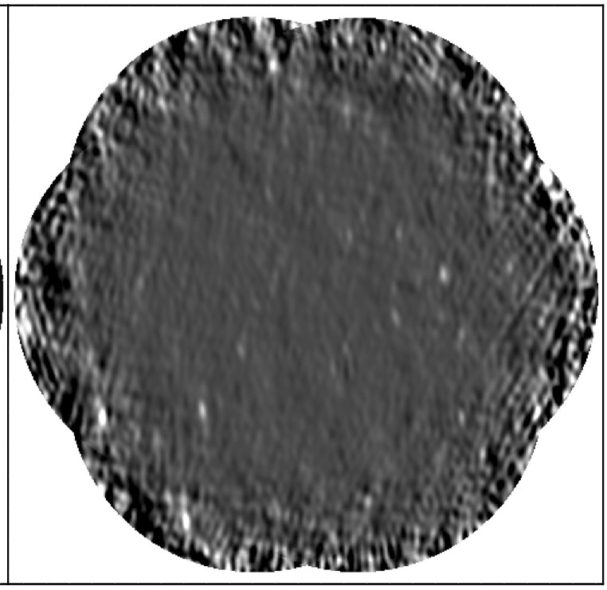
Data : Imaging and Subtraction
Mosaic size: 2.46 deg²
Beam size: 150’’x60’’
Mean <ν> : 1.75 GHz
Instrumental Noise <σ_{n}>= 55 μJy/Beam
Subtracted point source models from ATLAS survey :
  10’’ resolution
  σ_{n}= 15 μJy/Beam
Peak residual:
  3 mJy (1%)

Slide 21
Results: Unsubtracted Point Sources
No Subtraction
Subtraction

Slide 22

Results: Extended Source Counts
  Excess detected over model of noise+unsubtracted point sources of ~ 30 μJy/bm
Fit two source count models
  Model 1:
    Break discrete count up into AGN and starbursts.
    Assume each has extended halo with S_{extended}=S_{discrete}x C
    C is a constant → Fit for C_{AGN} and C_{SB} as shift of S in log[S]
  Model 2:
    Keep shifts from Model 1
    Add additional population modelled as parabola in S²dN/dS
    Fit for C_{AGN} , C_{SB}, A, h, and k

Slide 23
Results: Extended Source Counts
FITS TO DATA
ARCADE 2 FITS
FITS TO DATA
ARCADE 2 FITS

Slide 24
Results: Extended Source Counts

Slide 25
Results: Temperature & Integral Counts
T_{b} from MCMC Source count Fitting
  Model 1 μ = 11.1 +/- 0.6 mK
  Model 2 μ = 10.9 +/- 1.5 mK

Slide 26
Summary
Background temperatures
  Discrete only: 3GHz = 14 mK
  Discrete only: 1.4 GHz = 120 mK
  Discrete+ Extended: 1.75 GHz = 80 mK
Upper limits to peak of new population:
  3GHz discrete: 50 nJy
  1.75 GHz extended: 1 μJy
Continuing Work:
  Low frequency observations: 325 MHz GMRT Lockman Hole
  FIR-to-Radio correlation: Herschel+JVLA
  Clustering Power Spectrum: ATCA and JVLA

Slide 27
Additional Slides

Slide 28

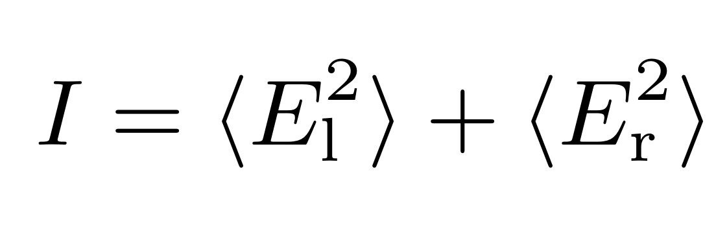

Measuring Image Noise
Two Methods:
  Jackknife and Stokes V
Jackknife:
  Two equal halves of data - even and odd channels- subtract and divide → all signal subtracted out
Stokes V:
  Make image with Stokes V parameter, if no circular polarization
  → all signal subtracted out

Slide 29
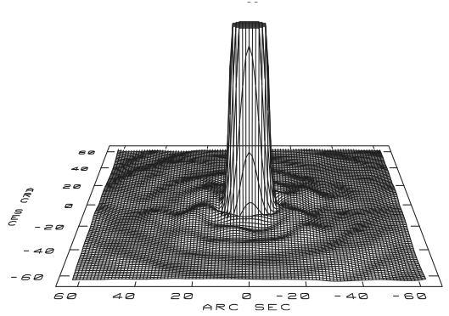
Synthesized Beams
Need to know synthesized beam for P(D)
JVLA: clean and dirty beam very similar – circular Gaussians – very little side lobes
ATCA: very elliptical beam – Clean and dirty beams very different – dirty beam large side lobes

